Slide 1
An Extrapolated Dynamic String Averaging Method^{[1]}
By: Victor Kolobov
Supervisors: Simeon Reich Rafał Zalas
[1] C. Bargetz, V. I. Kolobov, S. Reich, R. Zalas, Linear convergence rate of extrapolated fixed point algorithms (2018), submitted, arXiv.

Slide 2
Goals
The project deals with fixed point algorithms. The goal of the project is twofold:
Investigate theoretically "extrapolation" - allows the algorithms to take bigger steps and hopefully accelerate their convergence.
Develop a library for MATLAB which will allow researchers in the field to devise and experiment with different projection methods.
1/28

Slide 3
Talk plan
Background
Motivation
Results
MATLAB Library
Experiments
2/28

Slide 4
Setting
Convex Feasibility Problem (CFP): Given closed and convex sets $C_{1},…,C_{M}$ in Hilbert space $ℋ$ ($ℝ^{d}$), find $x∈C≔\bigcap_{i=1}^{M}{C_{i}}≠∅$
Problem “API”:
For some operators $U_{i}$, it holds that $C_{i}=Fix U_{i}=\{z|U_{i}z=z\}$.
$U_{i}$ are cutters.
Example: metric projections $U_{i}=P_{i}$.
3/28

Slide 5
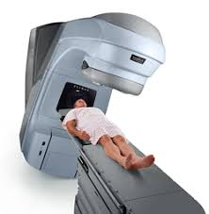
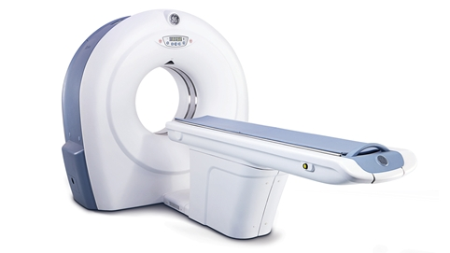
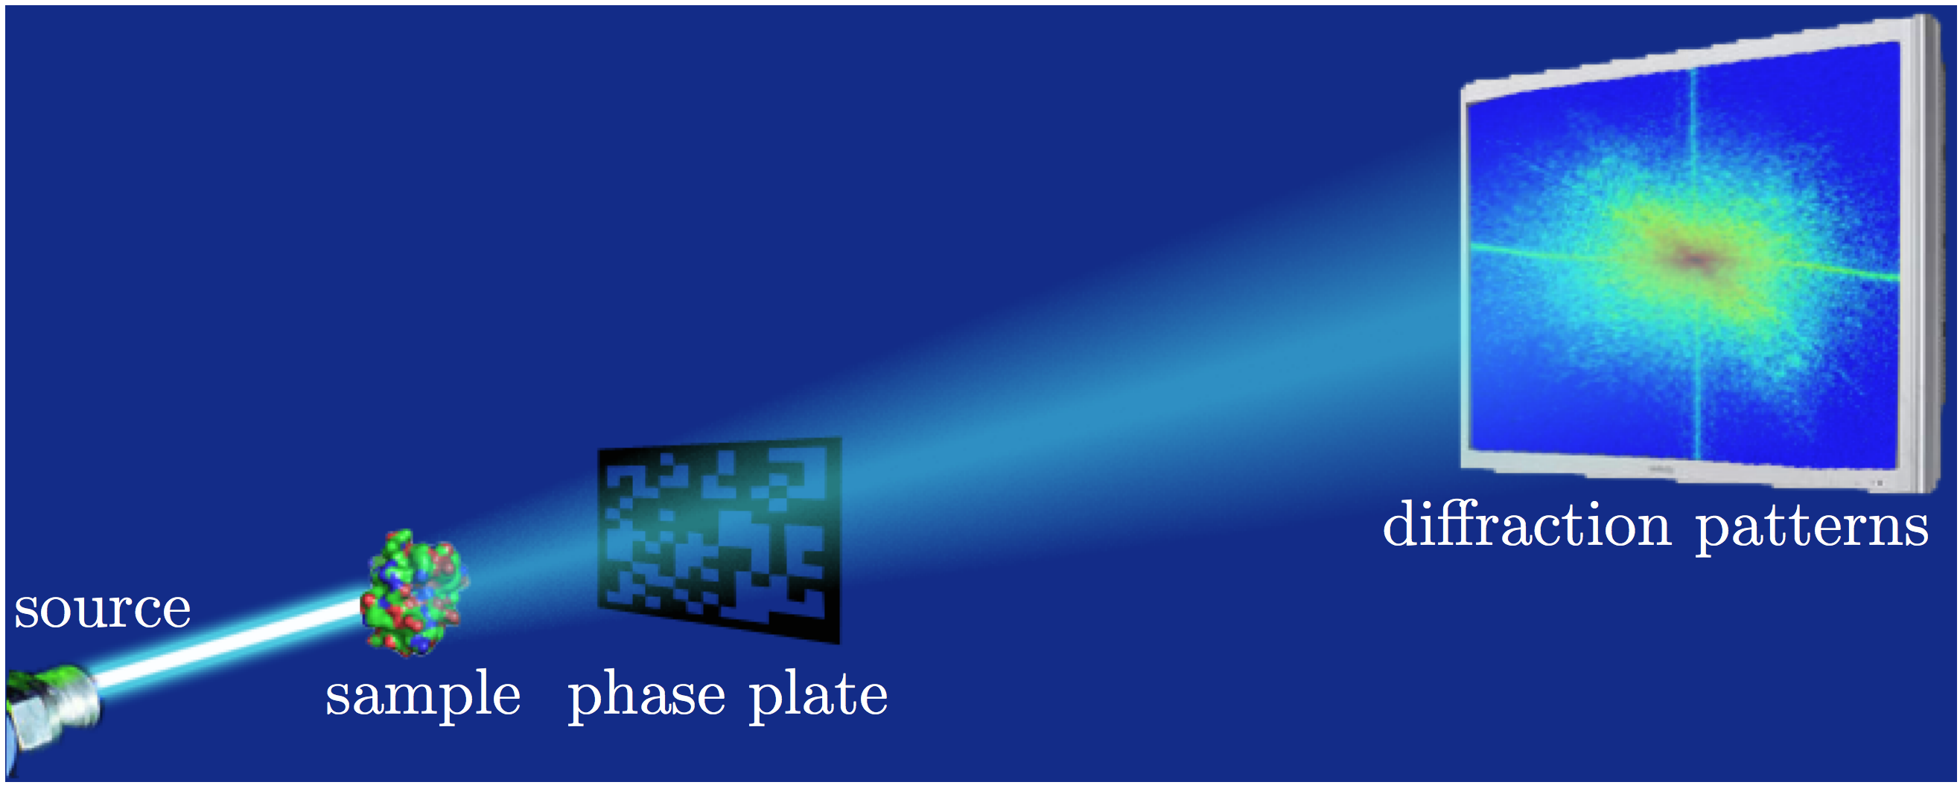
Useful models
4/28

Slide 6
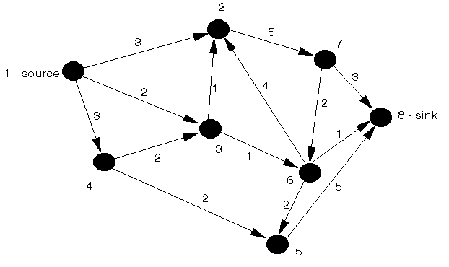
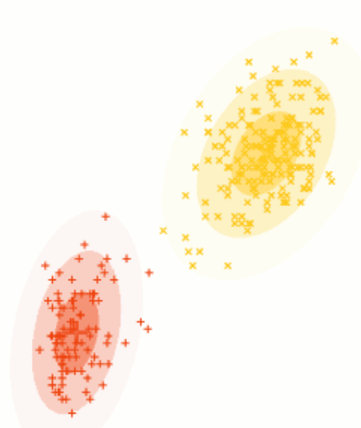
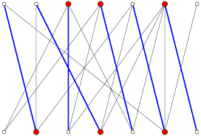
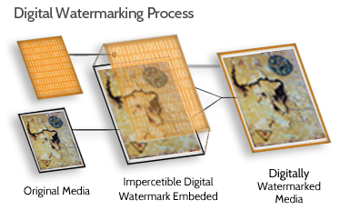
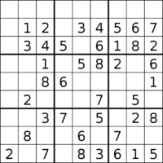
Useful models
5/28

Slide 7
Metric projections
Defined by $P_{i}x≔\underset{z∈C_{i}}{argmin}{|\left|x−z\right||}$. It holds then $d\left(x,C_{i}\right)=\left|\left|P_{i}x−x\right|\right|$
Unique for convex sets $C_{i}$.
Useful inequality: $||P_{i}x−z||^{2}≤|\left|x−z\right|{\left.​\right|}^{2}−||P_{i}x−x||^{2}$.
Metric Projection
$$x$$
$$P_{i}x$$
$$U_{i}x$$
$$z$$
$$C_{i}$$
6/28

Slide 8
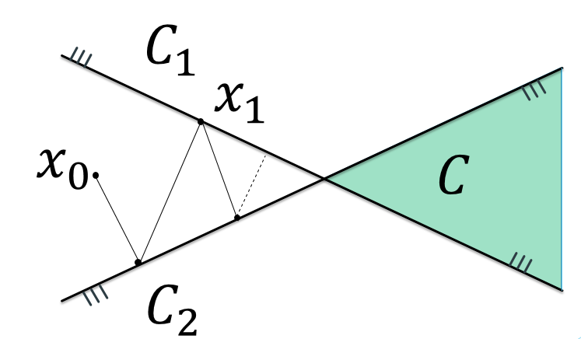
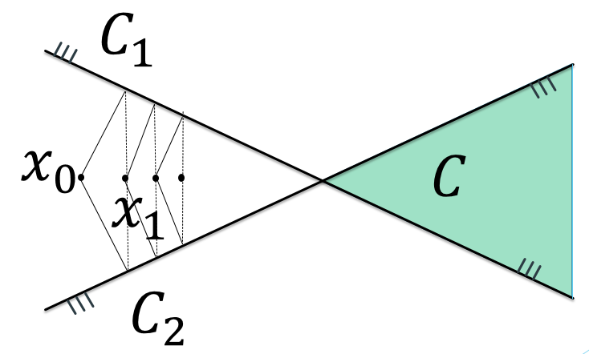
Projection method
Defined by the following general recursion*: $x^{0}∈ℋ;x^{k+1}:=Tx^{k}$ where $Fix T=C$ and $T$ depends algorithmically on $P_{1},…,P_{M}$.
Basic Examples:
Cyclic Method: $T=P_{M}⋯P_{1}$
Simultaneous Method: $T=\frac{1}{M}\sum_{i=1}^{M}{P_{i}}$
* The structure of $T↔T_{k}$ may depend on iteration step, in which case we refer to the method as “dynamic”.
7/28

Slide 9
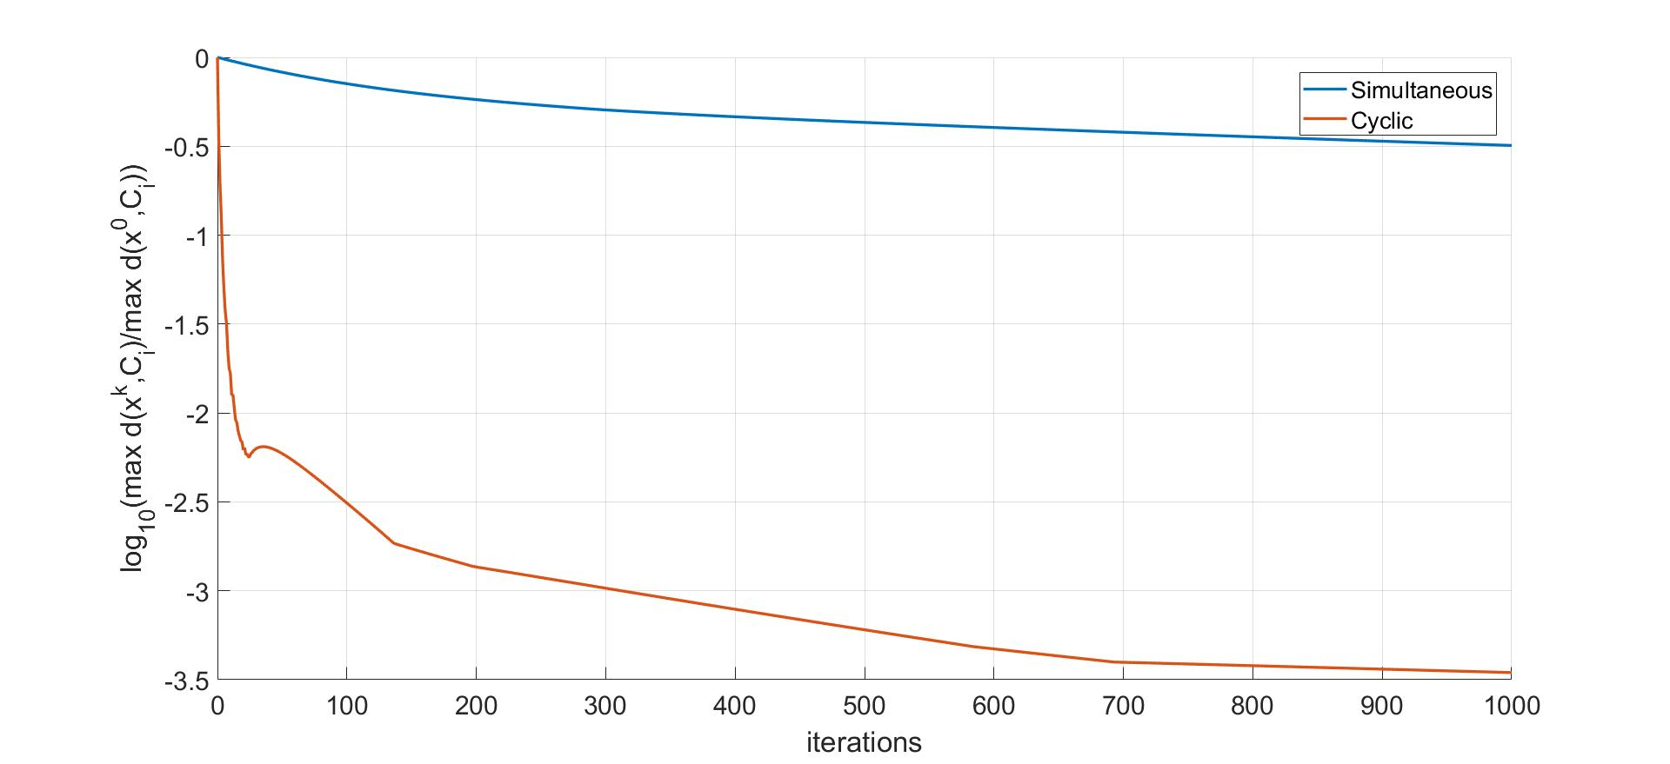
8/28

Slide 10
Extrapolated Fixed Point Algorithm
Defined by the following general recursion: $x^{0}∈ℋ;x^{k+1}:=x^{k}+σ\left(x^{k}\right)\left(Tx^{k}−x^{k}\right)$ where
$σ\left(x^{k}\right)≥1$ for $x∉C$.
$σ\left(x^{k}\right)=1$ for $x∈C$.
$T_{σ}=Id+σ(⋅)(T−Id)$ preserves certain properties of $T$.
$$x$$
$$Tx$$
$$T_{σ}x$$
9/28

Slide 11
Motivation
Let $T$ be an operator with $C=FixT≠∅$ which satisfies:
$T$ is $ρ$-SQNE, $||Tx−z||^{2}≤{\left|\left|x−z\right|\right|}^{2}−ρ||Tx−x||^{2}$
T is linearly regular, $δd\left(x,C \right)≤||Tx−x||$
For the Fixed point algorithm it holds that ($x^{k+1}:={Tx}^{k}$): $d\left(x^{k+1},C\right)≤\sqrt{1−ρδ^{2}}d\left(x^{k},C\right)$
For the extrapolated algorithm ($x^{k+1}:={T_{σ}x}^{k}$) whenever $T_{σ}$ is also $ρ$-SQNE with $σ≥1$ it holds that
$$d\left(x^{k+1},C\right)≤\sqrt{1−σ(x^{k})ρδ^{2}}d(x^{k},C)$$
10/28

Slide 12
How to define $σ(x^{k})$?
11/28

Slide 13
Extrapolation for sim. methods
$$x^{0}∈ℋ;x^{k+1}:=x^{k}+σ(x^{k})(Tx^{k}−x^{k})$$
Let $Tx^{k}≔\sum_{i=1}^{M}{ω_{i}P_{i}x^{k}}$ $σ\left(x^{k}\right)≔\frac{\sum_{i=1}^{M}{ω_{i}{\left|\left|P_{i}x^{k}−x^{k}\right|\right|}^{2}}}{{\left|\left|Tx^{k}−x^{k}\right|\right|}^{2}}≥1$
First proposed for projections by Pierra 1984.
Further studied by Dos Santos 1987, Combettes 1997, Cegielski 2012, just to name a few.
Linear rate of convergence - Xiaopeng Zhao, Kung Fu Ng, Chong Li, Jen-Chih Yao 2017.
12/28

Slide 14
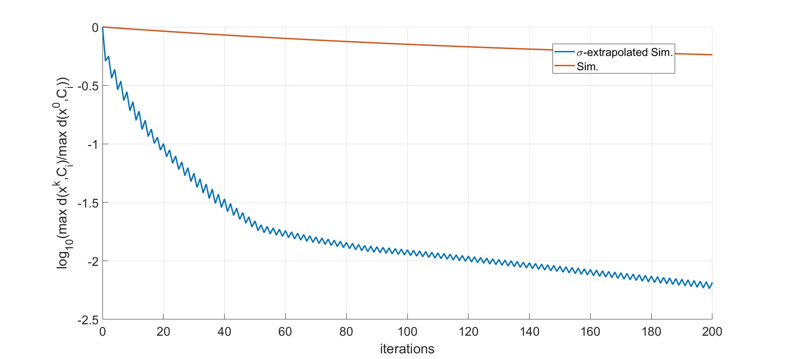
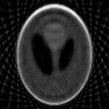
13/28

Slide 15
Extrapolation for cyclic methods
$$x^{0}∈ℋ;x^{k+1}:=x^{k}+λσ(x^{k})(Tx^{k}−x^{k})$$
Let $Tx^{k}≔P_{M}⋯P_{1}x^{k}$ $σ\left(x^{k}\right)≔\frac{M}{M+1}\frac{1+\sum_{i=1 }^{M}{||\left(P_{i}⋯P_{1}\right)x^{k}−\left(P_{i−1}⋯P_{1}\right)x^{k}||^{2}}}{{\left|\left|Tx^{k}−x^{k}\right|\right|}^{2}}≥1$, $λ=\frac{1}{2}$
First proposed by Cegielski, Censor 2012.
Further studied by Nikazad, Mirzapour 2015.
Linear convergence was not known.
14/28

Slide 16
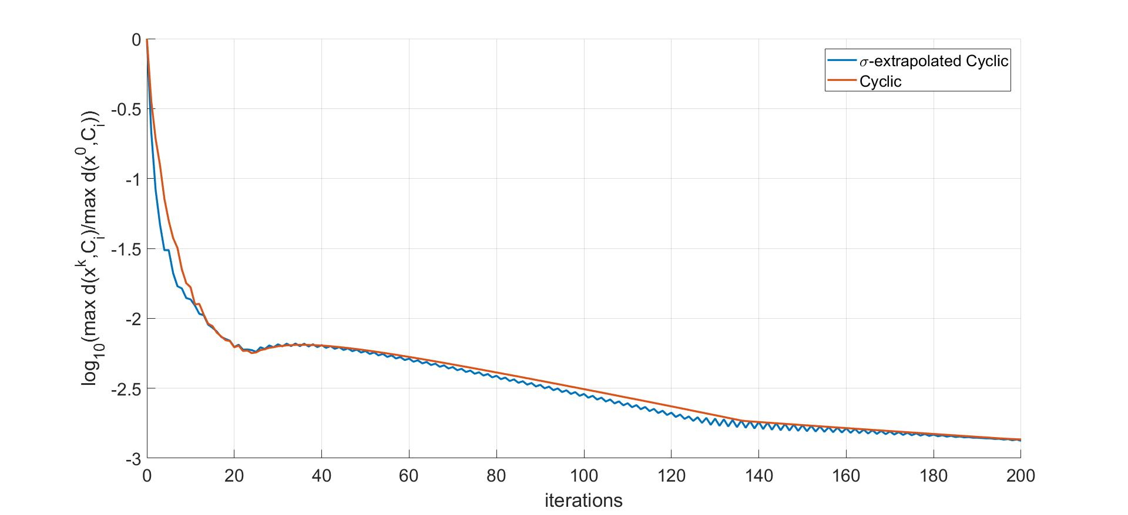
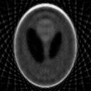
15/28

Slide 17
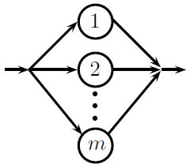
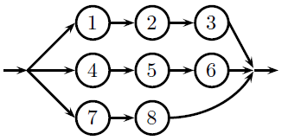
String averaging methods
The string averaging method generalizes the simultaneous and cyclic methods as particular cases.
Allows for additional flexibility in the trade-off between the two methods.
In the string averaging perspective, the simultaneous and cyclic methods are composed of strings.
16/28

Slide 18
String averaging methods
Back to our (non-extrapolated) recursion: $x^{0}∈ℋ;x^{k+1}=Tx^{k}≔\sum_{i=1}^{N}{ω_{n}S_{n}x^{k}}$
There are $N$ strings $J_{n}⊆\{1,…,M\}$ and $S_{n}=\prod_{j∈J_{n}}{P_{j}}$.
First SA projection method proposed by Censor, Elfving, Herman 2001.
Linear rate for SA projection methods - Bargetz, Reich, Zalas 2017.
Linear rate for SA with more general operators was not known.
17/28

Slide 19
Extrapolation for str. avg. methods
$$x^{0}∈ℋ;x^{k+1}:=x^{k}+τ(x^{k})(Tx^{k}−x^{k})$$
Let $Tx^{k}≔\sum_{n=1}^{N}{ω_{n}S_{n}x^{k}}$ $τ\left(x\right)=\frac{m}{m+1}\underset{σ_{sim}(x)}{\underbrace{\frac{\sum_{n=1}^{N}{ω_{n}{|\left|S_{n}x−x\right||}^{2}}}{{|\left|Tx−x\right||}^{2}}}}+\frac{m}{m+1}\frac{\sum_{n=1}^{N}{ω_{n}\sum_{i=1 }^{|J_{n}|}{{\left|\left|S_{n}^{i}x−S_{n}^{i−1}x\right|\right|}^{2}}}}{{|\left|Tx−x\right||}^{2}}≥1$ where $S_{n}^{i}$ is the product of $i$ first operators from $J_{n}$ and $m$ is the length of the longest string.
Can be deduced from Nikazad, Mirzapour 2017.
Linear rate of convergence was not known.
18/28

Slide 20
Main results
Setting: $P_{1},…,P_{M}$ -projections, $C=⋂_{i=1}^{M}C_{i}≠∅$, $ω_{n}≥ω>0$, $$T≔ \sum_{n=1 }^{N}{ω_{n}S_{n}}$$
Theorem 1: Let $T_{τ}x=x+τ(x)(Tx−x)$, where $$τ\left(x\right)=\frac{m}{m+1}\underset{σ_{sim}(x)}{\underbrace{\frac{\sum_{n=1}^{N}{ω_{n}{|\left|S_{n}x−x\right||}^{2}}}{{|\left|Tx−x\right||}^{2}}}}+\frac{m}{m+1}\frac{\sum_{n=1}^{N}{ω_{n}\sum_{i=1 }^{|J_{n}|}{{\left|\left|S_{n}^{i}x−S_{n}^{i−1}x\right|\right|}^{2}}}}{{|\left|Tx−x\right||}^{2}}$$ Then, $T_{τ}$ is $1/m$-SQNE, where $Fix T_{τ}=C$. That is, we have $||T_{τ}x−z||^{2}≤{|\left|x−z\right||}^{2} −\frac{1}{m}||T_{τ}x−x||^{2}, ∀z∈C$
19/28

Slide 21
Main results
Setting: $P_{1},…,P_{M}$ -projections, $C=⋂_{i=1}^{M}C_{i}≠∅$, $ω_{n}≥ω>0$, $$T≔ \sum_{n=1 }^{N}{ω_{n}S_{n}}$$
Corollary: extrapolated SA methods converge linearly!
Theorem 2: Assume that the family $\{C_{1},…,C_{M}\}$ satisfies some regularity conditions. Then for any bounded $S⊆ℋ$, there are $δ_{S},κ_{S}>0$, such that $$\frac{ωδ_{S}^{2}}{2mκ_{S}^{2}}τ\left(x\right)⋅d\left(x,C\right)≤\left|\left|T_{τ}x−x\right|\right|, ∀x∈S$$
20/28

Slide 22
MATLAB Library
Goal: Develop a library for MATLAB which will allow researchers in the field to devise and experiment with different projection methods.
Design philosophy:
Modularity: Independent modules.
Abstraction: Simple API.
Ease of use: Mild learning curve for using and extending the library.
Separation of concerns. Two layers: “Theory” and “Experiment”.
Theory: Mathematical Objects, Plotting.
Experiment: Problems, Algorithms, Data management.
21/28

Slide 23
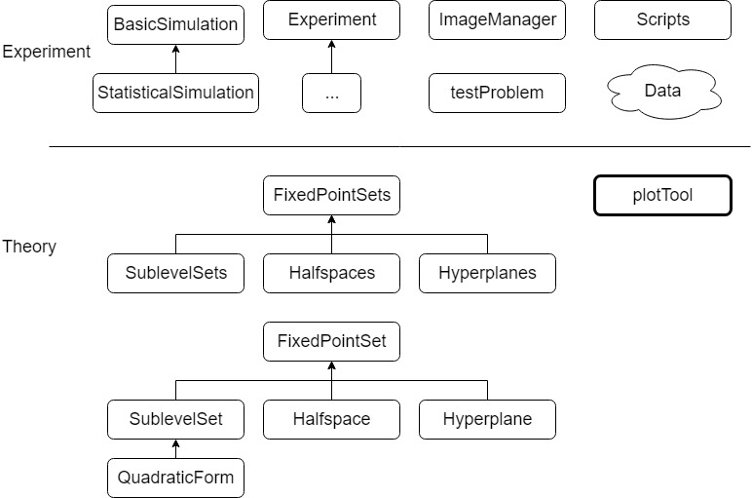
Architecture
22/28

Slide 24
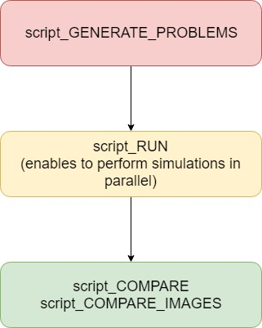
Workflow: Scripts
23/28

Slide 25
Experiments
We study performance on image reconstruction from projections.
Data – 30 rescaled images from [1,2].
[1] N. Asuni and A. Giachetti, Testimages: a large-scale archive for testing visual devices and basic
image processing algorithms, STAG - Smart Tools & Apps for Graphics Conference (2014).
[2] N. Asuni and A. Giachetti, Testimages: A large data archive for display and algorithm testing,
Journal of Graphics Tools 17 (2015), 113-125.
24/28

Slide 26
Experiments
Images are given by $f:{\left[1,32\right]}^{2}→\left[0,1\right]$
For angles $\{θ_{i}\}$ and displacements $\{d_{i}\}$ we compute the discrete Radon transform: $Rf\left(L\right)=\int_{L}{f\left(x\right)|dx|}⟹Rf\left(θ_{i},d_{j}\right)=\sum_{t}{f(tsinθ_{i}+d_{j}cosθ_{i},−d_{j}cosθ_{i}+tsinθ_{i})}$
The feasibility problem is to compute the “inverse” of the Radon transform $R^{−1}$.
25/28

Slide 27
Experiments
Every sum $\sum_{t}{f(…)}$ defines a linear equality constraint over the intensity of the image’s pixels.
An image can be cast as system of equalities: $Ax=b, A∈ℝ^{835×1024},b∈ℝ^{835}$ where $x∈ℝ^{1024}$ is the unknown image.
To solve the system, we use projections: $P_{i}x=x−\frac{\left\langle a_{i},x\right\rangle −b_{i}}{{\left||a_{i}\right||}^{2}}a_{i}$
26/28

Slide 28
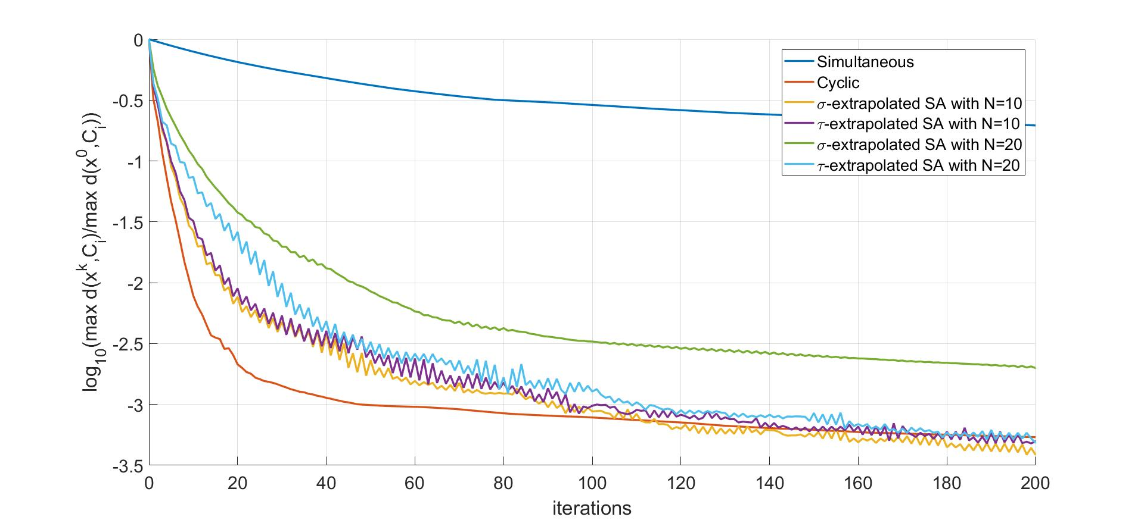
Experimental results
27/28

Slide 29
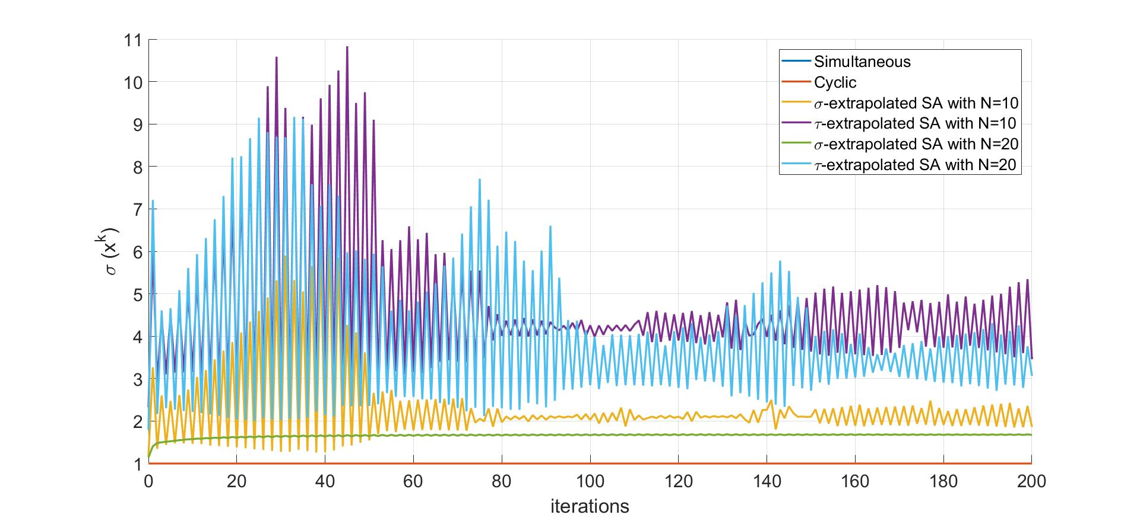
Experimental results
28/28

Slide 30
Appendix

Slide 31
Cutters
An operator $U_{i}:ℋ→ℋ$ is a cutter if for all $z∈C_{i}=FixU_{i}$ it holds that $\left\langle z−U_{i}x,x−U_{i}x\right\rangle ≤0$
Interpretation: $U_{i}x$ – metric projection onto half-space $H_{i}(x)⊇C_{i}$ for $x∉C_{i}$.
Useful inequality: $||U_{i}x−z||^{2}≤|\left|x−z\right|{\left.​\right|}^{2}−||U_{i}x−x||^{2}$.

Slide 32
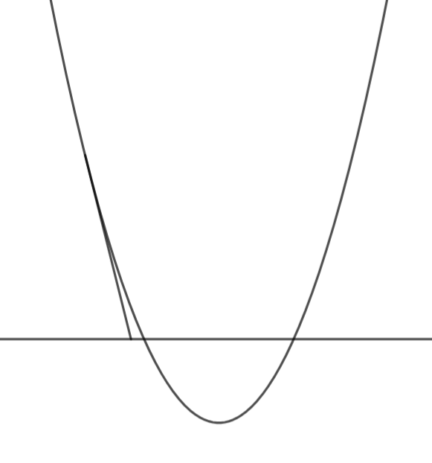
Examples
Metric Projection: $P_{C_{i}}x:=argmin_{z∈C_{i}}\{||x−z||\}$ and $H_{i}\left(x\right)=\left\{z|\left\langle z−{P_{C}}_{i}x,x−{P_{C}}_{i}x\right\rangle ≤0\right\}$
(Sub)gradient Projection: $P_{f_{i}}x=x−\frac{f_{i}\left(x\right)}{{\left|\left|∇f_{i}\left(x\right)\right|\right|}^{2}}∇f_{i}(x)$ and $H_{i}\left(x\right)=\{z|f_{i}\left(x\right)+\left\langle ∇f_{i}\left(x\right),z−x\right\rangle ≤0\}$
Metric Projection
Subgradient Projection
$$P_{C_{i}}x$$
$$P_{f_{i}}x$$

Slide 33
Caveat – SQNE operators
In fact, in this work we deal with more general operators than cutters.
An operator T is said to be $ρ$-Strongly Quasinonexpansive (SQNE) if it satisfies $||Tx−z||^{2}≤{|\left|x−z\right||}^{2} −ρ||Tx−x||^{2}$ for every $x∈ℋ$ and $z∈Fix T$.
Shares many mathematical properties with cutters. SQNE operators are “stretched” cutters.
Cutters are $1$-SQNE!

Slide 34
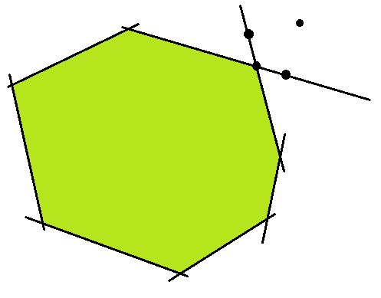
Linear regularity - Sets
A family of sets $∁=\left\{C_{1},…,C_{M}\right\}$ is said to be linearly regular if $d\left(x,C\right)≤κ⋅\max_{j}{d\left(x,C_{i}\right)}$ for every $x∈ℋ$ and some $κ>0$.
“If you are close to each of the sets you cannot be too far way from their intersection”.
Examples:
$int\bigcap_{i}{C_{i}}≠∅$*
Every $C_{i}$ is a half-space
Note: It may happen that $∁$ is linearly regular but some of it’s subfamilies fail to be!
* In this case the family $∁$ is boundedly linearly regular.

Slide 35
Linear regularity - Operators
An operator $U_{i}$is said to be linearly regular if $δd\left(x,C_{i}\right)≤||U_{i}x−x||$ for every $x∈ℋ$ and some $δ>0$, where $C_{i}=FixU_{i}$.
“Move at least some fraction of your distance from the solution”.
Since cutters move towards the solution, they imply linear convergence ($x^{k+1}=U_{i}^{k}x^{0}$): $d\left(x^{k+1},C_{i}\right)≤q^{k}⋅d\left(x^{0},C_{i}\right)$
Examples:
Metric Projections: $d\left(x,C_{i}\right)≤|\left|P_{C_{i}}x−x|\right|=d(x,C_{i})$, that is, $δ=1$.
Subgradient Projections*: if there is some $x$ such that $f_{i}\left(x\right)<0$.
* In this case the operator $P_{f_{i}}$ is boundedly linearly regular.

Slide 36
Nice correspondence
There is a correspondence between the above definitions of linear regularity.
For a family of sets $∁=\{C_{1},…,C_{M}\}$ it holds that
$∁$ is a linearly regular family of sets
The operator $Tx≔P_{C_{i\left(x\right)}}x$, where $i\left(x\right)≔argmax_{i}d(x,C_{i})$, is linearly regular
$$⟺$$

Slide 37
Main results
Setting: $U_{1},…,U_{M}$ -cutters, $C=⋂_{i=1}^{M}FixU_{i}≠∅$, $ω_{n}≥ω>0$, $$T≔ \sum_{n=1 }^{N}{ω_{n}S_{n}}$$
Fact: $T$ is $1/m$-SQNE, $Fix T=C$, $$||Tx−z||^{2}≤{|\left|x−z\right||}^{2} −ρ||Tx−x||^{2}$$ for every $x∈ℋ$ and $z∈Fix T$.
Theorem 1: Let $T_{τ}x=x+τ(x)(Tx−x)$, where $$τ\left(x\right)=\frac{m}{m+1}\underset{σ(x)}{\underbrace{\frac{\sum_{n=1}^{N}{ω_{n}{|\left|S_{n}x−x\right||}^{2}}}{{|\left|Tx−x\right||}^{2}}}}+\frac{m}{m+1}\frac{\sum_{n=1}^{N}{ω_{n}\sum_{i=1 }^{|J_{n}|}{{\left|\left|S_{n}^{i}x−S_{n}^{i−1}x\right|\right|}^{2}}}}{{|\left|Tx−x\right||}^{2}}$$ Then, $T_{τ}$ is $1/m$-SQNE, where $Fix T_{τ}=C$.

Slide 38
Main results
Setting: $U_{1},…,U_{M}$ -cutters, $C=⋂_{i=1}^{M}FixU_{i}≠∅$, $ω_{n}≥ω>0$, $$T≔ \sum_{n=1 }^{N}{ω_{n}S_{n}}$$
Corollary: extrapolated SA methods converge linearly!
Theorem 2: Assume that
$U_{1},…,U_{M}$ are boundedly linearly regular.
$\{C_{1},…,C_{M}\}$ is boundedly linearly regular.
Then for any bounded $S⊆ℋ$, there are $δ_{S},κ_{S}>0$, such that $$\frac{ωδ_{S}^{2}}{2mκ_{S}^{2}}τ\left(x\right)⋅d\left(x,C\right)≤|\left|T_{τ}x−x\right||, ∀x∈S$$

Slide 39
Questions?

