Slide 1
Faster and Lighter Online Sparse Dictionary Learning
By: Omer Dahary & Shay Ben-Assayag
Supervisor: Jeremias Sulam

Slide 2
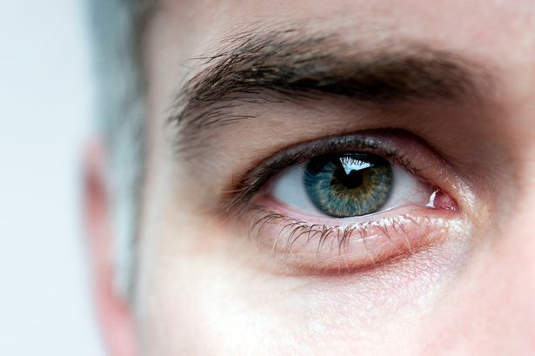
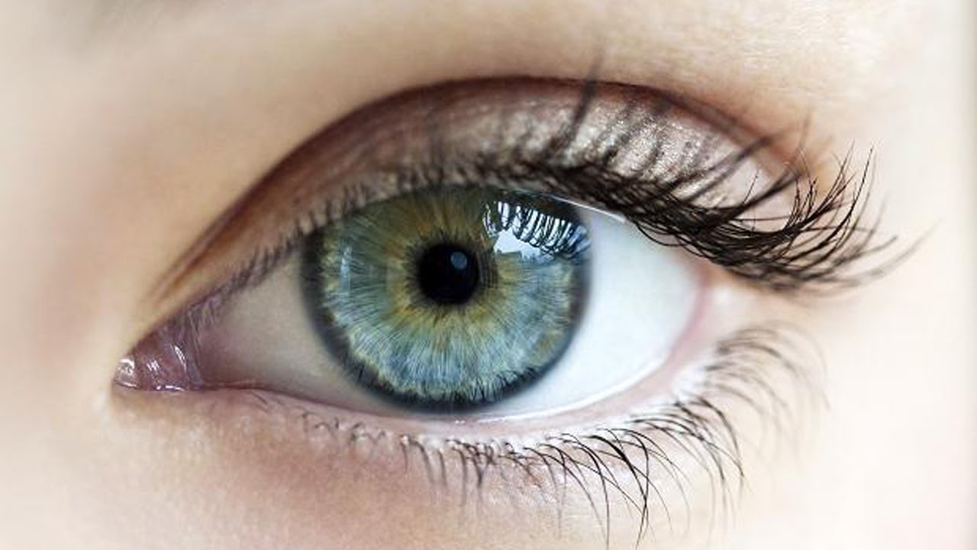
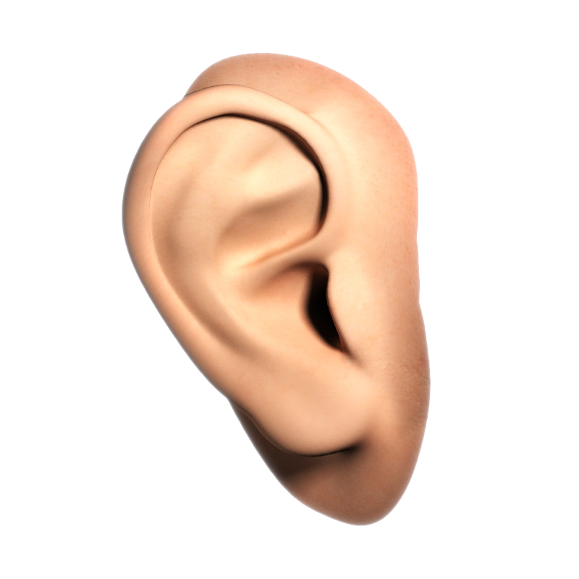
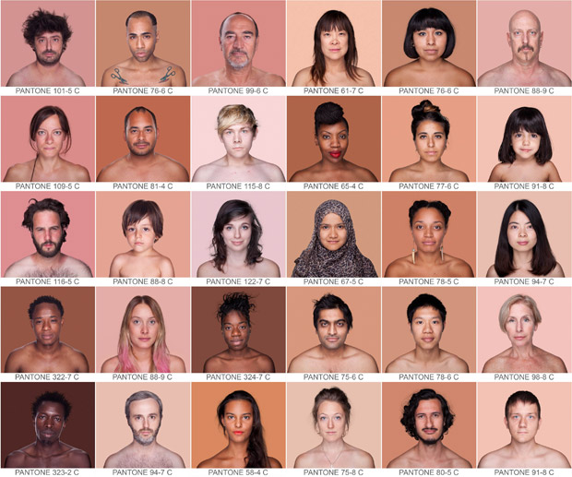
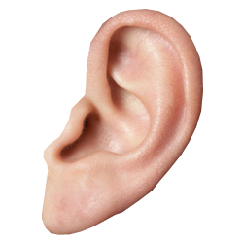
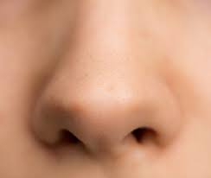
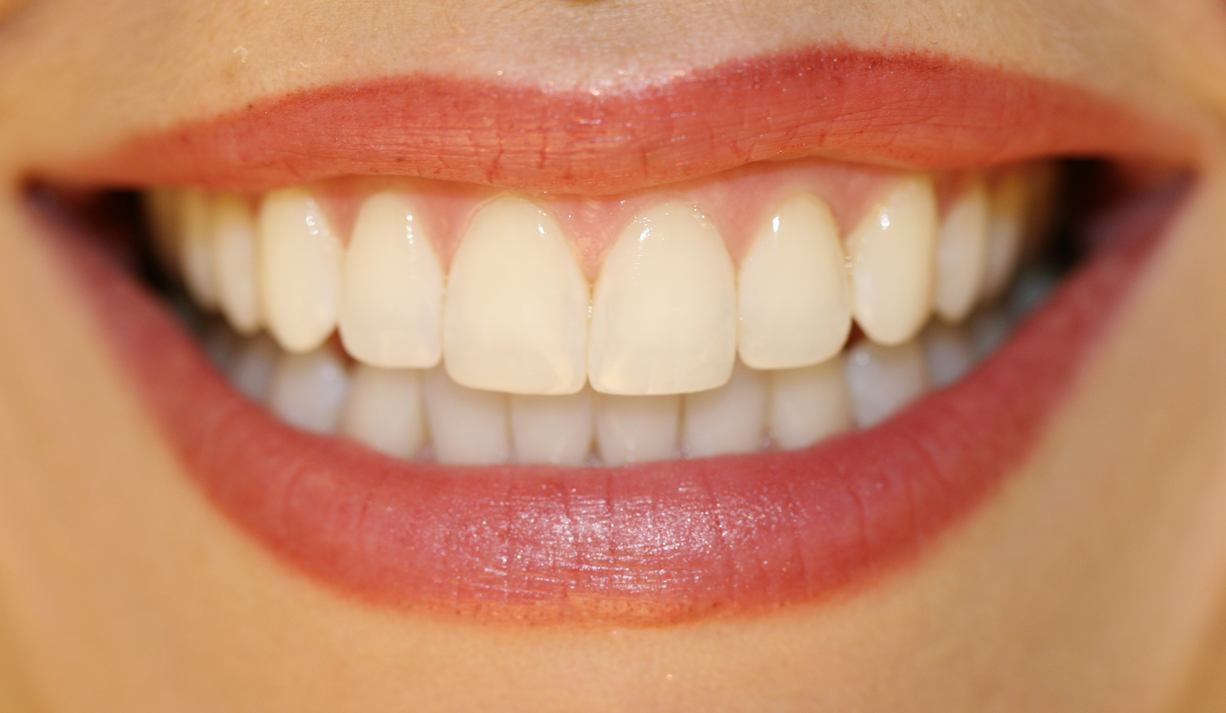
So what’s the project all about?
Notes:
The GIP Framework goals are:
Being a simple as possible so that the overhead for learning to use it will be as low as possible.
Providing flexibility so that the user will be able to implement any algorithm and will not be drawn back by missing functionalities.
To answer the needs of the GIP researchers by providing UI utilities that are need for research and by attempting to support a wide type of image formats.
Providing a simple GUI for working on a batch of images or on a single image.

Slide 3
The quest for a dictionary
Learning a linear basis for a set of signals
Obtaining a model for how signals behave has a lot of practical applications
Notes:
The GIP Framework goals are:
Being a simple as possible so that the overhead for learning to use it will be as low as possible.
Providing flexibility so that the user will be able to implement any algorithm and will not be drawn back by missing functionalities.
To answer the needs of the GIP researchers by providing UI utilities that are need for research and by attempting to support a wide type of image formats.
Providing a simple GUI for working on a batch of images or on a single image.

Slide 4
The problem of high dimensions
The problem is that most of the signals we want to work with have high dimensions
Online Sparse Dictionary Learning (OSDL) to the rescue!
Notes:
The framework was designed for GIP students and researchers.
Other existing frameworks are either too complex, the overhead for learning is too great or they are not flexible enough.
The GIP framework was designed specifically for the needs of GIP researchers. It intends to provide both simplicity and flexibilty.

Slide 5
Project goals
Studying the problem of high dimensional dictionary learning
Testing OSDL and its limitations
Providing an improved implementation
Testing with a large dataset of high dimensional images
But Let’s take a step back…
Notes:
The framework was designed for GIP students and researchers.
Other existing frameworks are either too complex, the overhead for learning is too great or they are not flexible enough.
The GIP framework was designed specifically for the needs of GIP researchers. It intends to provide both simplicity and flexibilty.

Slide 6
Sparse coding
We are all familiar with the problem of solving a linear system of equations:
$Ax=b$
But what about infinite number of solutions?
Let’s narrow it down:
$\min_{x}{{\left\|x\right\|}_{0} s.t. Ax=b}$
NP-hard
Notes:
The framework was designed for GIP students and researchers.
Other existing frameworks are either too complex, the overhead for learning is too great or they are not flexible enough.
The GIP framework was designed specifically for the needs of GIP researchers. It intends to provide both simplicity and flexibilty.

Slide 7
Dictionary learning
Natural signals can be expressed as a sparse linear combinations of atoms, called a dictionary
${\left\{y_{i}\right\}}_{i=1}^{M}$ training examples
$\min_{D,{\left\{x_{i}\right\}}_{i=1}^{M}}{\sum_{i=1}^{M}{{\left\|y_{i}−Dx_{i}\right\|}_{2}^{2}}} s.t. {\left\|x_{i}\right\|}_{0}≤k$
No analytic solution
Iterative algorithms: MOD, K-SVD
Notes:
The framework was designed for GIP students and researchers.
Other existing frameworks are either too complex, the overhead for learning is too great or they are not flexible enough.
The GIP framework was designed specifically for the needs of GIP researchers. It intends to provide both simplicity and flexibilty.

Slide 8
Online Sparse Dictionary Learning
Double sparsity model $D=ΦA$
$\min_{A,X}{{\left\|Y−ΦAX\right\|}_{F}^{2}} s.t. {\left\|x_{i}\right\|}_{0}≤p,{\left\|a_{j}\right\|}_{0}=k$
Alternating minimization:
Sparse coding
$\min_{A}{{\left\|Y−ΦAX\right\|}_{F}^{2}} s.t. {\left\|a_{j}\right\|}_{0}=k$
Cost function: $f\left(a_{j}\right)={\left\|Y−\sum_{i=1}^{M}{Φa_{i}x_{i}^{T}}\right\|}_{F}^{2}$

Slide 9
Implementation
OSDL has a Matlab implementation
We concentrated on improving it:
Alternative pursuit algorithm
Alternative dictionary constraint
Reimplementing dictionary clearing stage
Bug fixes

Slide 10
Orthogonal Matching Pursuit (OMP)
Used as the sparse coding algorithm
Based on a greedy strategy:
Maintains a set of active columns (support)
At each iteration – expand the set by one additional column:
Compute all possible $ℓ_{2}$ error using LS
Choose the minimalizing column
Stop when the error is low enough

Slide 11
Why did we choose to replace it?
Number of iterations == size of support
We prefer dedicating the time for going through more examples
Gram matrix needs to be kept in memory
Huge
Needs to be updated each iteration

Slide 12
Subspace Pursuit (SP)
Identifies a subspace of columns in which the signal lies
Employs a search strategy with a constant number of vectors
At each iteration – expand the current subspace with the largest inner product of the atoms with the current residue
Solve LS problem with the expanded subspace
Prune the subspace to the indices corresponding to the largest coefficients of the solution

Slide 13
Why is it any better?
Number of iterations doesn’t depend on the number of coefficients
Converges in a few Iterations
The number of iterations can be controlled
Does not have any extra memory constraints
Easy to parallelize

Slide 14
Hard-thresholding
OSDL keeps the $k$ largest nnz in an atom
Forcing each atom to have a strict $ℓ_{0}$ norm
A global constraint might give better results
$\min_{A}{{\left\|Y−ΦAX\right\|}_{F}^{2}} s.t. {\left\|x_{i}\right\|}_{0}≤p, {\left\|A\right\|}_{0}=Mk$
Too sparse atoms are not allowed

Slide 15
Dictionary clearing stage
Pruning conditions:
An atom is rarely used
Two atoms are similar
Using the Gram matrix causes problems:
Two highly used similar atoms are removed
Pruned atoms are taken into account
Time consuming
Adopting a stochastic approach

Slide 16
The dataset
Roughly 1M face images
MegaFace (Flickr), WIKI-crop, IMDB-crop
Wide variety of angles, positions, ages, and ethnicities
Implemented a python script for cropping around faces
Grayscaled and 128x128 pixels

Slide 17
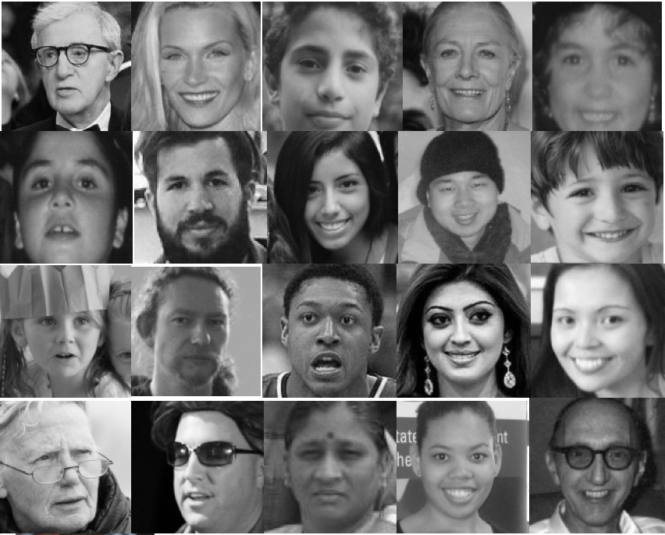
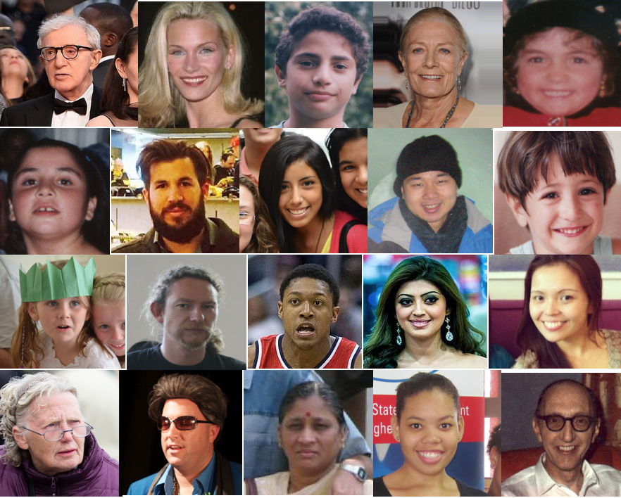
The dataset

Slide 18
It’s time to show some results

Slide 19
Experiment #1 (side features)
Testing the old implementation compared to the new one
Hard-thresholding, dictionary clearing, bug fixes
Parameters:
5,150 train images
270 test images
1,500 atoms
98/327 nnz per atom

Slide 20
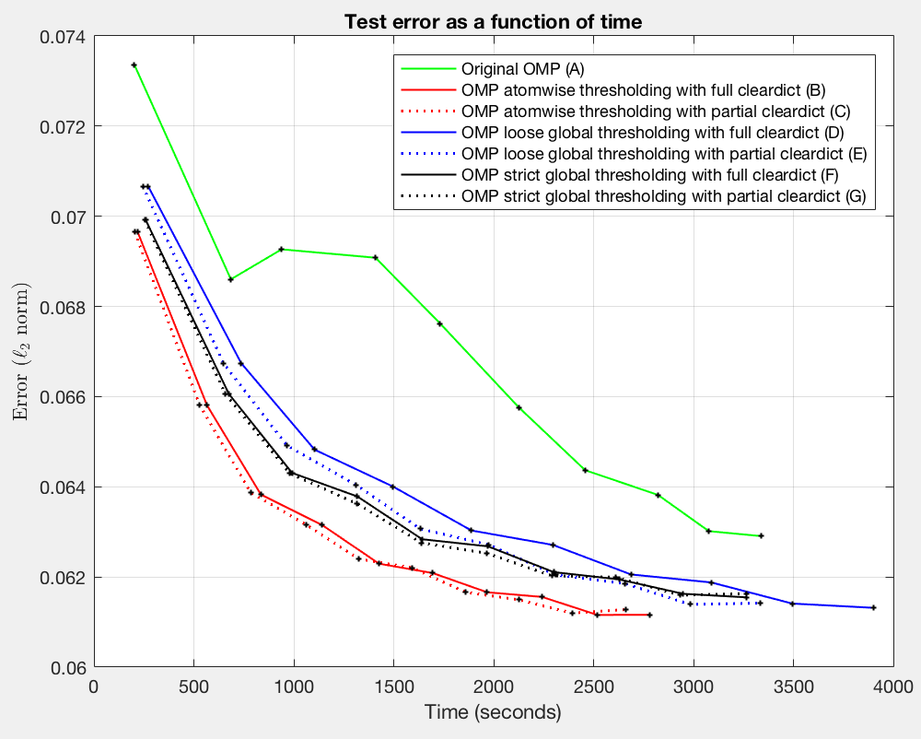
Experiment #1 (side features)

Slide 21
Experiment #1 (side features)

Slide 22
Experiment #2 (OMP vs. SP)
Testing the effect of the sparse coding method: OMP, OMP w\o Gram, SP
Parameters:
35,000 train images
1,930 test images
7,000 atoms
491 nnz per atom

Slide 23
Experiment #2 (OMP vs. SP)
Running time:
OSDL with SP - 8 iterations in 20 hours
OSDL with OMP – 2 iterations in 23 hours
OSDL with OMP w\o Gram – 0.25 iterations
Ran more than 96 hours!

Slide 24
Experiment #2 (OMP vs. SP)

Slide 25
Experiment #2 (OMP vs. SP)

Slide 26
Experiment #3 (1M examples)
Tested with the Chicago Face Database
OSDL with OMP – 0.4 iterations in 48 hours
OSDL with SP – 2 iterations in 36 hours

Slide 27
Experiment #2 (OMP vs. SP)

Slide 28
Experiment #2 (OMP vs. SP)

Slide 29
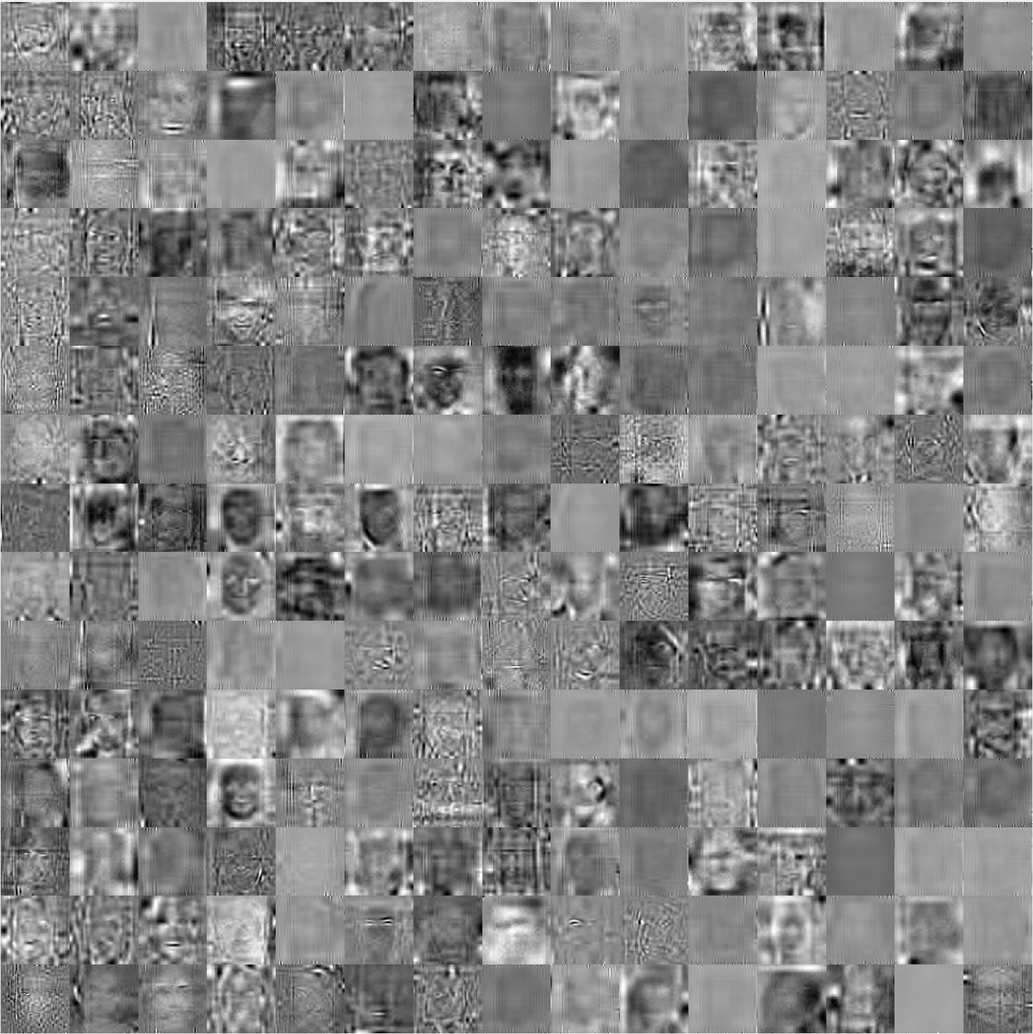
Conclusion
Few bullets how

Slide 30
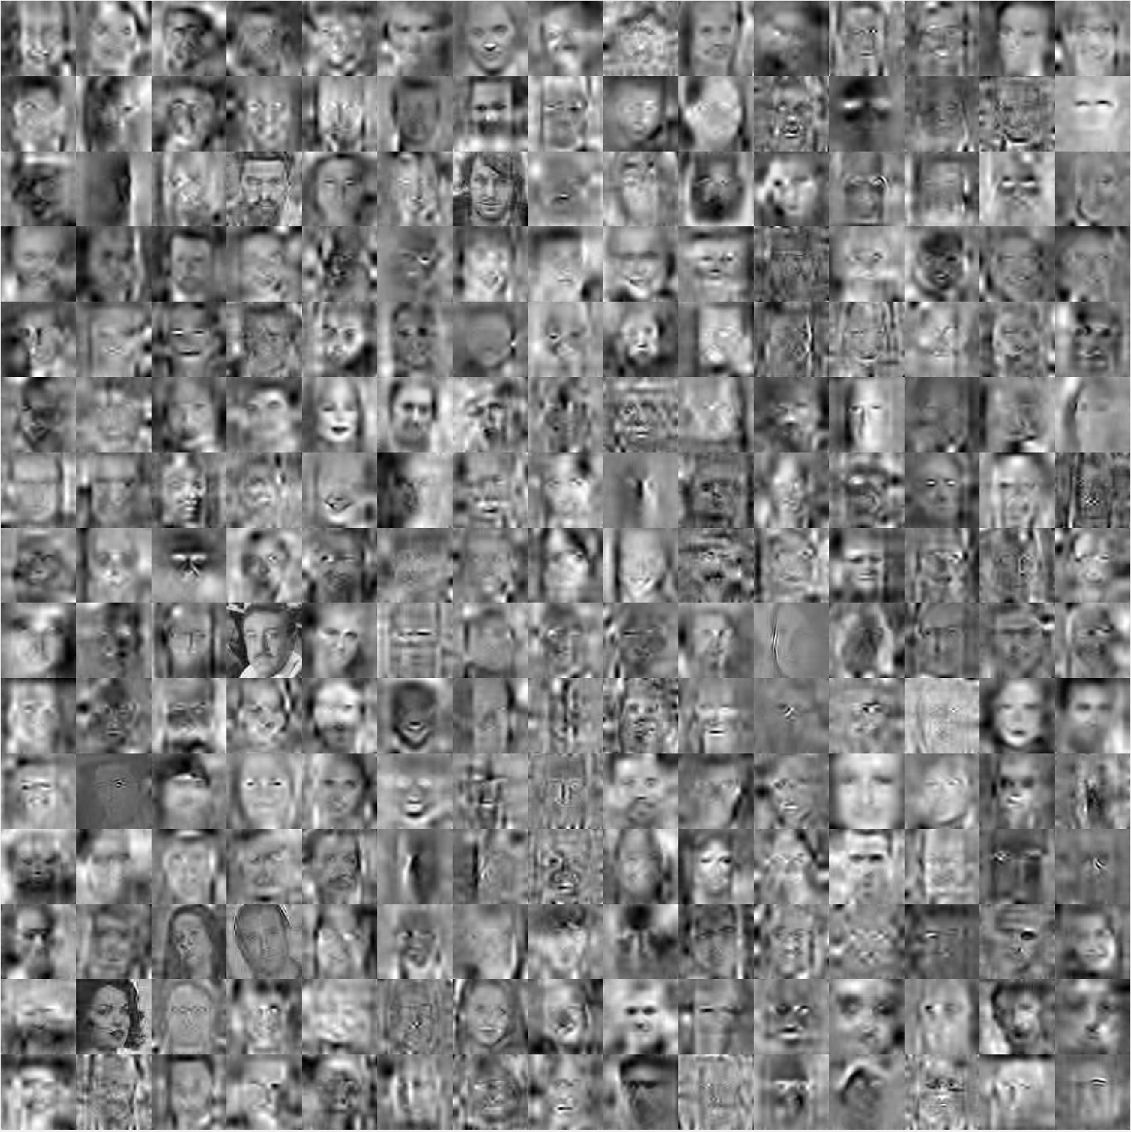
Conclusion
Few bullets how

Slide 31
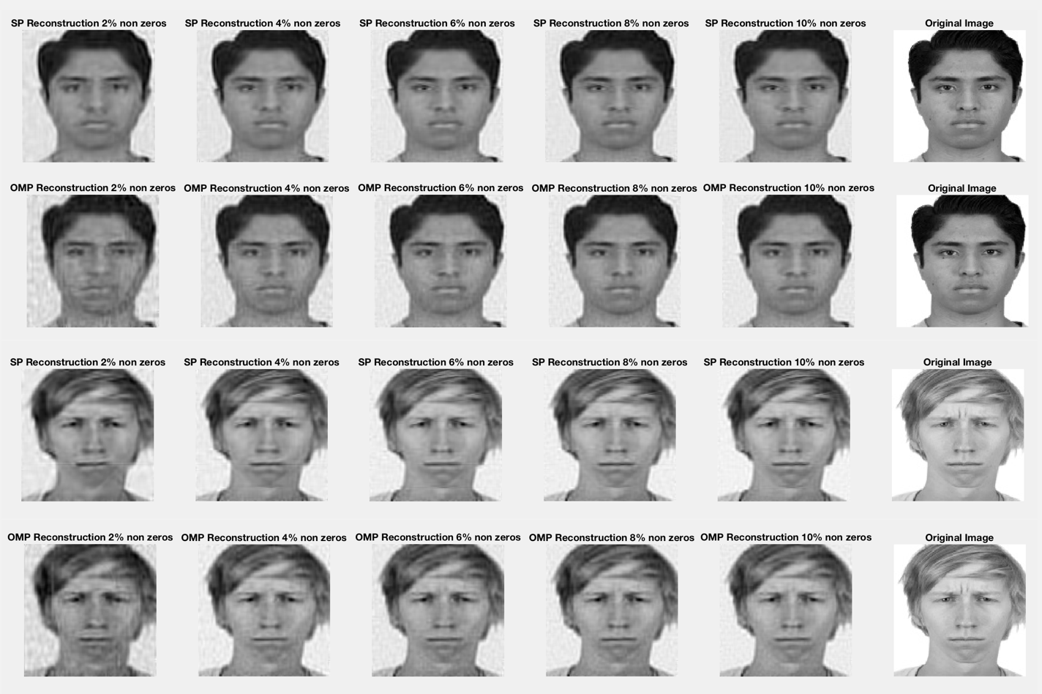
Conclusion
Few bullets how

Slide 32
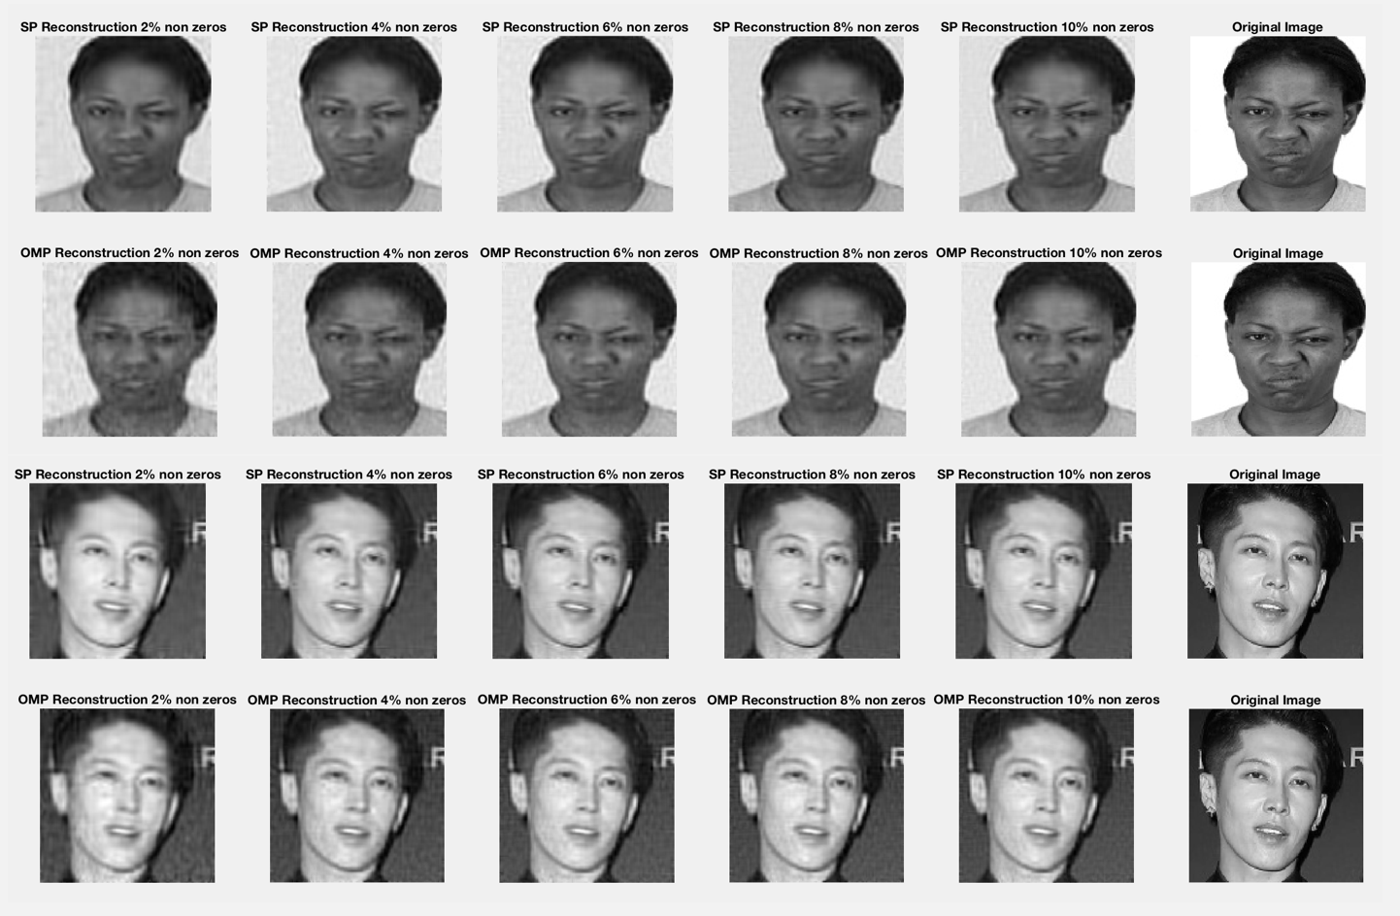
Conclusion
Few bullets how

Slide 33
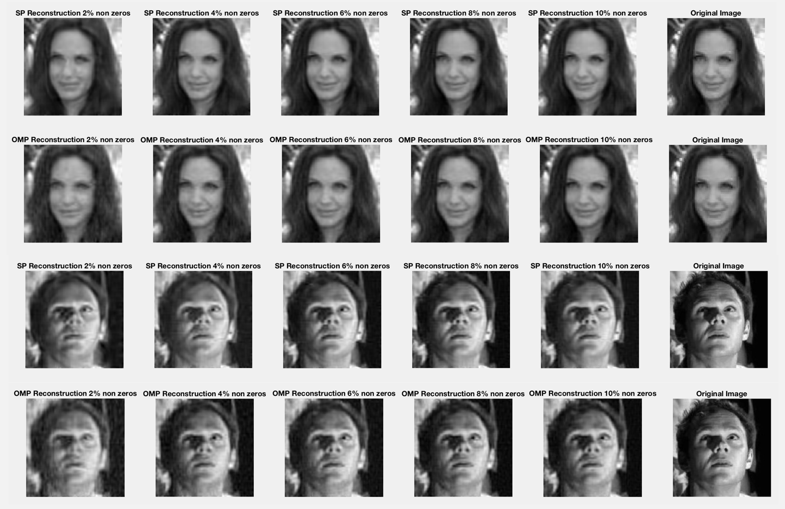
Conclusion
Few bullets how

Slide 34
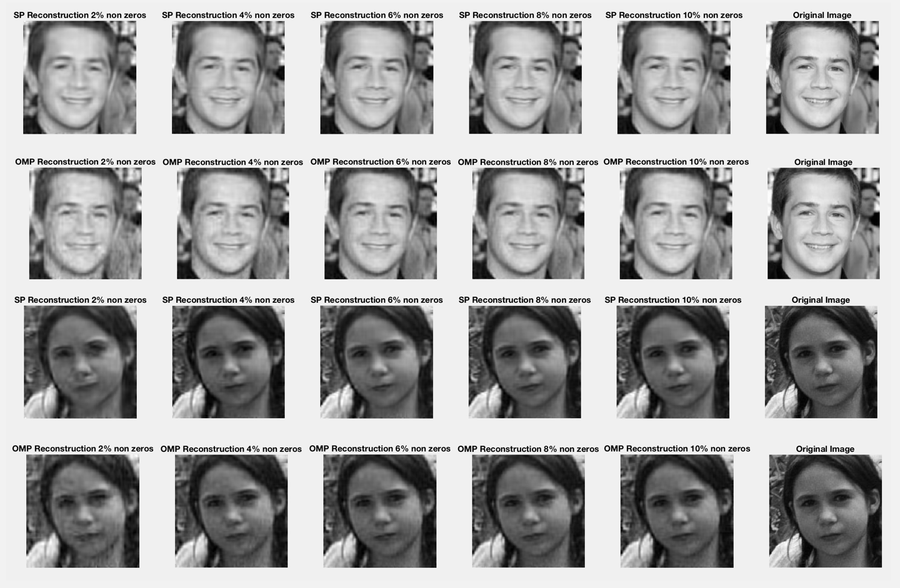
Conclusion
Few bullets how

Slide 35
Conclusions
New implementation outperforms previous one
Local is better than global
Although might work better under different conditions
SP is an efficient alternative
Faster => More iterations => Better results
No extra memory required
Especially better with highly sparse signals

Slide 36
Future Work
Further experimentation with global thresholding
Understanding the effect of parameters
Apply fixes in the dictionary clearing stage to other algorithms

