Slide 1
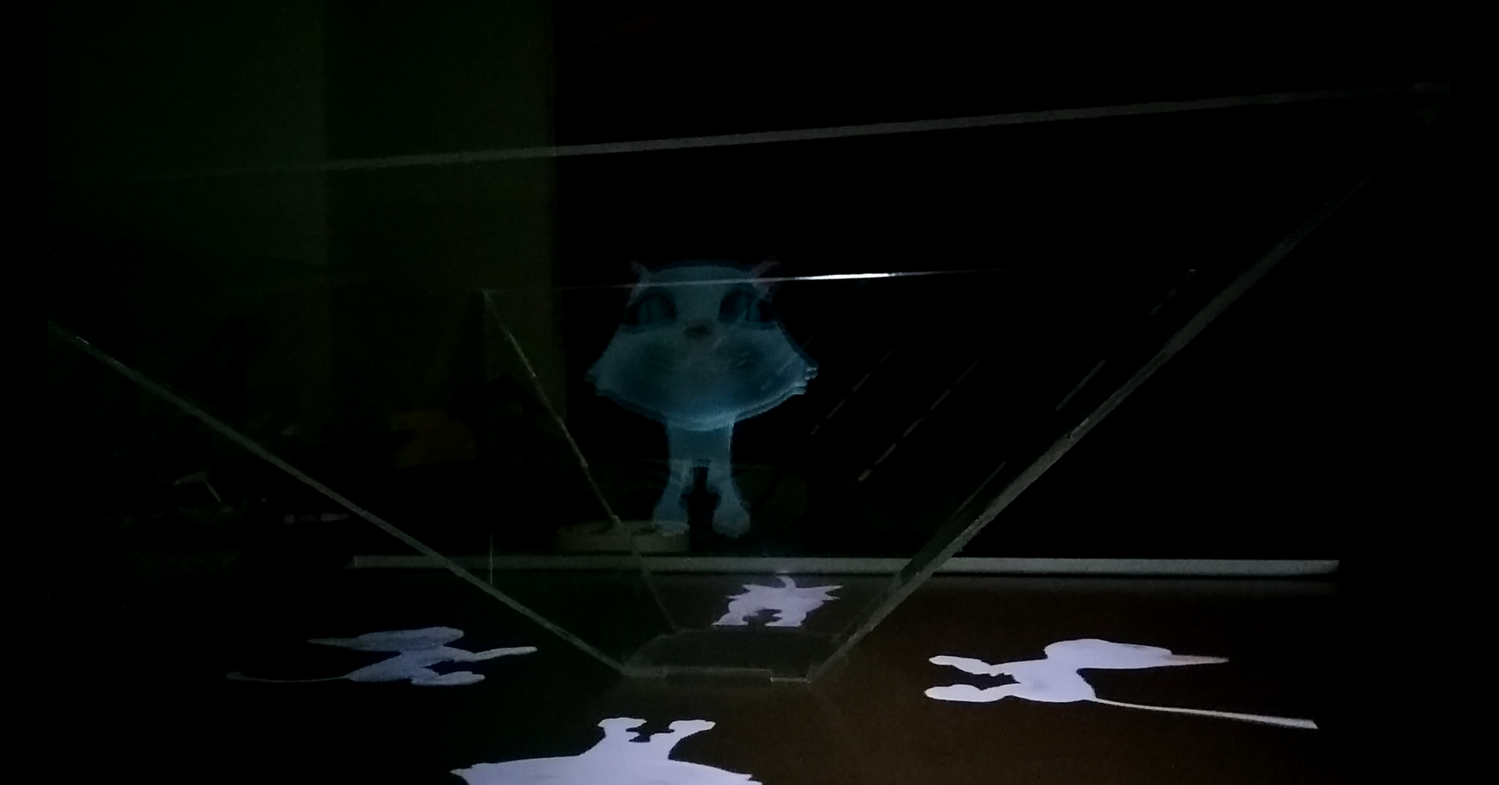
Salevich Alex
Extended Hologram Project

Slide 2
Project goal
Goal:
The old version of this project was a stand alone application with fixed models
and no control over the presentation of the holograms.
The goal of this project was to extend the application in 2 ways:
1) The app will have a user interface for user control over the presentation at computer which the app is running at.
2) The app will act as a server that can be connect to by clients so that they control the many features of the main application. In order for this to work a second Client side application has been developed as a part of this project.

Slide 3
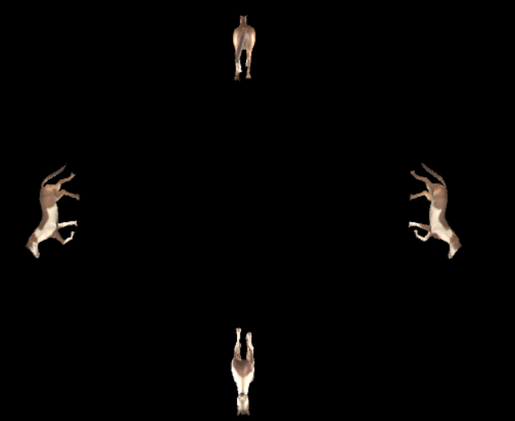
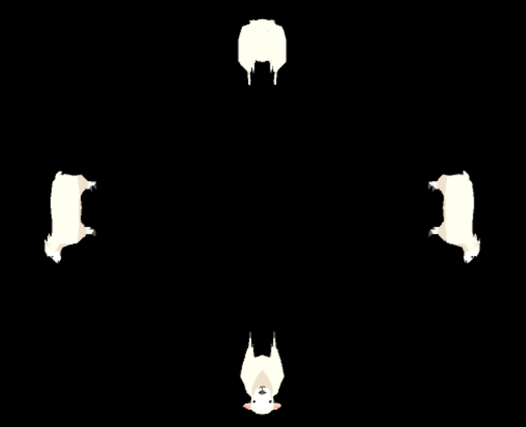
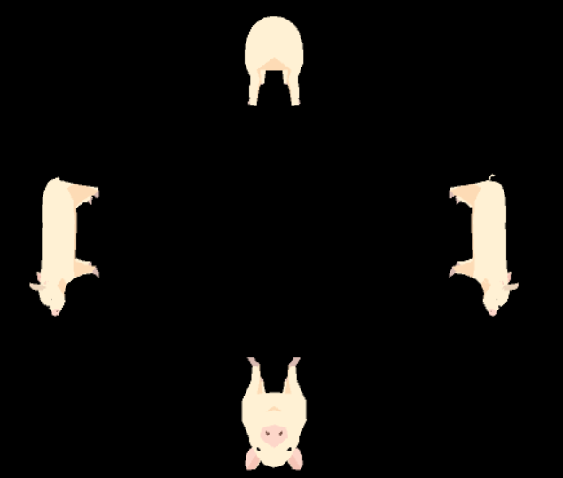
Project Extension
Server
The application has added with a simple keyboard shortcut interface.
Controls:
P-Toggle the presentation mode, it can be automatic which means the app will choose the models
and will switch them in a fixed time or manual in which then the user can control the sliding of models by other controls.
Right/Left Arrows-when presentation mode is manual these keys will be used to show the next or previous model, right being next and left being previous.
w-rotate the model up s-rotate model down a-rotate model to the left
d-rotate model to the right q-rotate model counter clockwise e-rotate model clockwise
numpad’+’ /’+’-enlarge model
numpad’-’/’-’-shrink model
c-clear model rotation

Slide 4
Project Extension
Adding new models
There is a simple procedure to add new models to the server.
First you need to get your model prefabs and preferably make sure they have either
A mesh or skinned mesh renderer for optimized behaviour in the app.
Then you will need to open the application project in unity and add the models prefab to
The Hologram_Repo folder in resources folder.
Run the app once in the editor, this will cause Auto creation of model preview images in the resources folder that will later will be sent to the clients upon connection. This preview images are usually lighter and better for network transport. Now you can build the project again into an executable and use it.

Slide 5
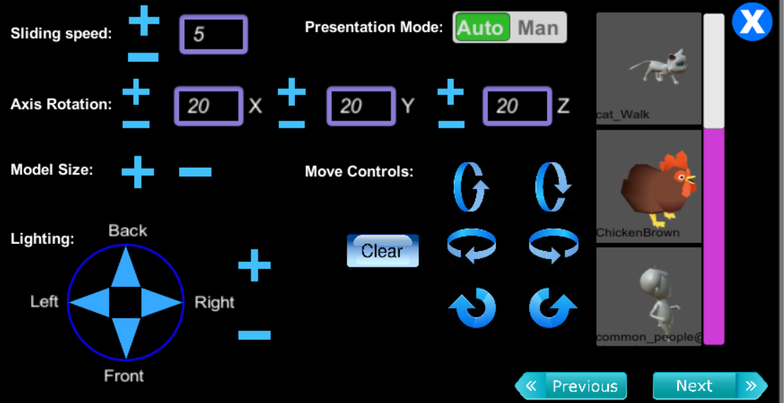
Project Extension
Client
For this part a second application was developed to perform as a client that connects via
IP with TCP Sockets.
When a clients ask to connect to the server, the server sends the status of
the app meaning sliding speed, presentation mode, rotation axis magnitude and the images of current models that are in the presentation.
The client app has a easy and intuitive GUI which allows the user to control the distant server app from another device like mobile phones Ipads etc.

Slide 6
Client Side GUI
Presentation mode is controlled by a toggle button.
Sliding Speed of the presentation is changed by the user with
the plus and minus button current value is showed.
Axis rotation which defines the rotation angle in each axis
when rotating a model in that direction controlled with minus
plus buttons.
Model size is control by minus and plus buttons.
Sliding manually the model is done by next
previous buttons.

Slide 7
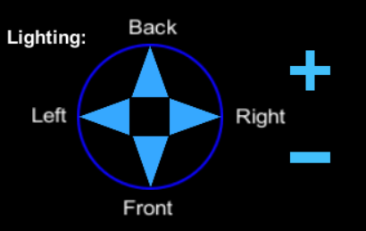
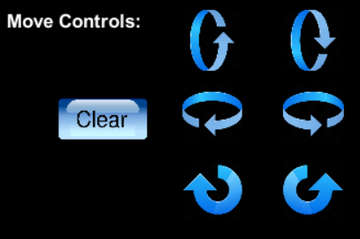
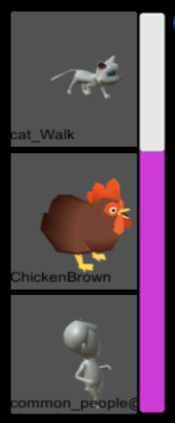
Client Side GUI
Lighting is controlled by a circular menu in which you first
choose the side you want to control its light and then
with the plus and minus buttons control the light intensity.
Rotation is controlled by a 6 buttons each depicting the
direction of the rotation when the angle of the rotation
is defined in axis rotation. Also a clear button is available
o reset the model rotation.
Model manual selection is done by clicking/pressing at
the desired image in the scrollable menu, upon choosing the
model the server will show it on its side.

Slide 8
External Links
Git repositories:
https://github.com/sloovi90/HologramClient
https://github.com/sloovi90/HologramServer
Video link:https://www.youtube.com/watch?v=j_v4hae5gtE

