Slide 1
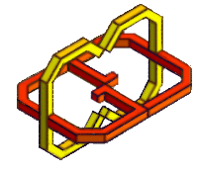
VR FloorPlanner
By: Netanel Lev & Dolev Ben Ami
Supervisor: Yaron Honen & Boaz Sternfeld

Slide 2
Vision
An architect’s creativity tool
A VR application that helps create and edit a house’s infrastructure
Enables the editing of walls, windows, doors for users’ projects
Multi-project support with a “miniature park” effect

Slide 3
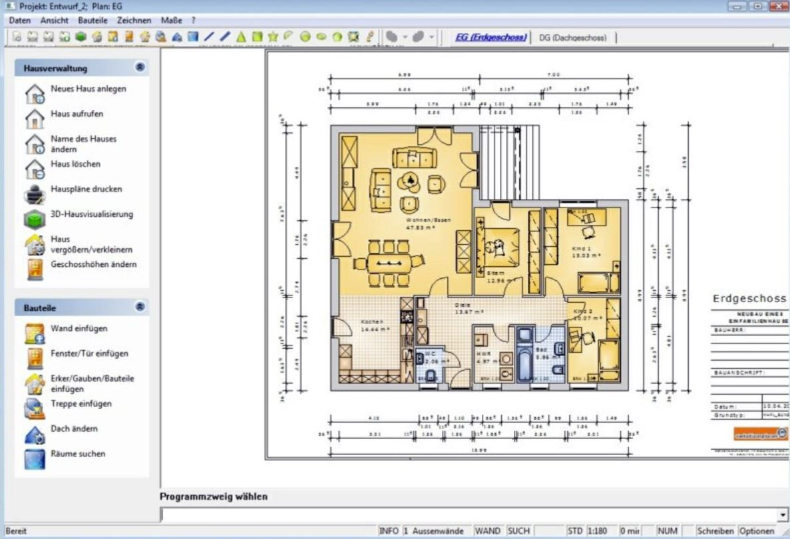
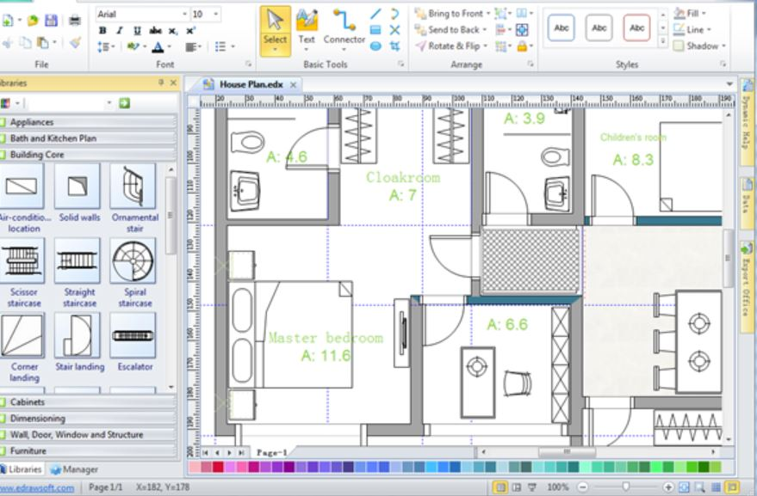
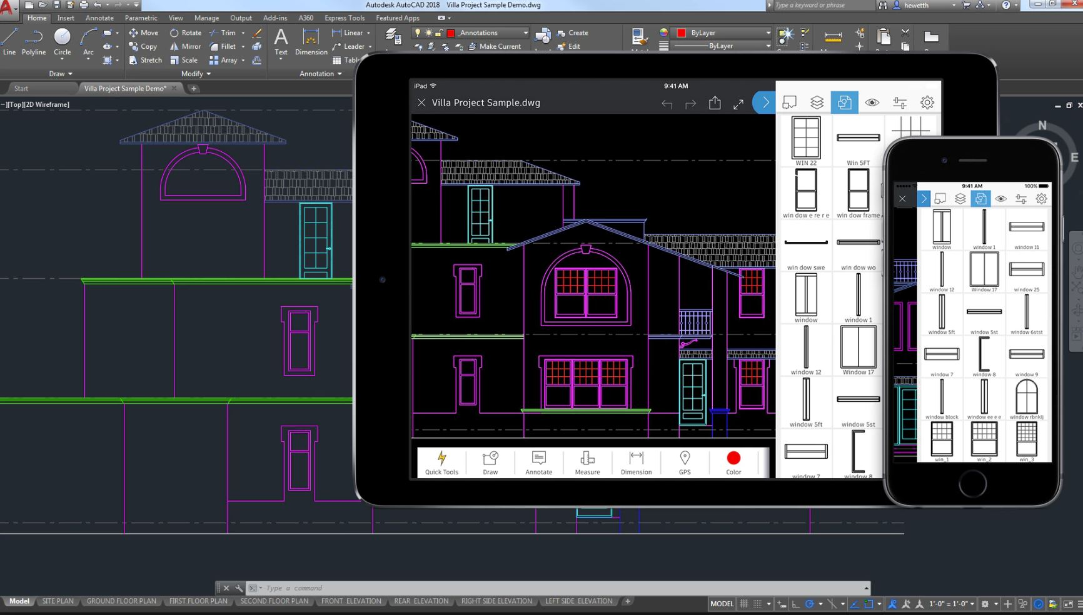
Motivation
Common complicated editing tools
Atir, AutoCad, ETC..

Slide 4
Motivation
VR advantages
Visualization while editing
Attraction
Potentially commercial product

Slide 5
Project Objectives
Intuitive architectural editing tool
Supported objects:
Walls
Windows
Doors
Multi-project support

Slide 6
App design
Start Scene
Load Model
Edit Scene
Save Model

Slide 7
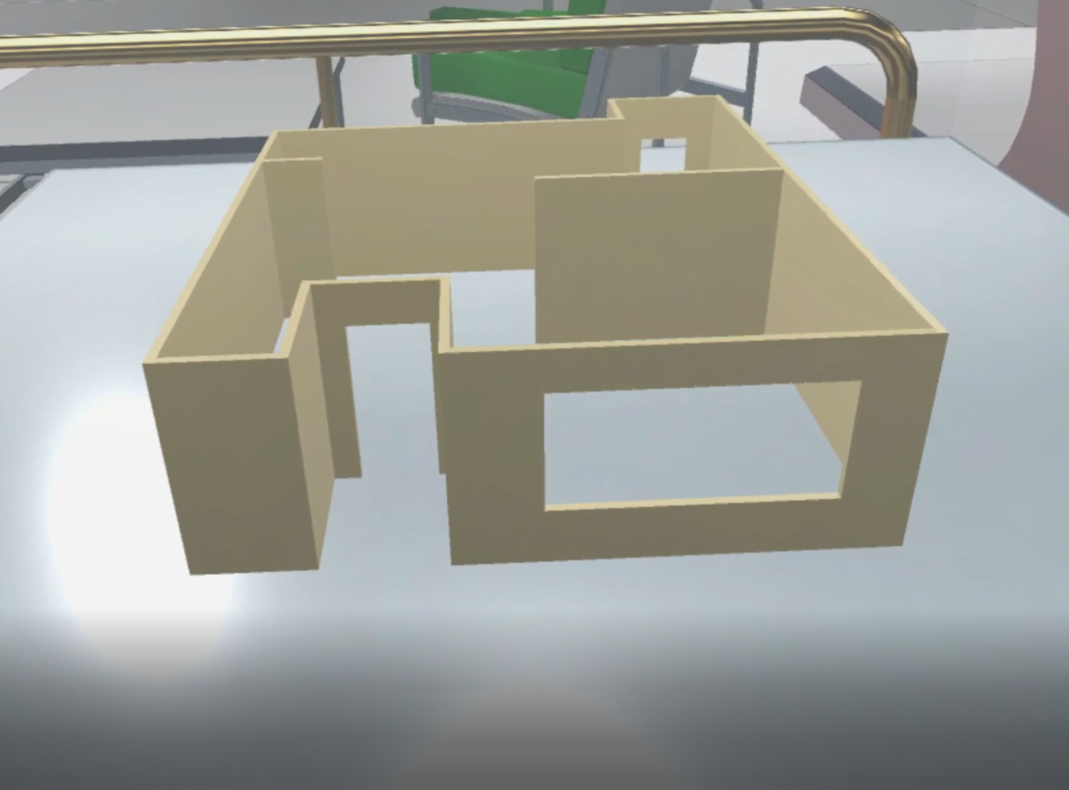
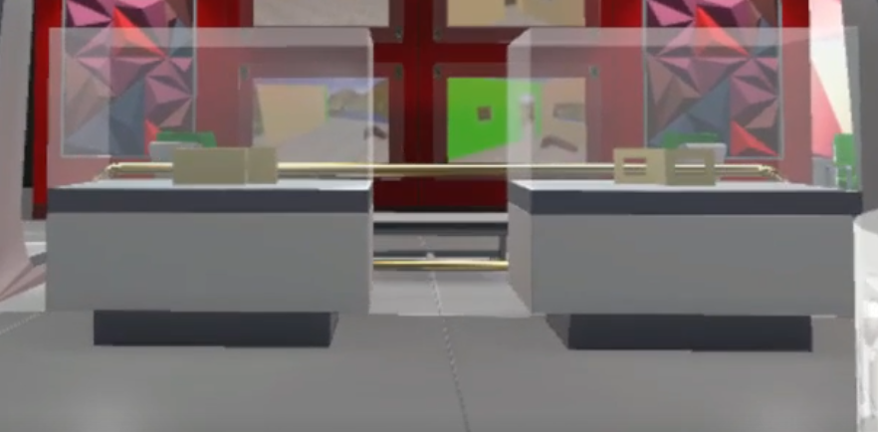
App design – start scene
Projects’ Miniatures

Slide 8
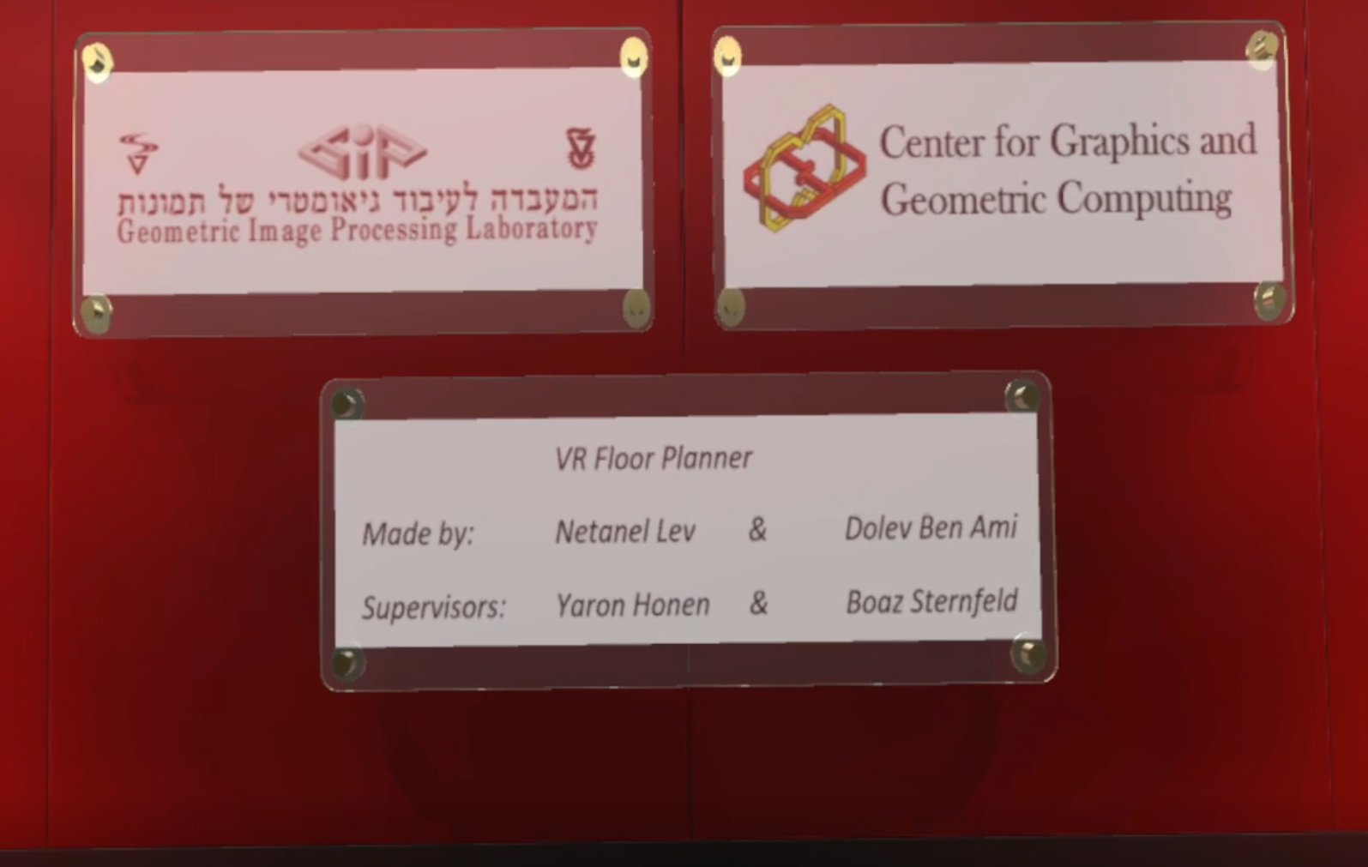
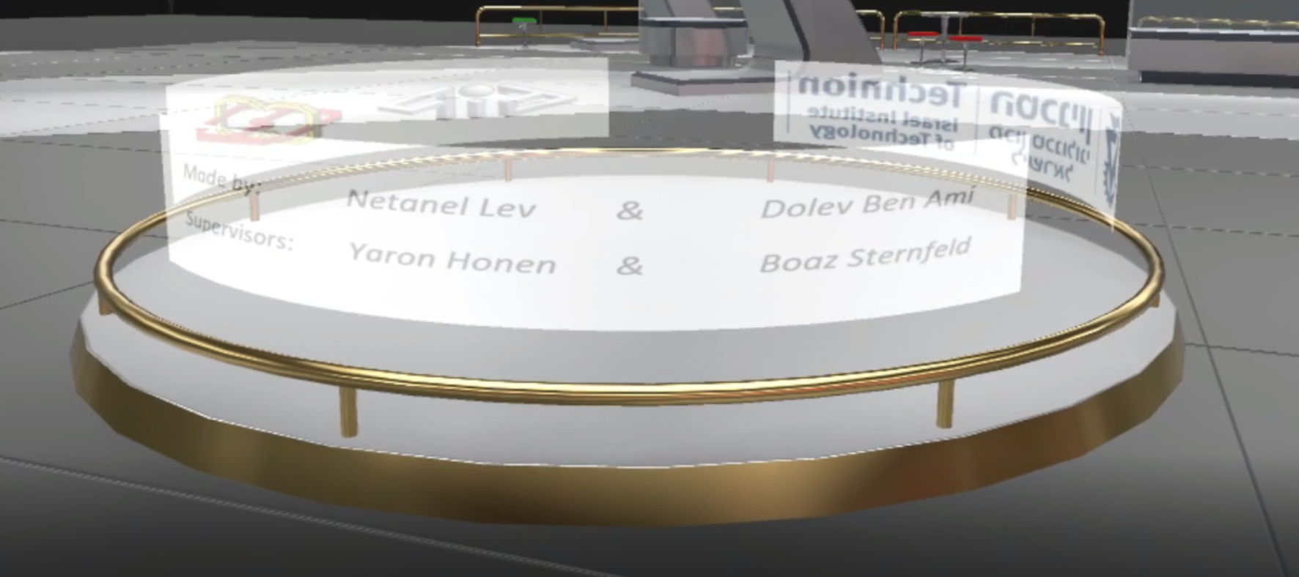
App design – start scene
Publicity

Slide 9
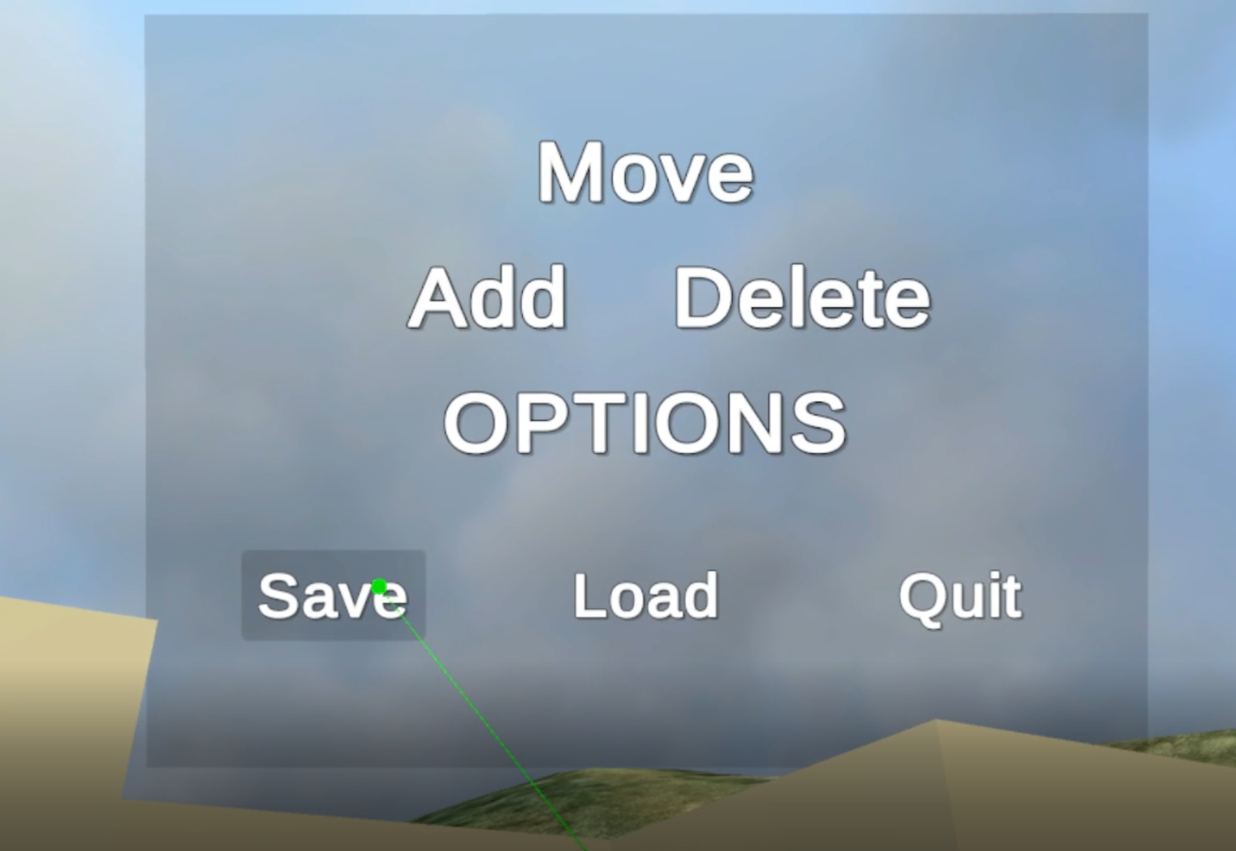
App design – save / load
Serialize / De-serialize objects
Position
Rotation
Scale

Slide 10
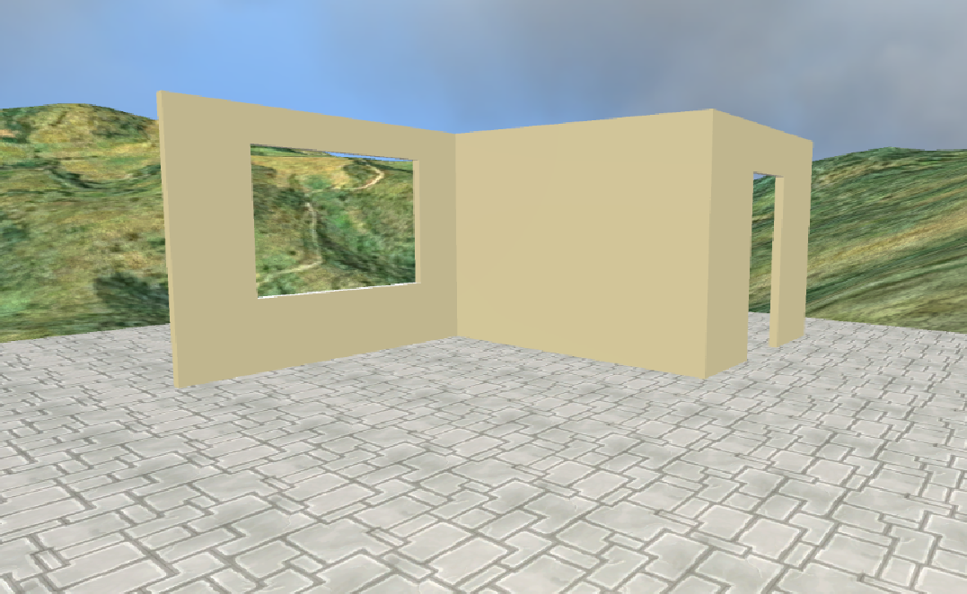
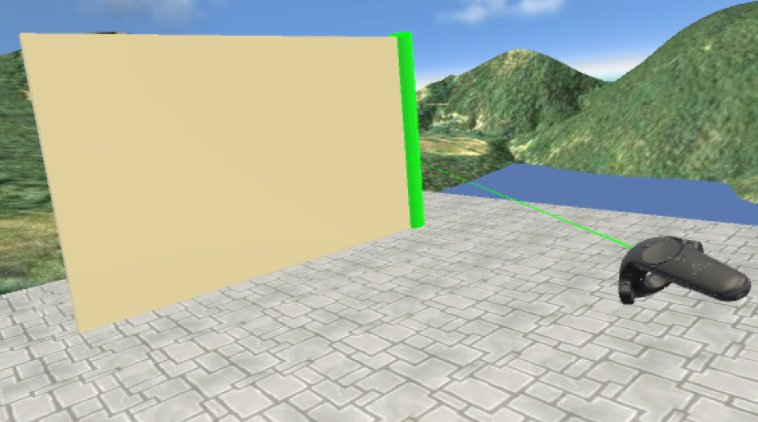
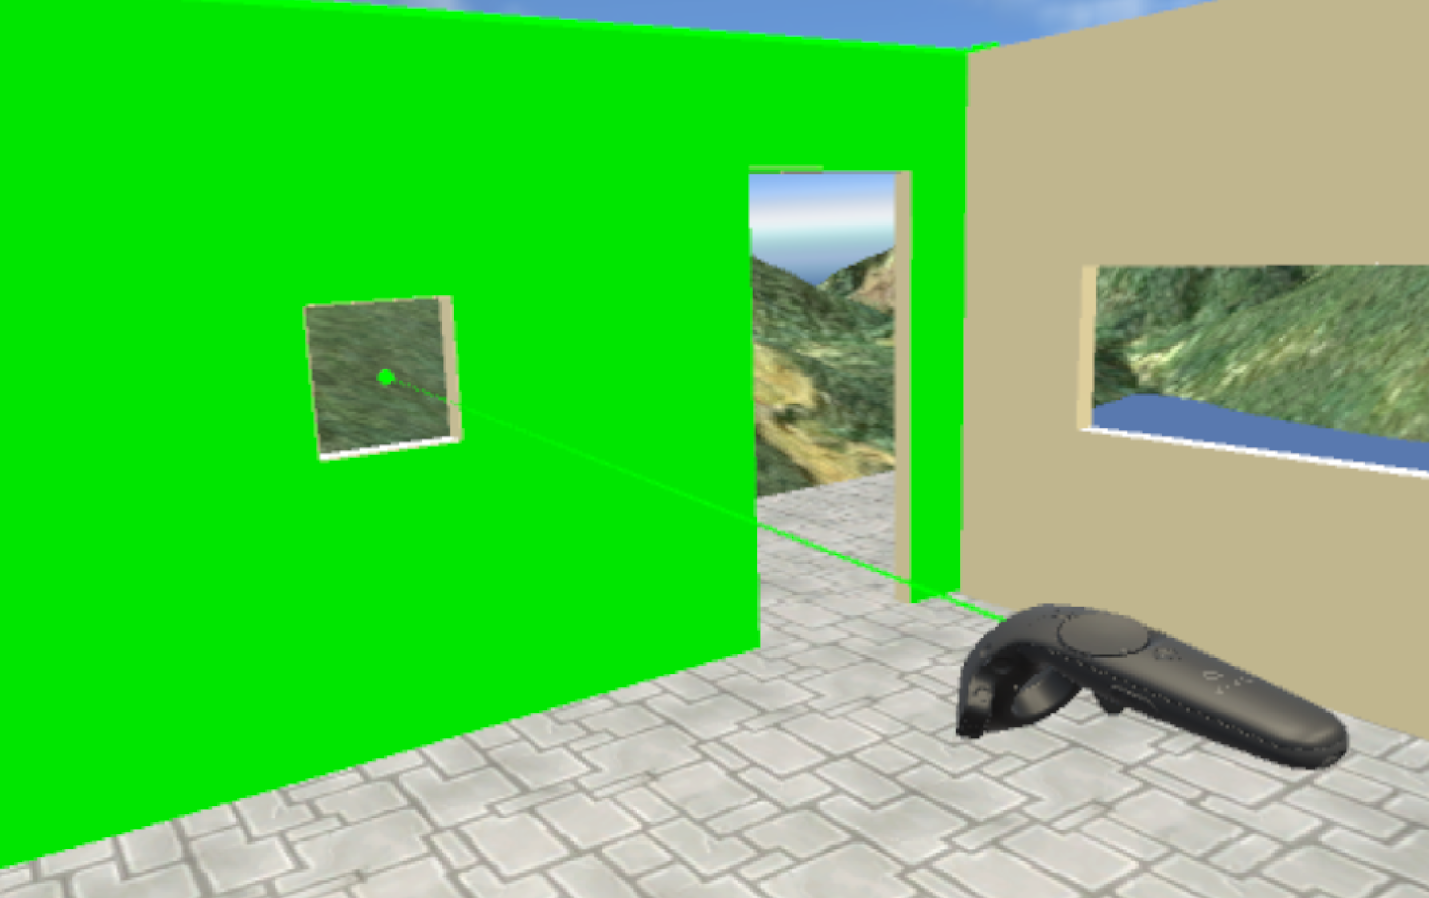
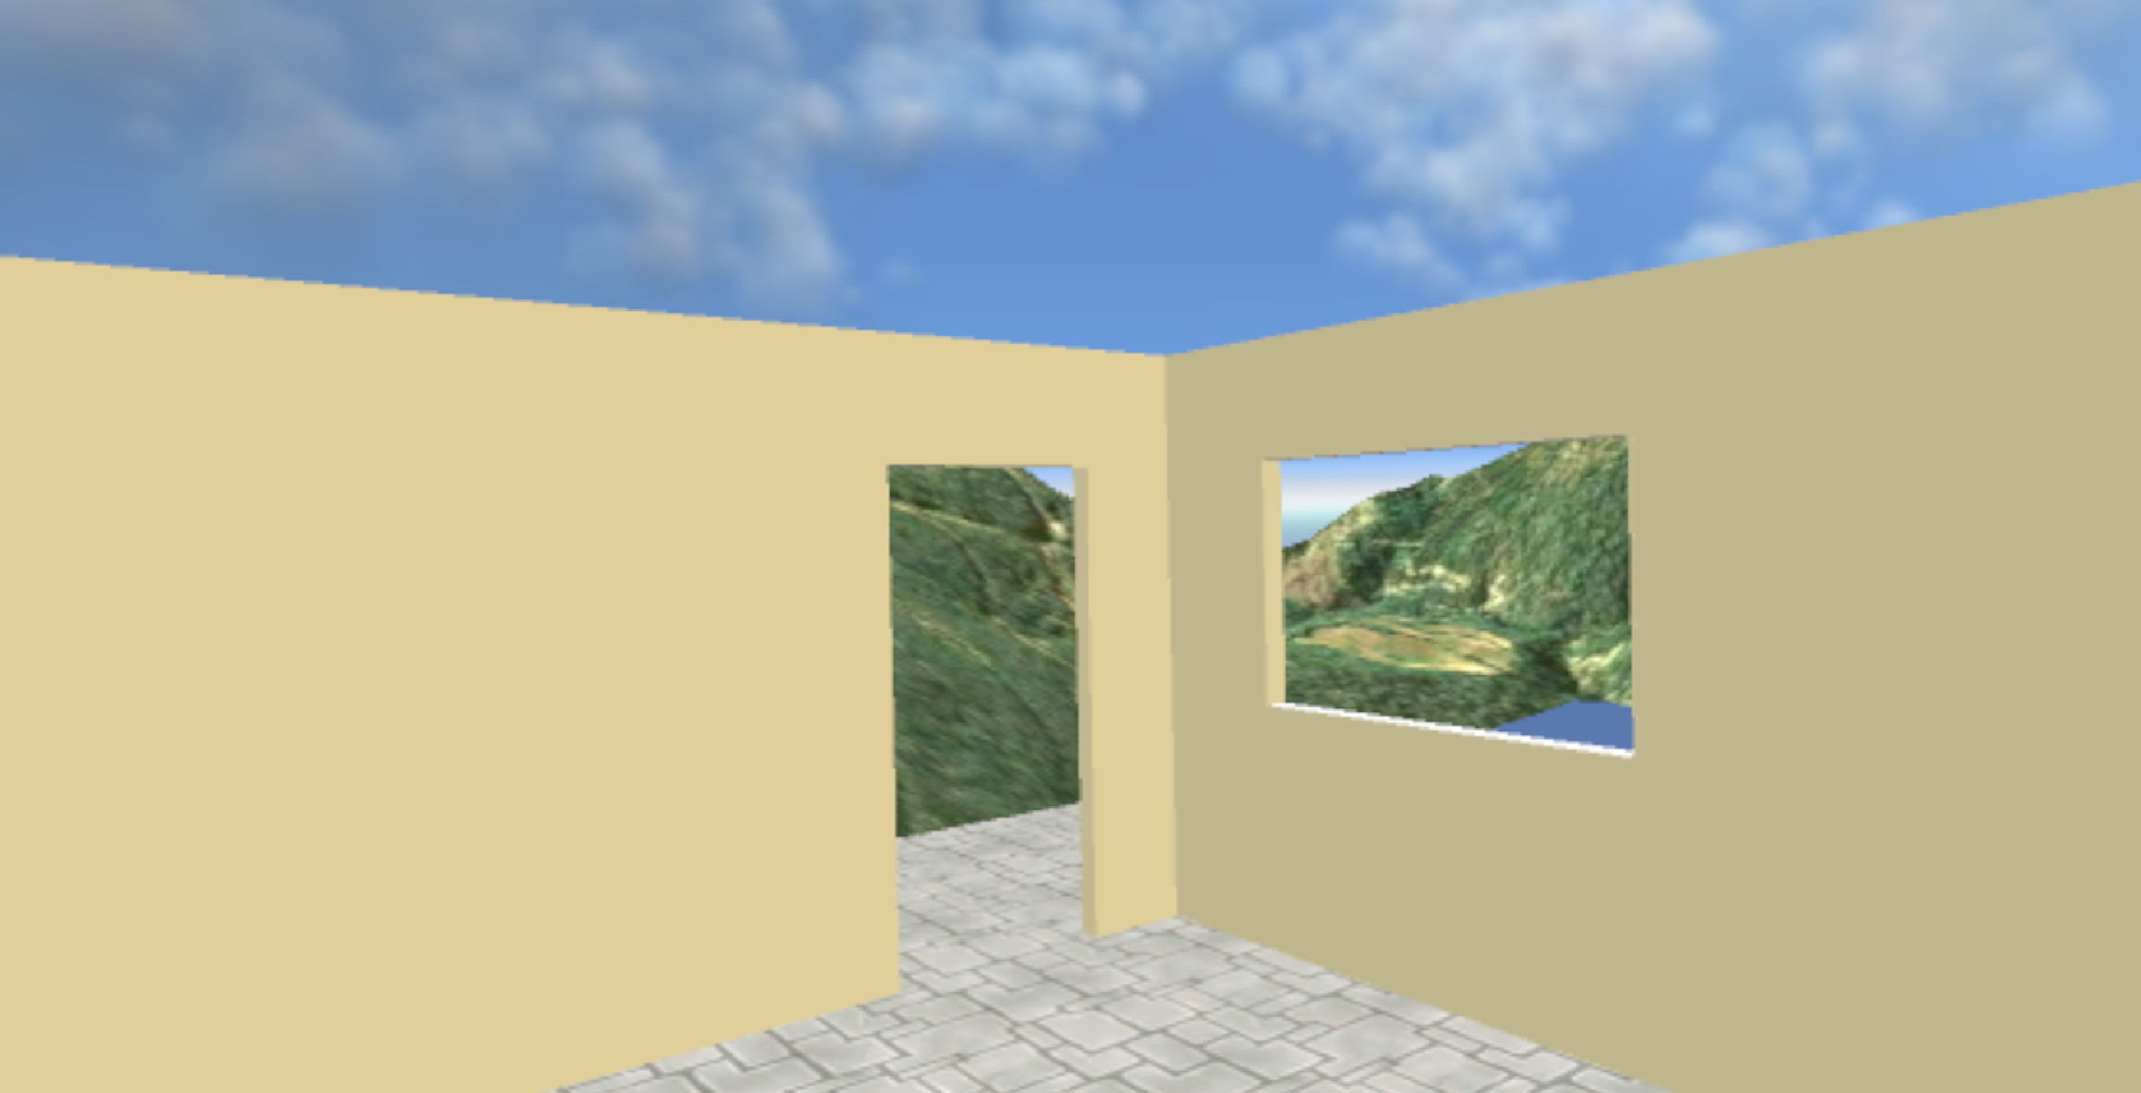
App design – edit scene
Create
Move
Adjust
Delete

Slide 11
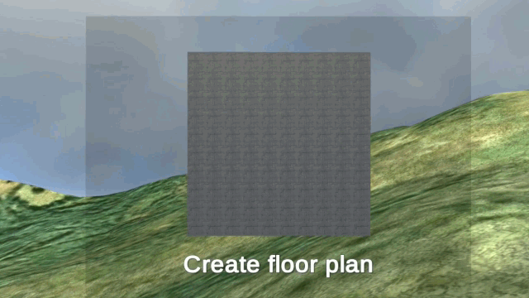
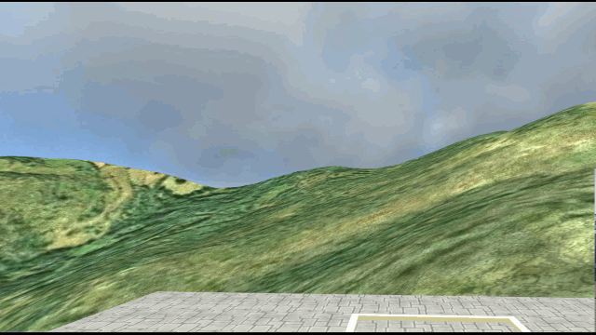
App design – edit scene
Easy 2D to 3D

Slide 12
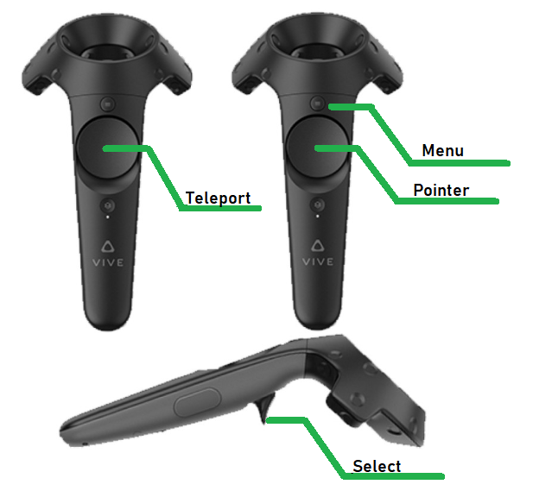
Input - controllers

Slide 13
Challenges Faced
Gloves
Windows + Doors
Transparent Renderer
HW usage
VRTK – hardware toolkit

Slide 14
Challenges Faced
Relevant information gathering
Overwhelming data
Lack of automated QA
Manual test for every change

Slide 15
Premade used assets
VRTK
Controllers
VIVE operation
Materials:
Sky sphere
Project display
Terrain
Hollow objects

Slide 16
Results
movie

Slide 17
Conclusion
Technology feasibility check
Gloves limitations
HTC VIVE resolution
Existing library usage
Save \ Load
VRTK
Materials
Background scenes

