Slide 1
360$°$ Video Editing
VR
360$°$ Video Editing
Technion
Computer Science Faculty
Final Project

Slide 2
General Introduction
VR
360$°$ Video Editing

Slide 3
Nice to Meet
Daniel Weisberg Mitelman
Lorella Matathia

Slide 4
Overview
360 Video Editing is a unique VR tool that gives you an option to edit a video, without losing the special experience.
With the controllers, you can interact with the editor. You are able to delete frames, show specific frames and export the edited video.

Slide 5
Main Goals
Where do we help the world?
Providing different experience for 360 video editing
Experimenting new User Interface gestures for video editing
Creating fun environment for the user

Slide 6
Main Tools
How do we help the world?
Displaying a video on sphere
Dividing the video into sub-frames
Displaying sub-frames
Splitting video
Showing effects
Exporting final video

Slide 7
Technical Introduction
VR
360$°$ Video Editing

Slide 8
System & Technology
The editor runs on computer and played with VR gear, targeted for Oculus users.
Required equipment:
Oculus headset
Oculus right controller

Slide 9
Development Environment
Required applications:
Unity
Ffmpeg
Oculus

Slide 10
Our Project
VR
360$°$ Video Editing

Slide 11
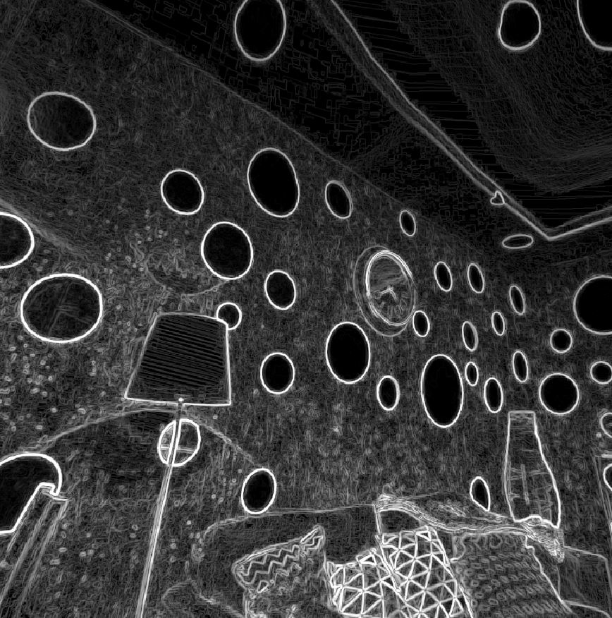
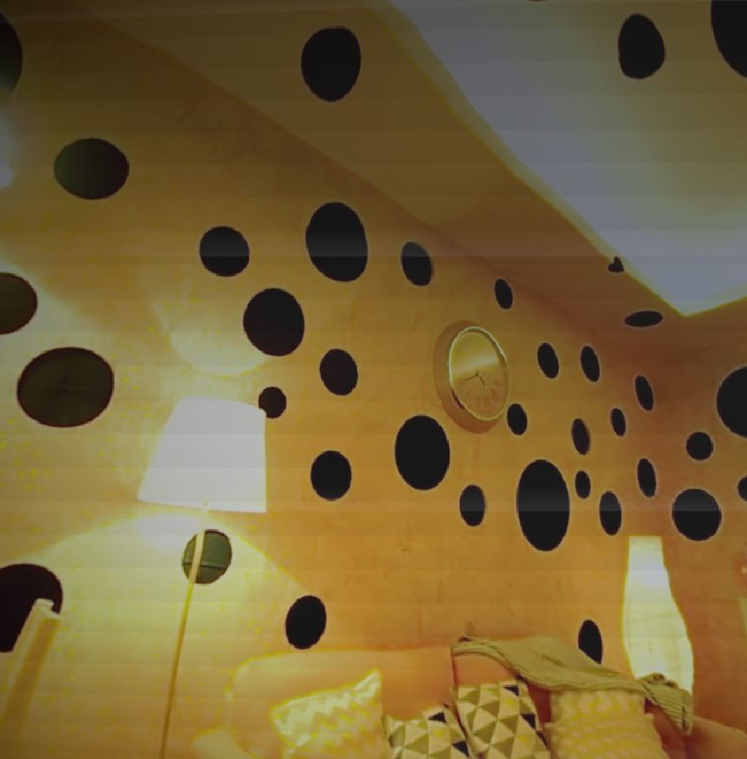
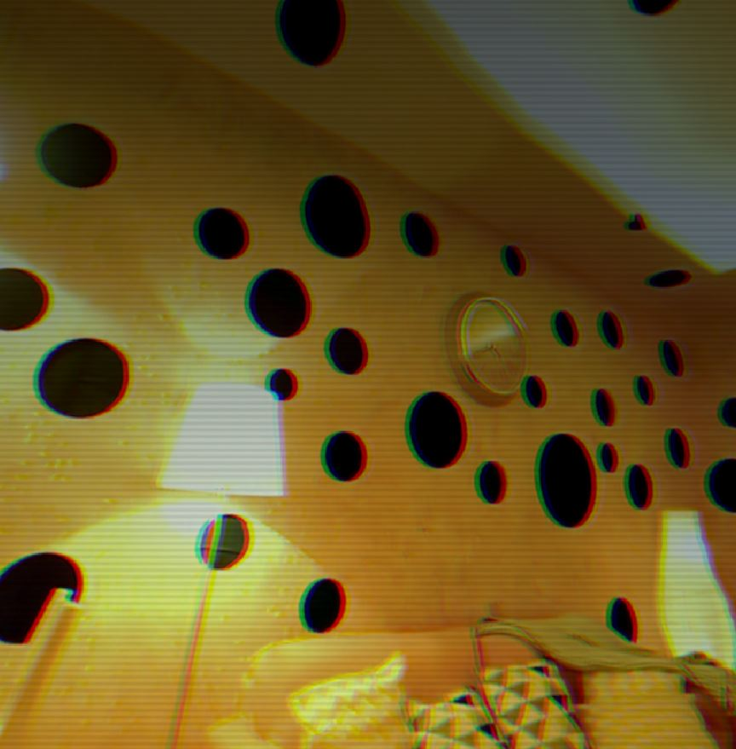
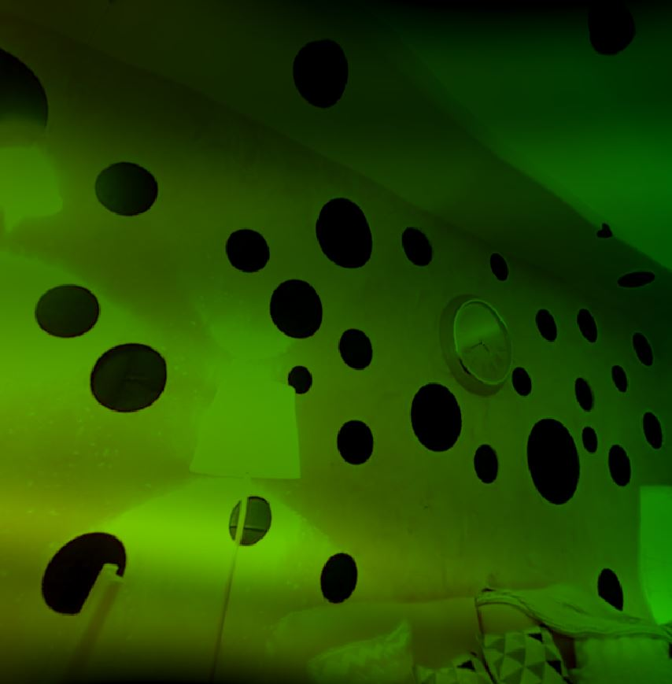
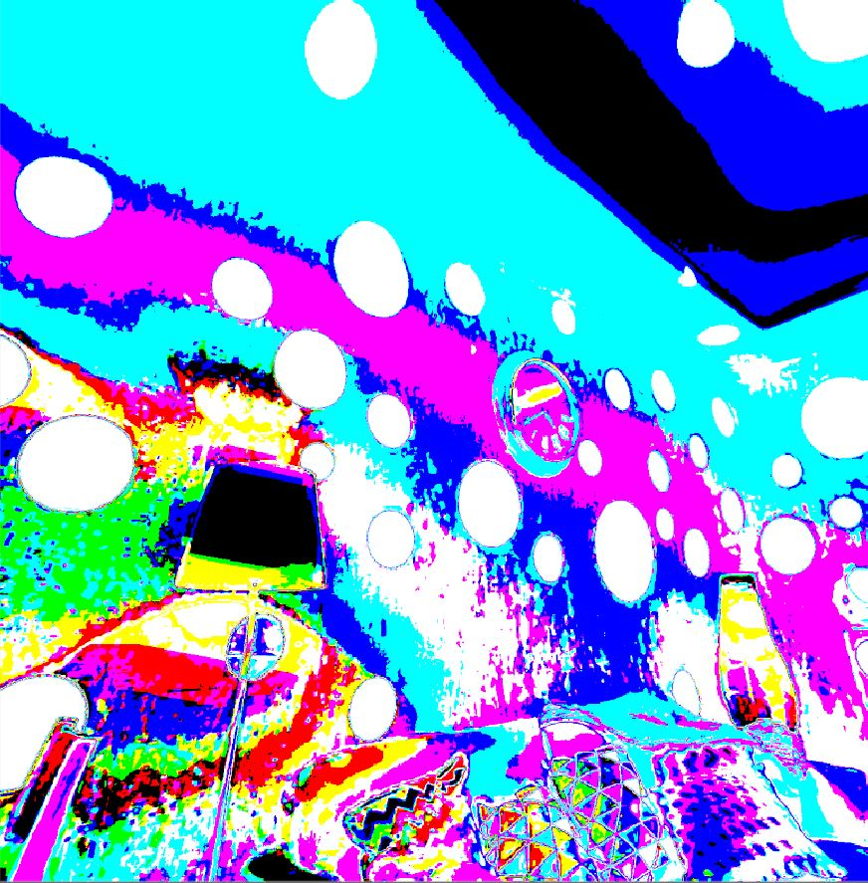
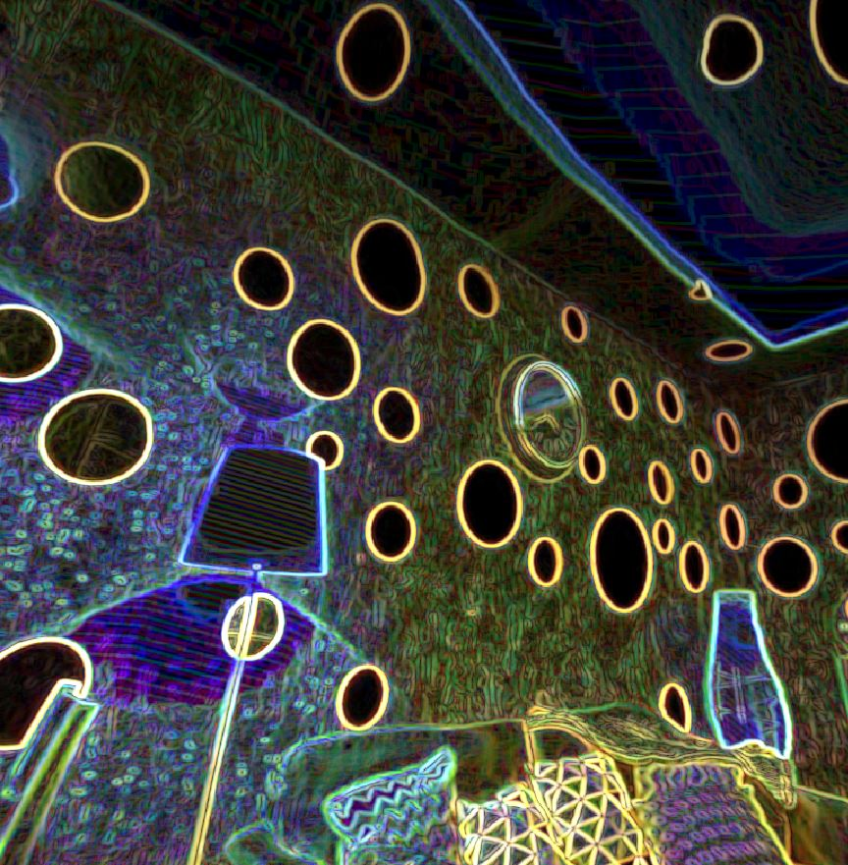
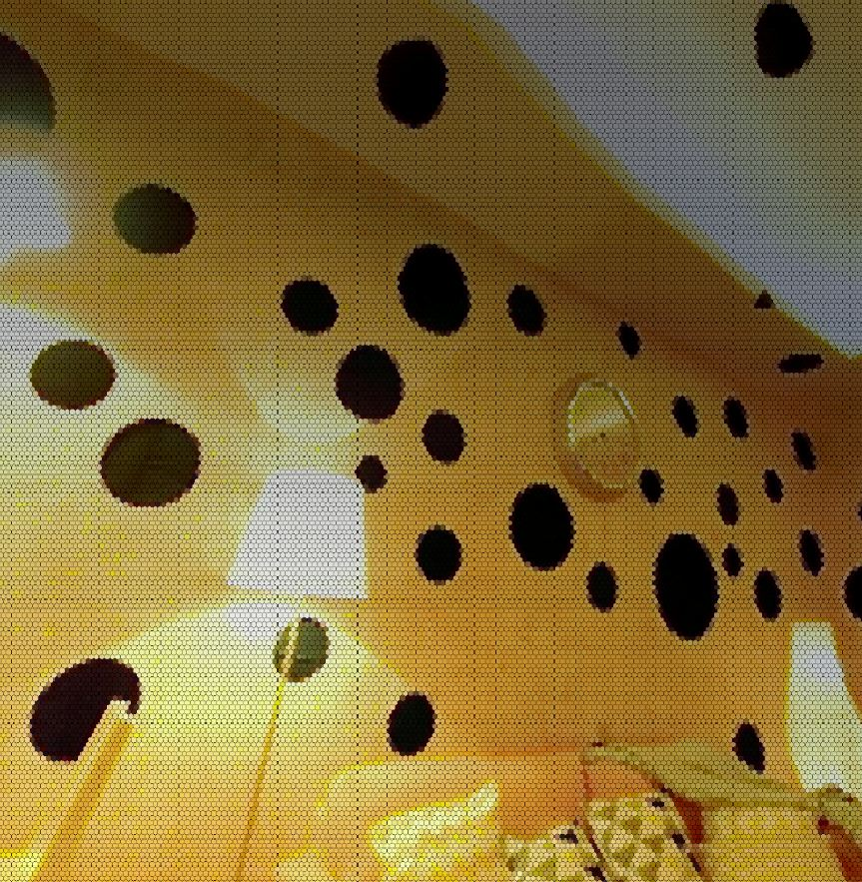
Cool Effects
Sobel
VCR
Vintage
Rainbow
Psycho
Neon
Hexagons
Grey
Waves

Slide 12
Thank You
VR
360$°$ Video Editing

