Slide 1
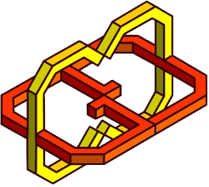
Whack a mole – vr project
Mirit allush
Or gitli
Tal pilo

Slide 2
Overview
Whack a mole vr
We developed a VR game based on the common arcade game “Whack a mole”.
The levels are against the clock, and the goal is to hit as many moles or ghosts as possible and avoiding obstacle.
We added features to the game (that wasn’t in the original game) and adjusted these features and the exiting ones to the VR experience

Slide 3
System & Technologies
Whack a mole vr
We developed the project using Unity 2017.03 – graphic engine, scripted with C# in Visual Studio 2017.
Equipment required:
HTC VIVE headset
Manus VR – one pair of gloves , sensors to track hand movement and one wireless dongle.

Slide 4
The game
Whack a mole vr
The application consist of three scenes for the user to navigate:
Menu
Classic level scene
Advanced level scene
There are several kinds of sounds and new .features we added the game

Slide 5
The scenes - menu
Whack a mole vr
Allows the user to:
Read the game instructions
Choose difficulty level – classic level is the easy one or the advanced level.
Each choice in the menu has the feature of the level gameplay.
The instruction allow the player to understand both of the games rules.

Slide 6
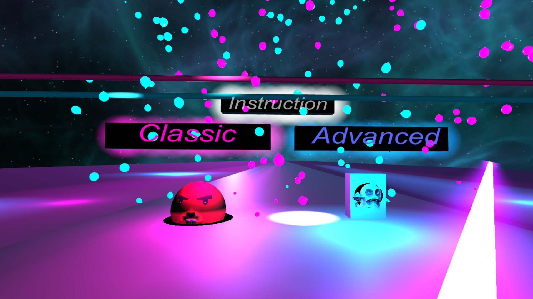

Slide 7
The scenes – classic level scene
Whack a mole vr
The main feature in the first level were created in "Blender“. We used it to make the moles, room and the "Whack a mole" arcade machine which contains the moles.
By making a fist, the player replace his glove with a hammer, with this hammer you can achieve point by hitting the moles whenever they comes out. As the countdown reaches to zero, the moles stop to come out and the score is displayed on screen.
At first the moles will come out in a slow pace and the interval between each mole that come out is quite long. As the time decrease, the more often the moles will comes out and much faster.

Slide 8
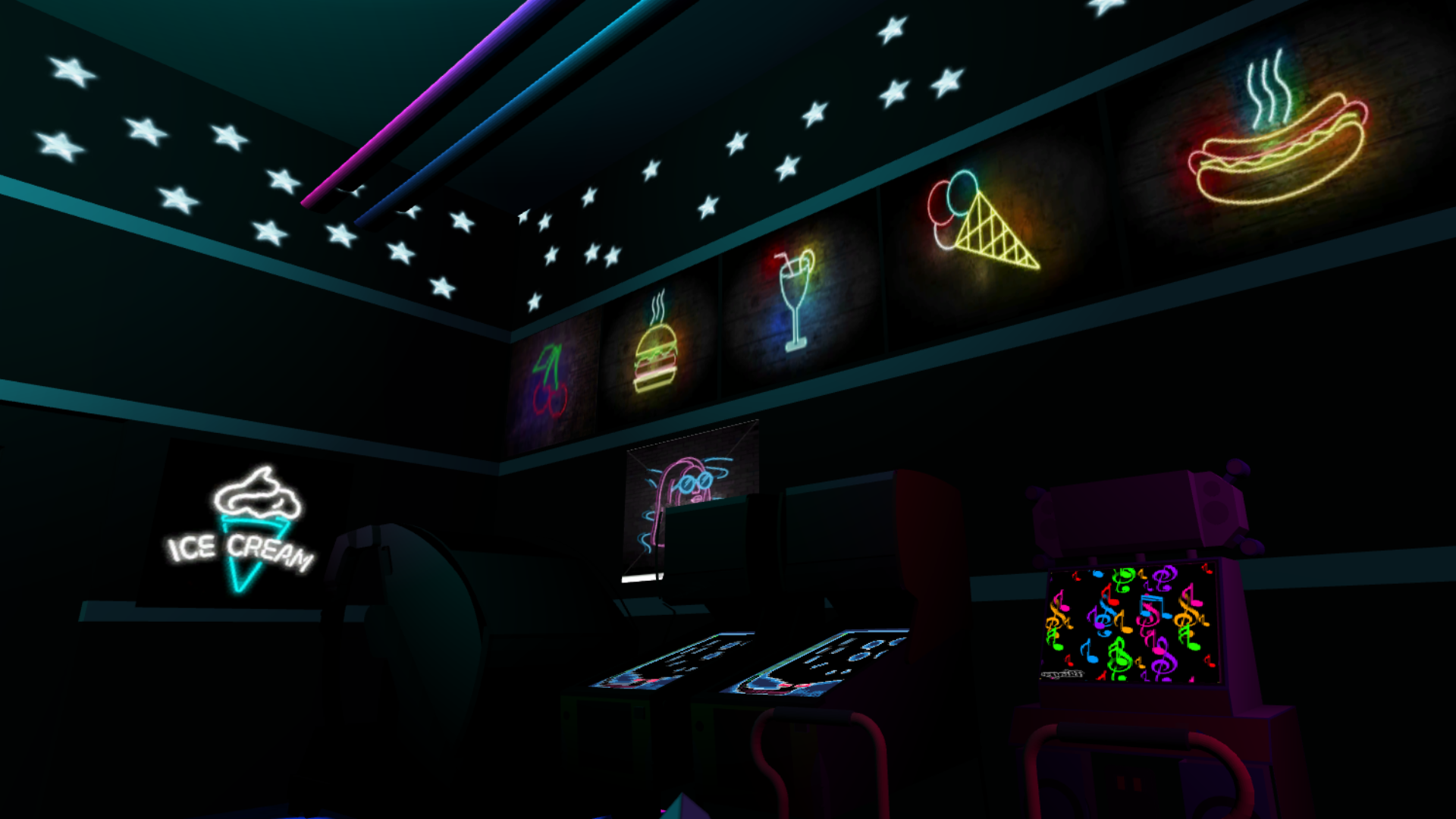
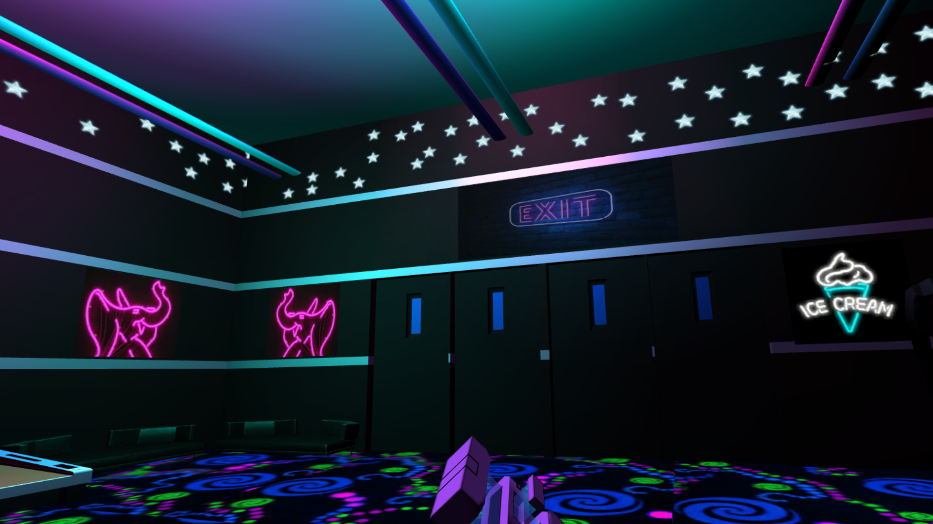
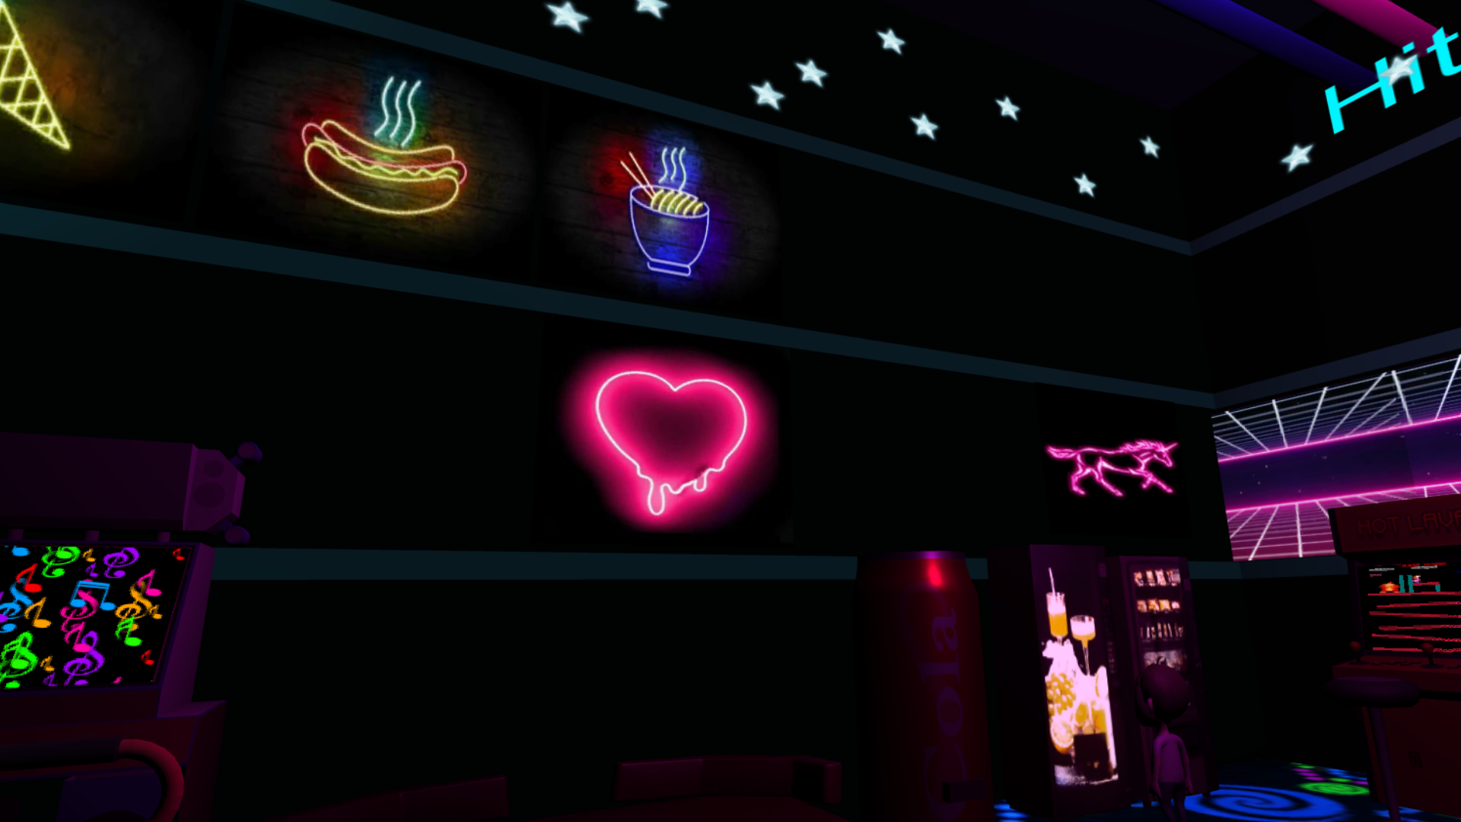

Slide 9
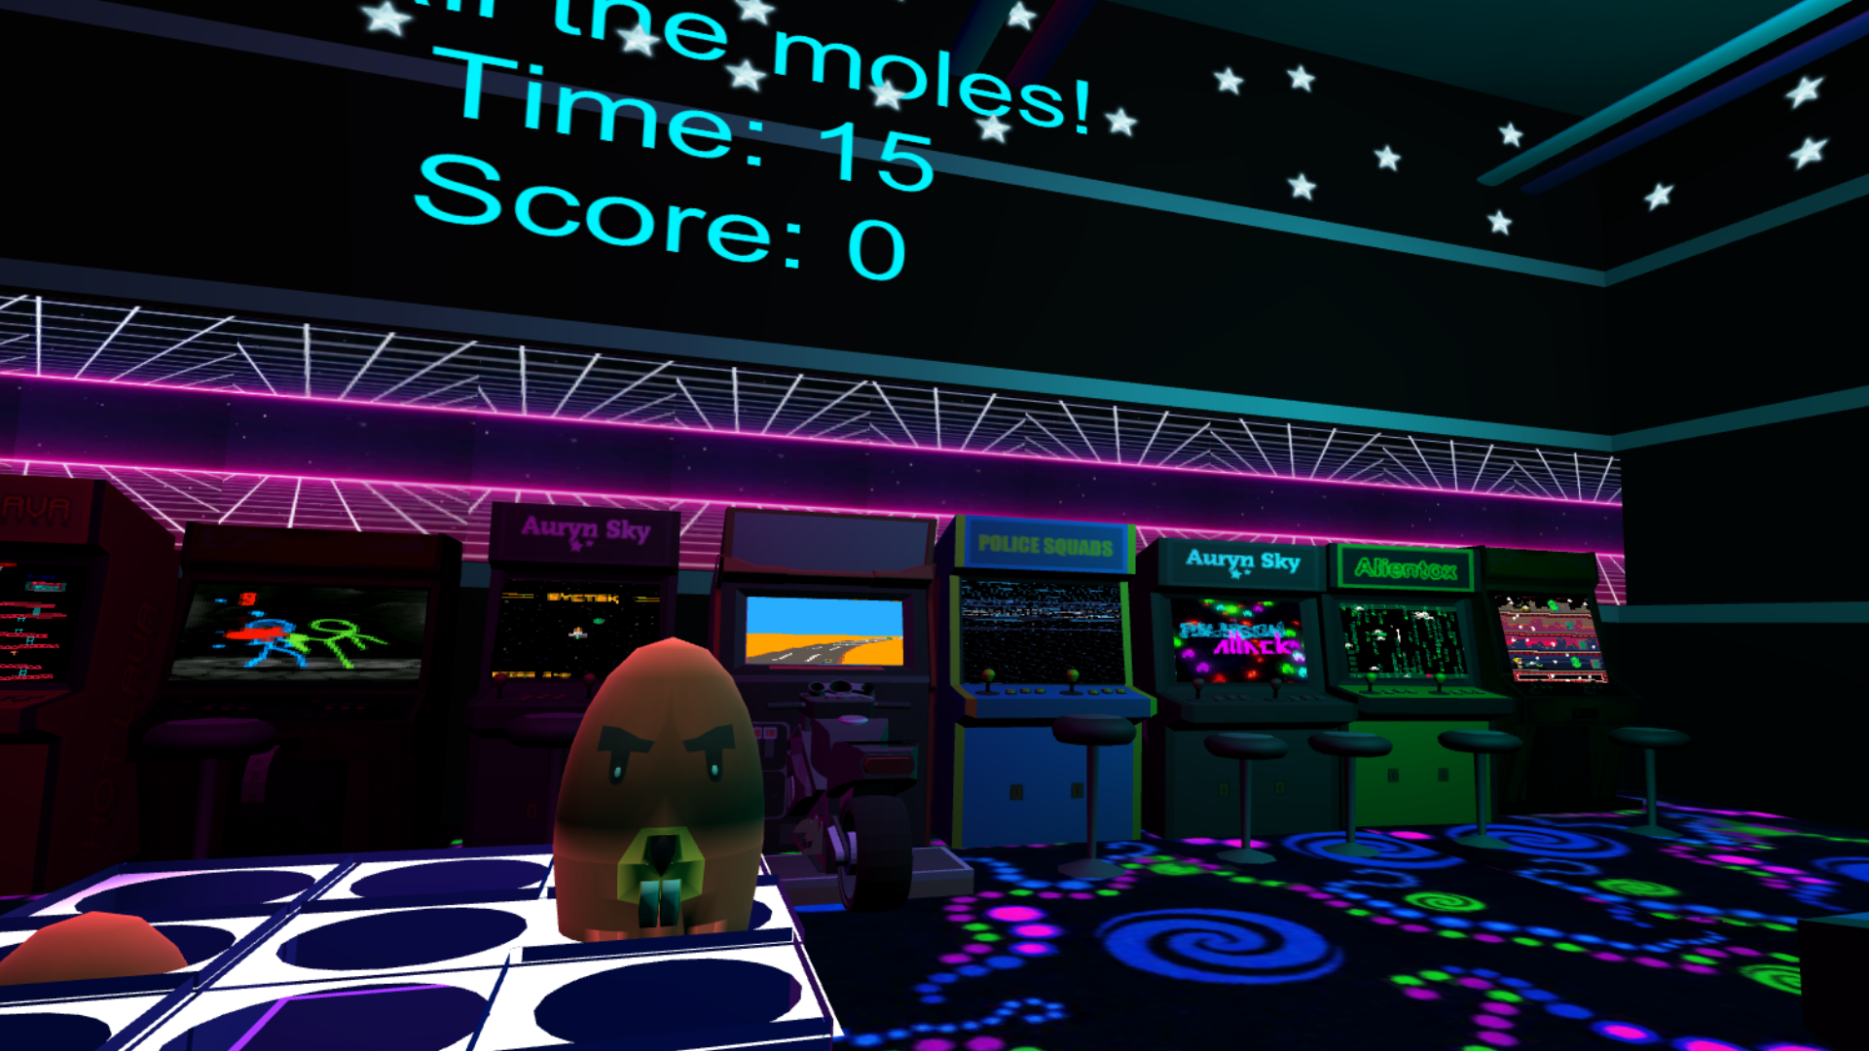
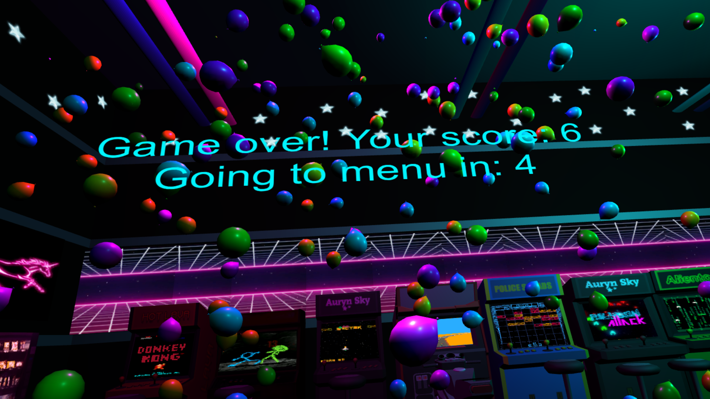

Slide 10
The scenes – advanced level scene
Whack a mole vr
In this level, opposed to the classic one, we have control on both of the gloves.
The room has seven pillars, each pillar has three holes. Ghosts come out randomly from the holes toward the player direction.
The player need to punch ghosts as much as possible within the time limit and each hit grant him one point. At random times bombs and clocks are coming out from the holes. The player need to ignore the bombs- if he hit one, three point is reduced from the score. If the player hit a clock, five seconds is added to the time limit. In the end, like the classic level, the player goal is to get as much point as he can until the countdown reaches to zero.

Slide 11
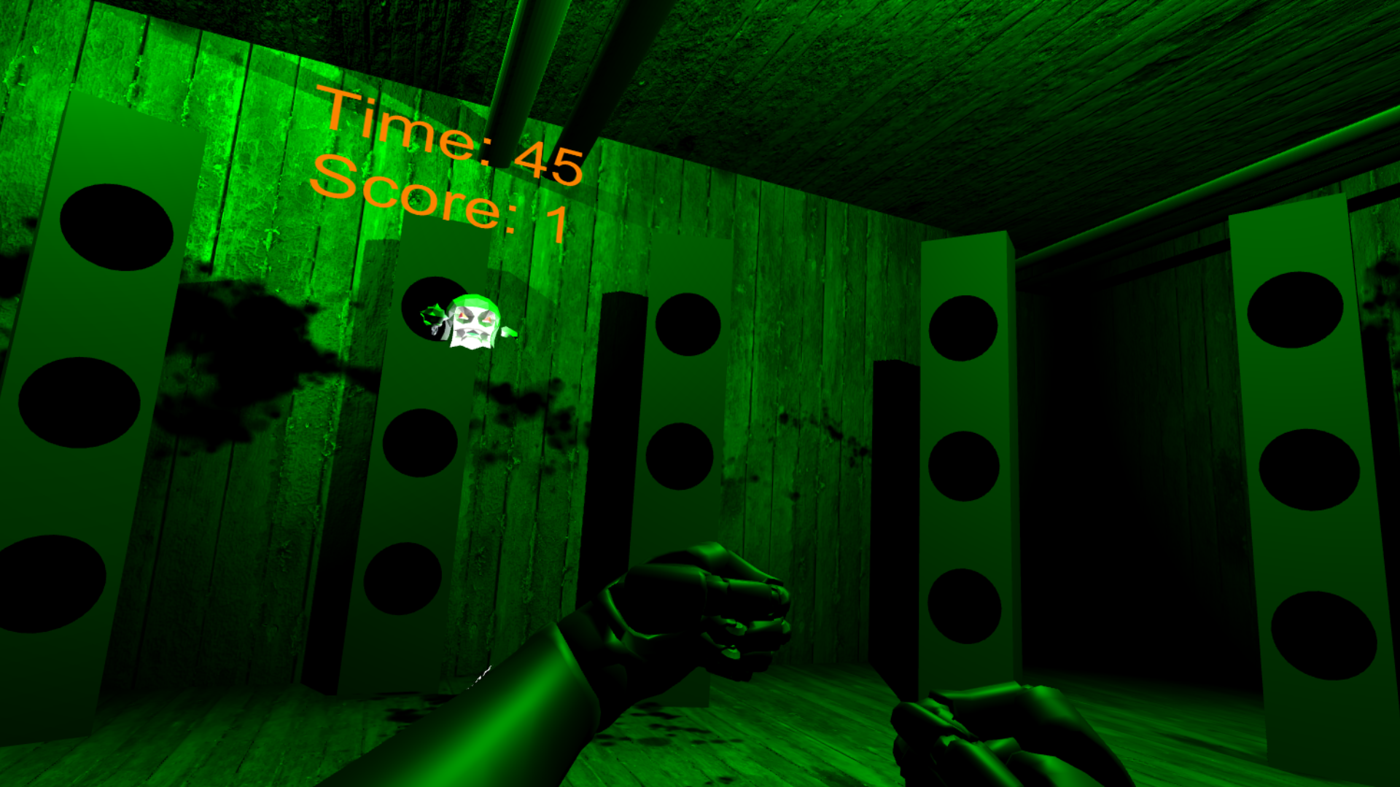
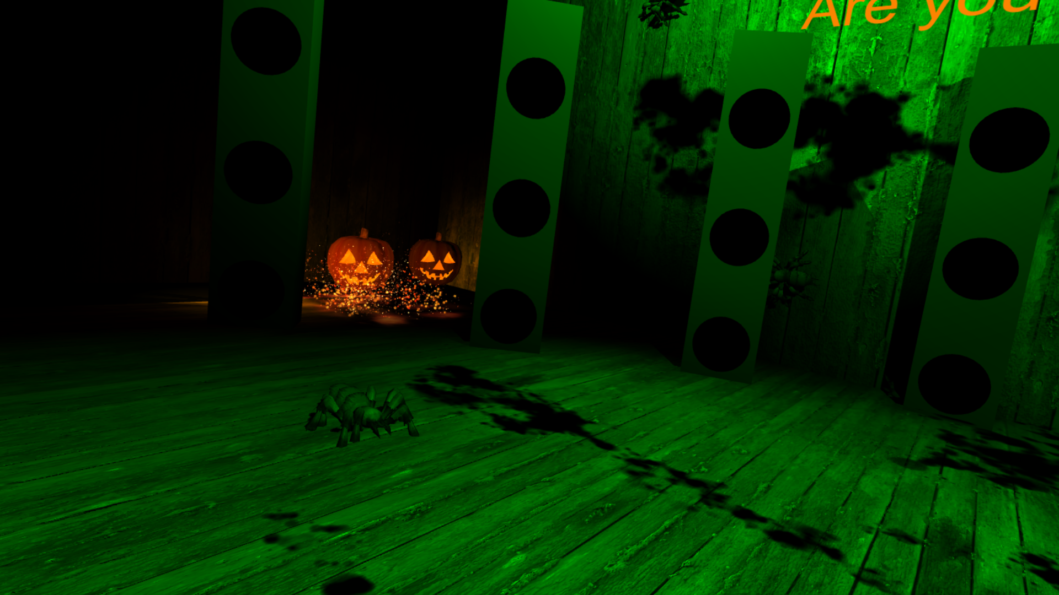
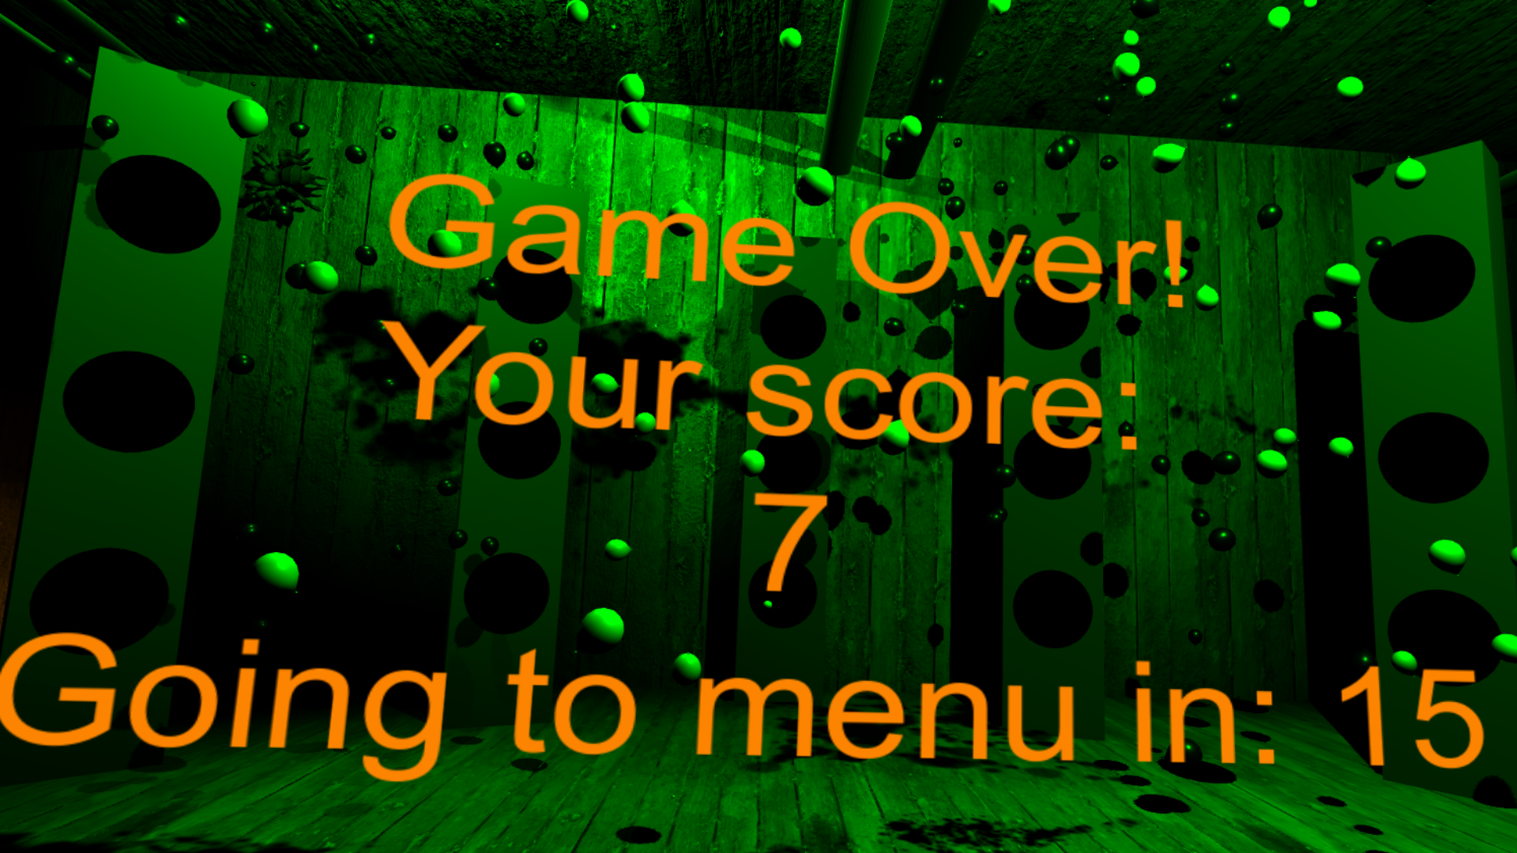
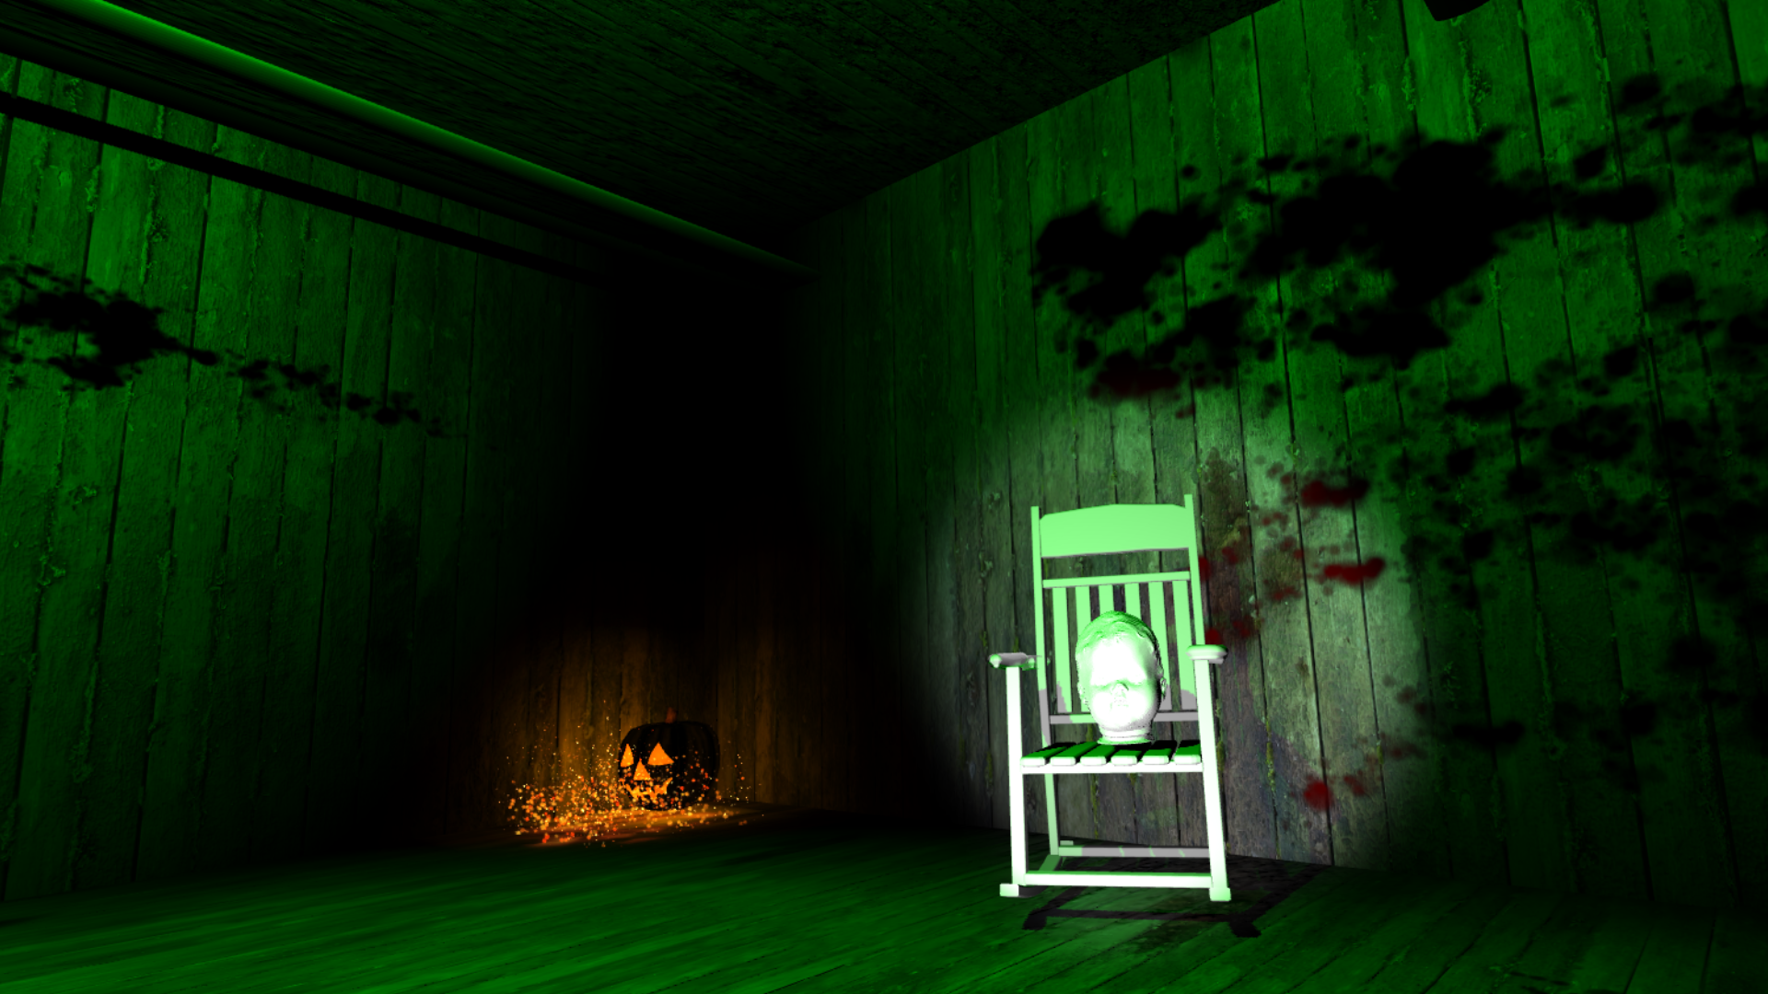

Slide 12
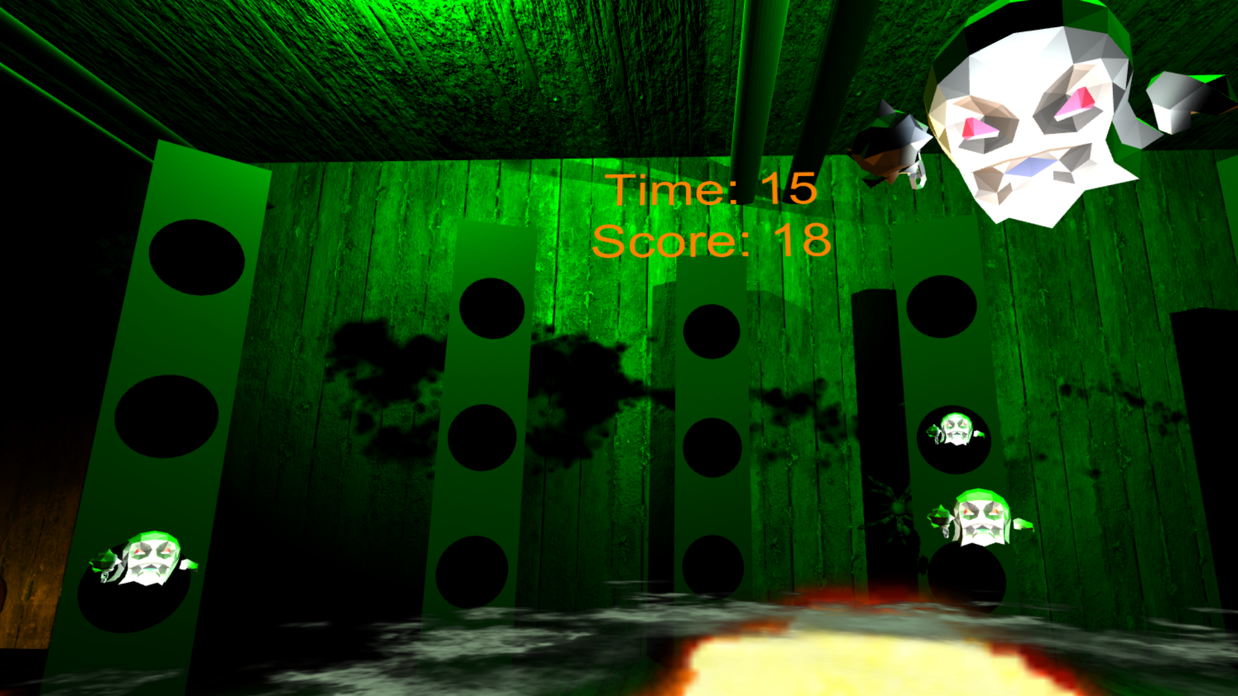
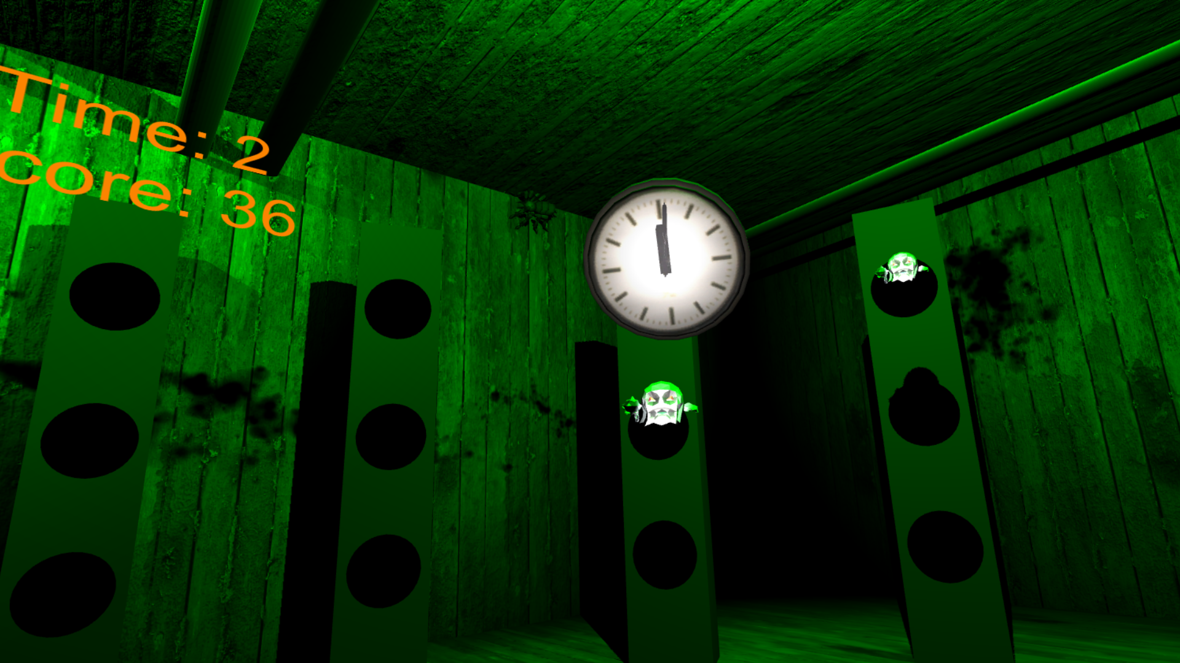
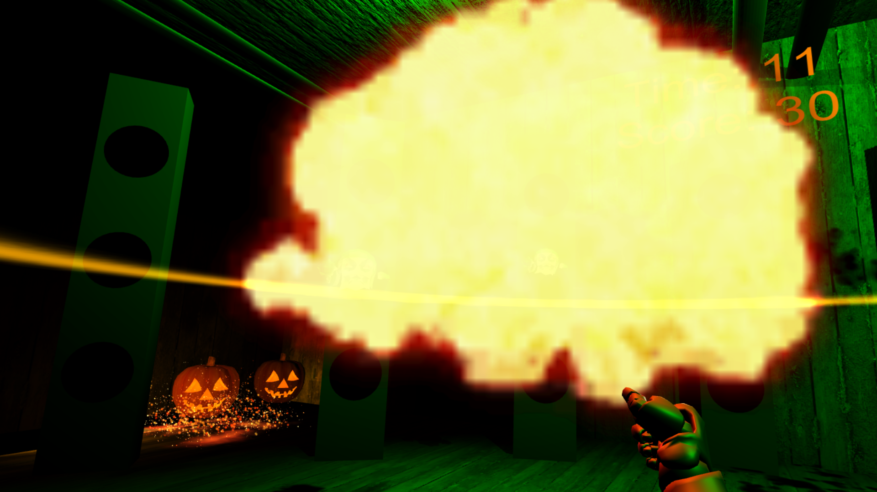
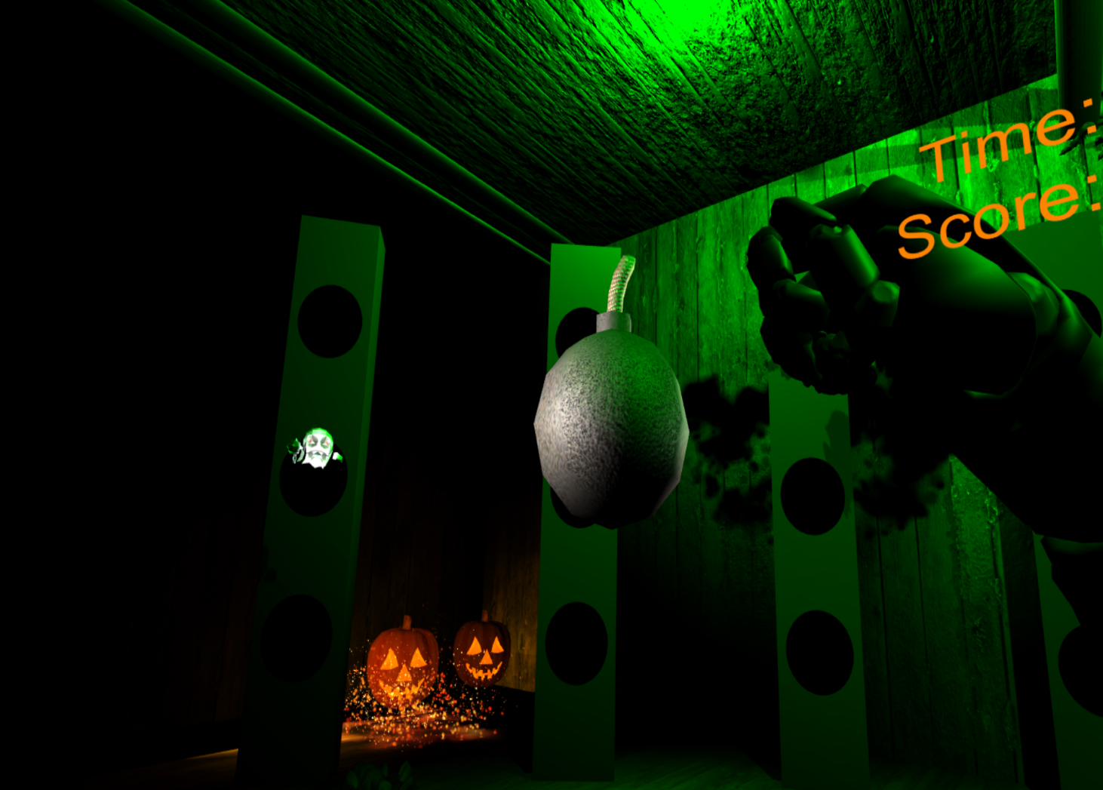

Slide 13
Let's play !

