Slide 1
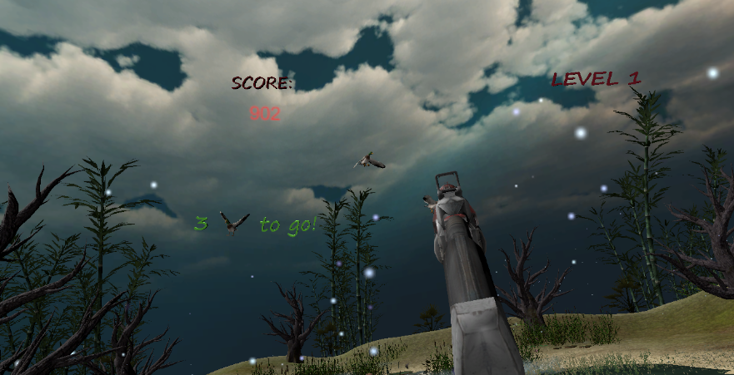
Duck hunt revolution -the VR game-
Rotem Ohana
Snir Zango
Or Harchol

Slide 2
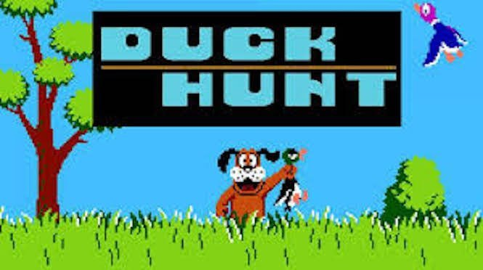
Overview
Duck hunt revolution
A VR game that is based on the nostalgic Mega-Son game “Duck Hunt”
The player’s main goal is to kill as many ducks as possible and get points, the speed of hitting the ducks is also a factor
We added another environment to the game (that wasn’t in the original game), a zombie mode, and adjusted both to the VR experience

Slide 3
System & Technologies
Duck hunt revolution
We created a game that runs on computer and played with VR gear, targeted for HTC VIVE
The application developed using Unity 2018.2.6F1 game engine
Equipment required
HTC VIVE headset
HTC VIVE right controller
HTC VIVE left controller

Slide 4
The game
Duck hunt revolution
This game can be played with one or two controllers
Pressing the controller’s trigger to choose the game preferences (in the game’s Garage scene menu)
Pressing the controller’s trigger in order to shot
The game consists 3 scenes for the user to navigate
Garage Menu
Classic Play Mode
Zombie Play Mode
There are several kinds of sounds and new features we added to the game

Slide 5
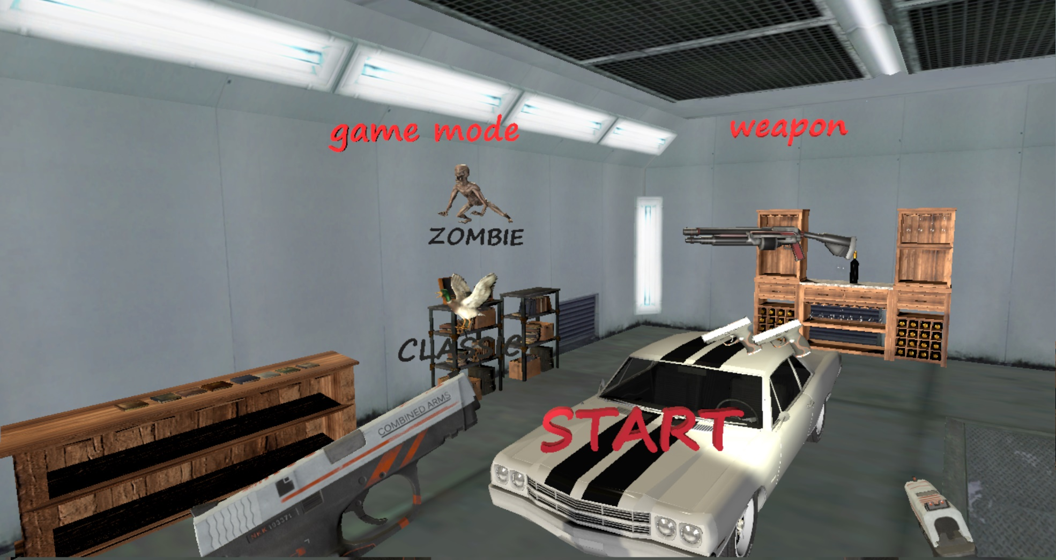
The scenes – Garage menu
Duck hunt revolution
Allows the user to:
Choose the game mode
Get his weapon of choice

Slide 6
The scenes – classic play mode
Duck hunt revolution
The user can see his score and the level he’s in at all time
The user is waiting for the hunting dog to go and get those duck fly
Once the ducks are airborn, user’s goal is to hit them
Score is updated constantly
When the pistols are chosen, the user can shot simultaneity on both
This scene has other uniqe objects as a part of the background, such as trees and flowers

Slide 7
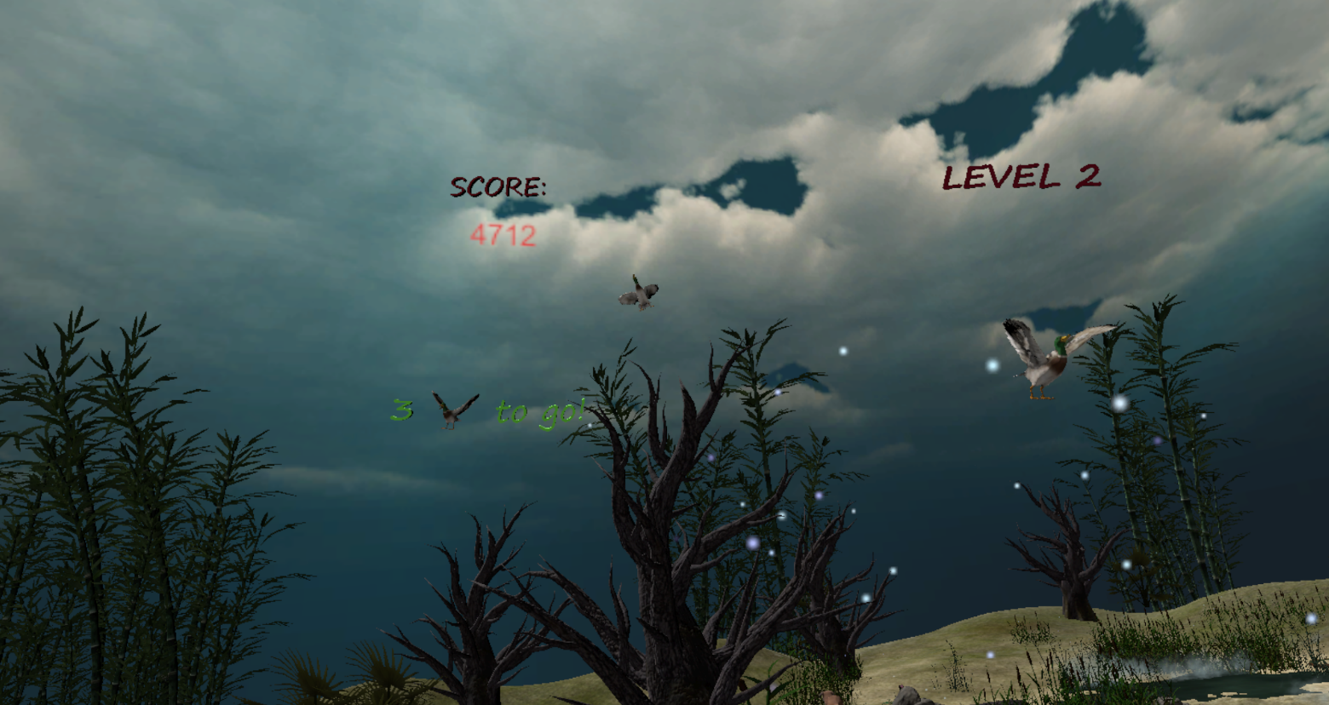
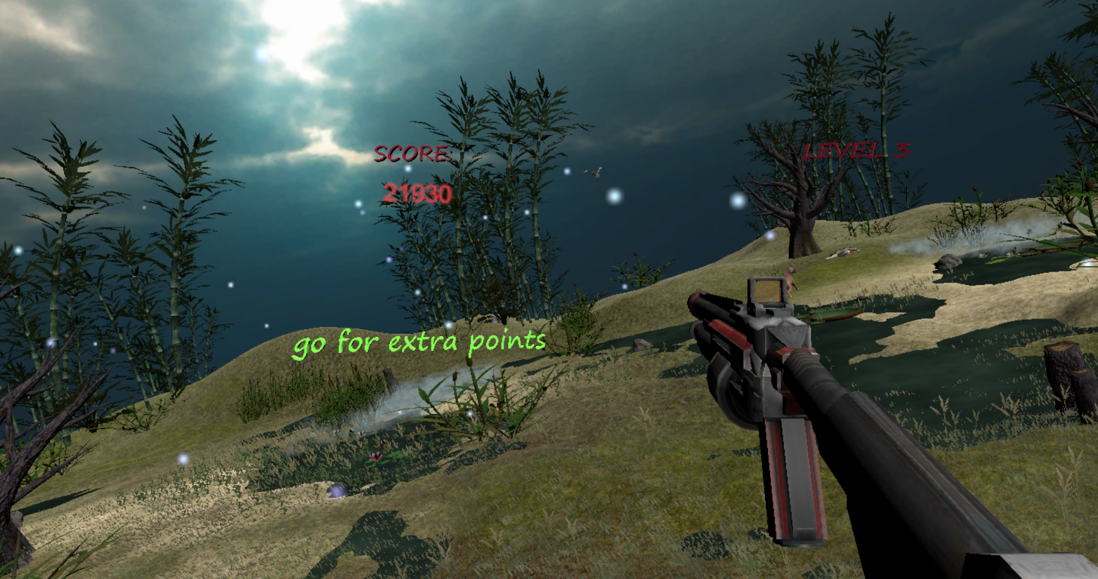
The scenes – classic play mode
Duck hunt revolution

Slide 8
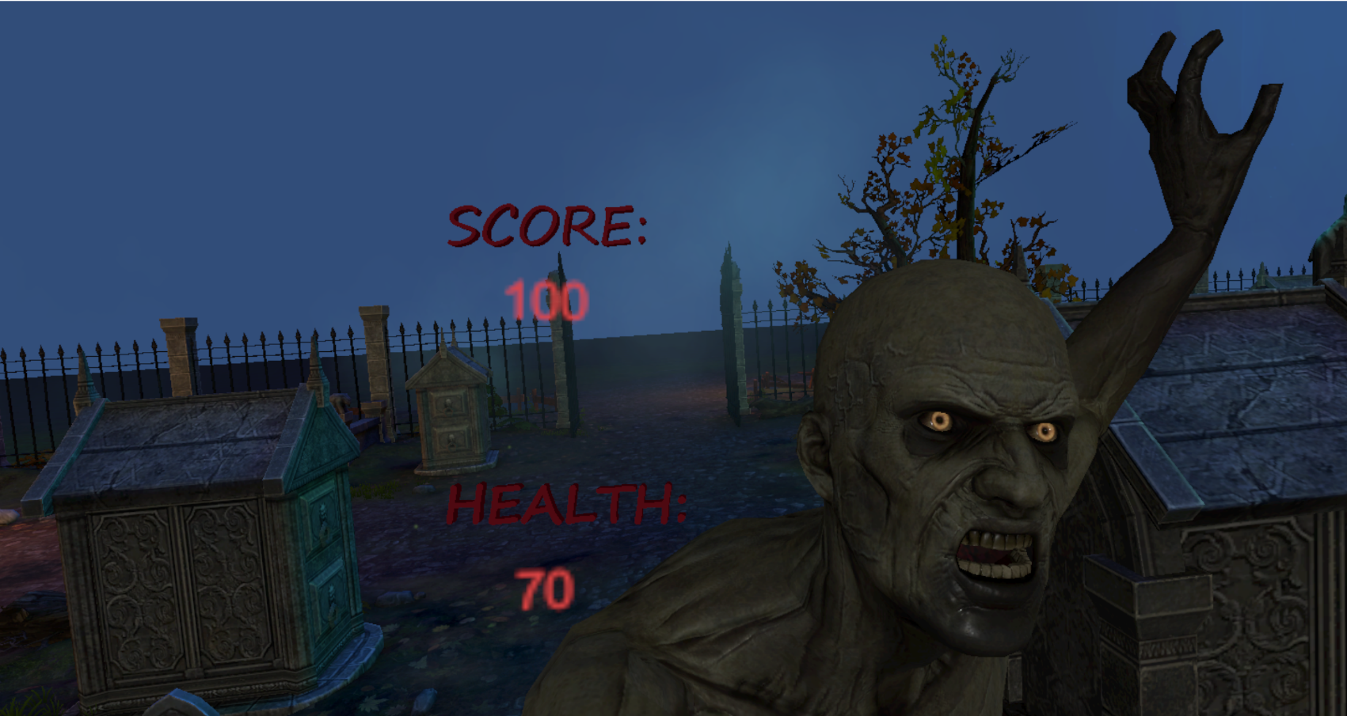
The scenes – zombie play mode
Duck hunt revolution
This mode is an adaptation we created to the classic mode
This time the user should protect himself by killing zombies
Once the user see a zombie walks through him his goal is to shot him and get points
The more zombies you shoot, the more zombies will come towards you

Slide 9
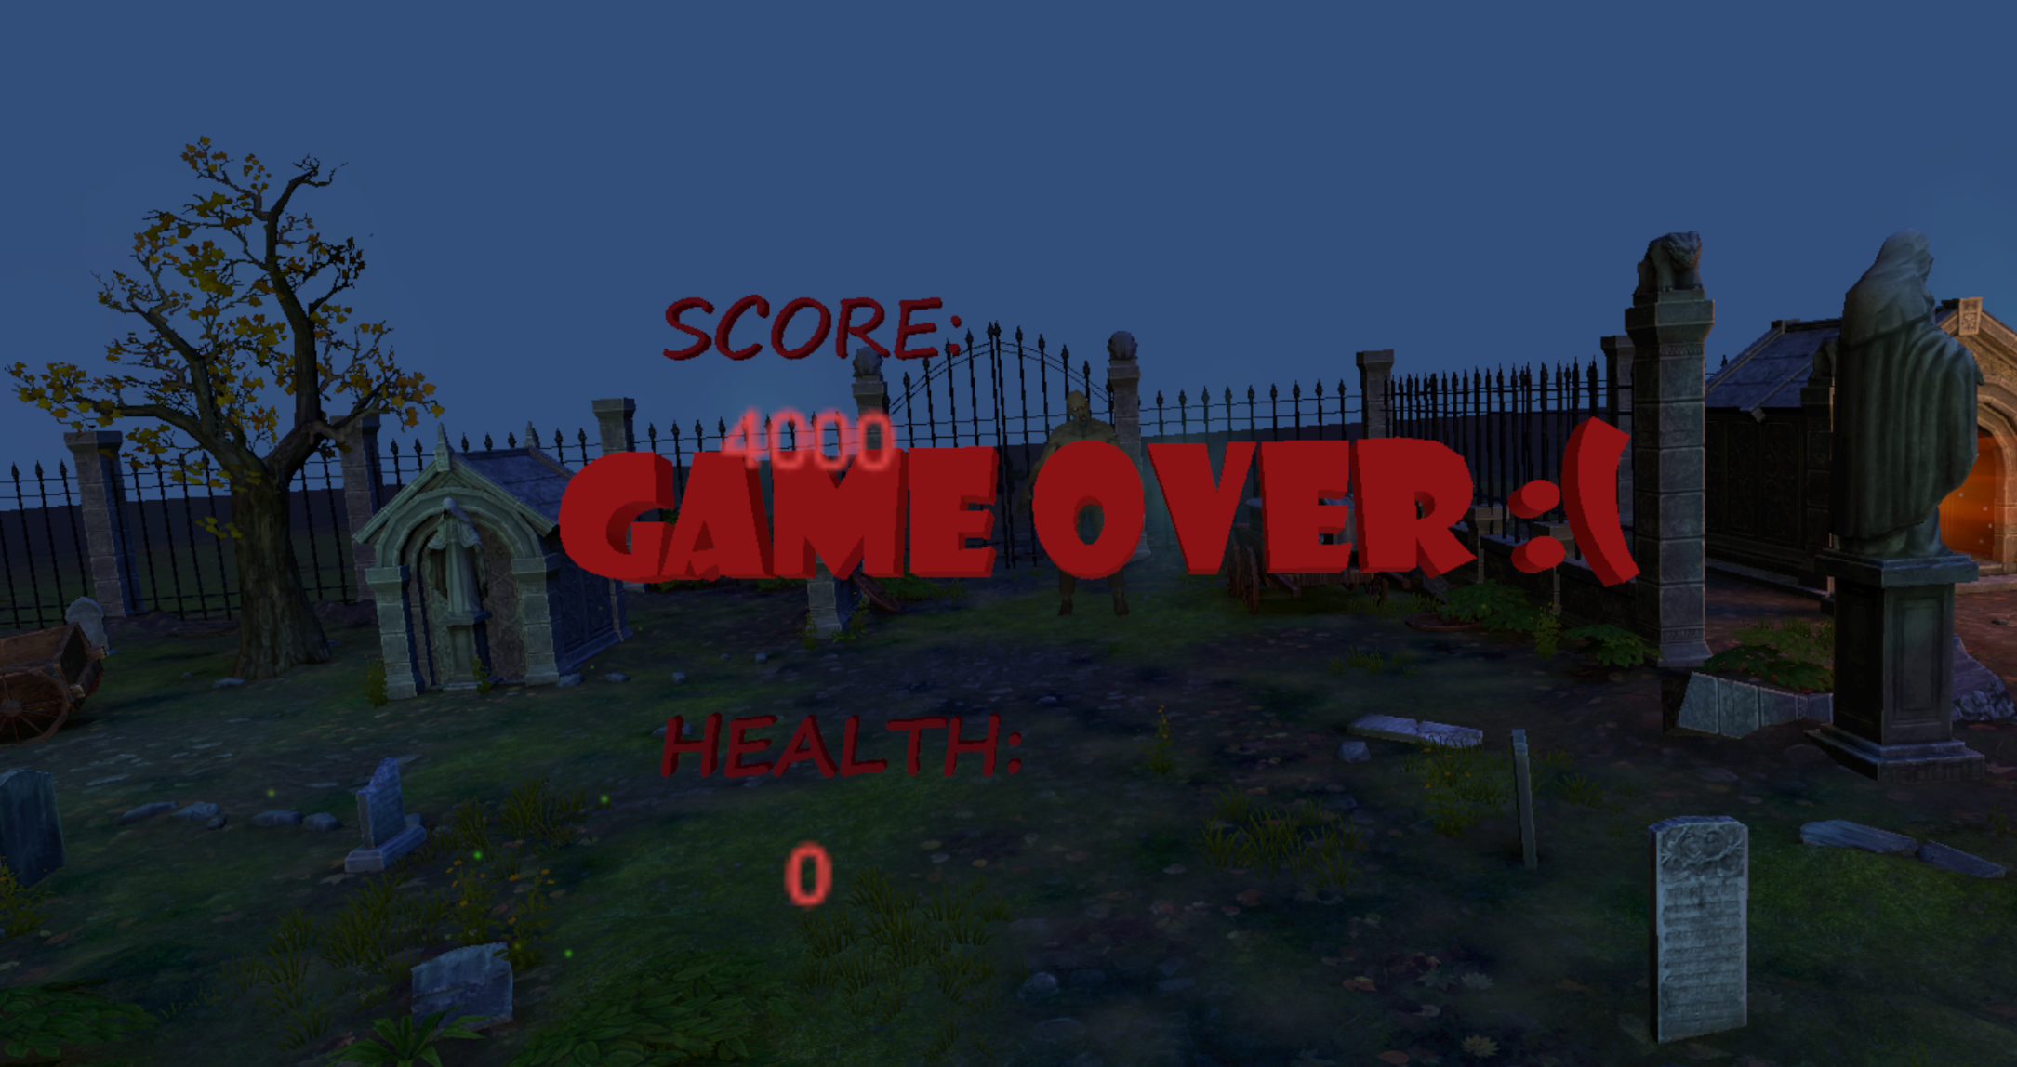
Check our website
Duck hunt revolution
https://orharchol.wixsite.com/duck-hunt

