Slide 1
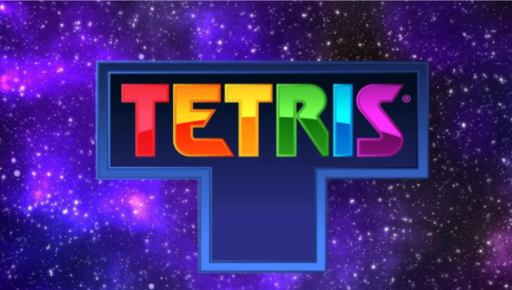
VR Tetris Project
By Naama Glicksberg and Gai Lazar
Supervisors: Yaron Honen and Boaz Sternfeld

Slide 2
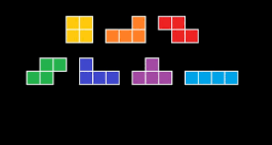
Who are we?
We are Gai and Naama, students in the last semester in the computer science faculty in the Technion – Israel's Institute of Technology.
During our studies at the Technion, we worked as partners in many courses, so it was clear to us that we would work together in our final project. When we heard about the project in the lab, which includes building a virtual reality game, we were very excited and decided to choose it.

Slide 3
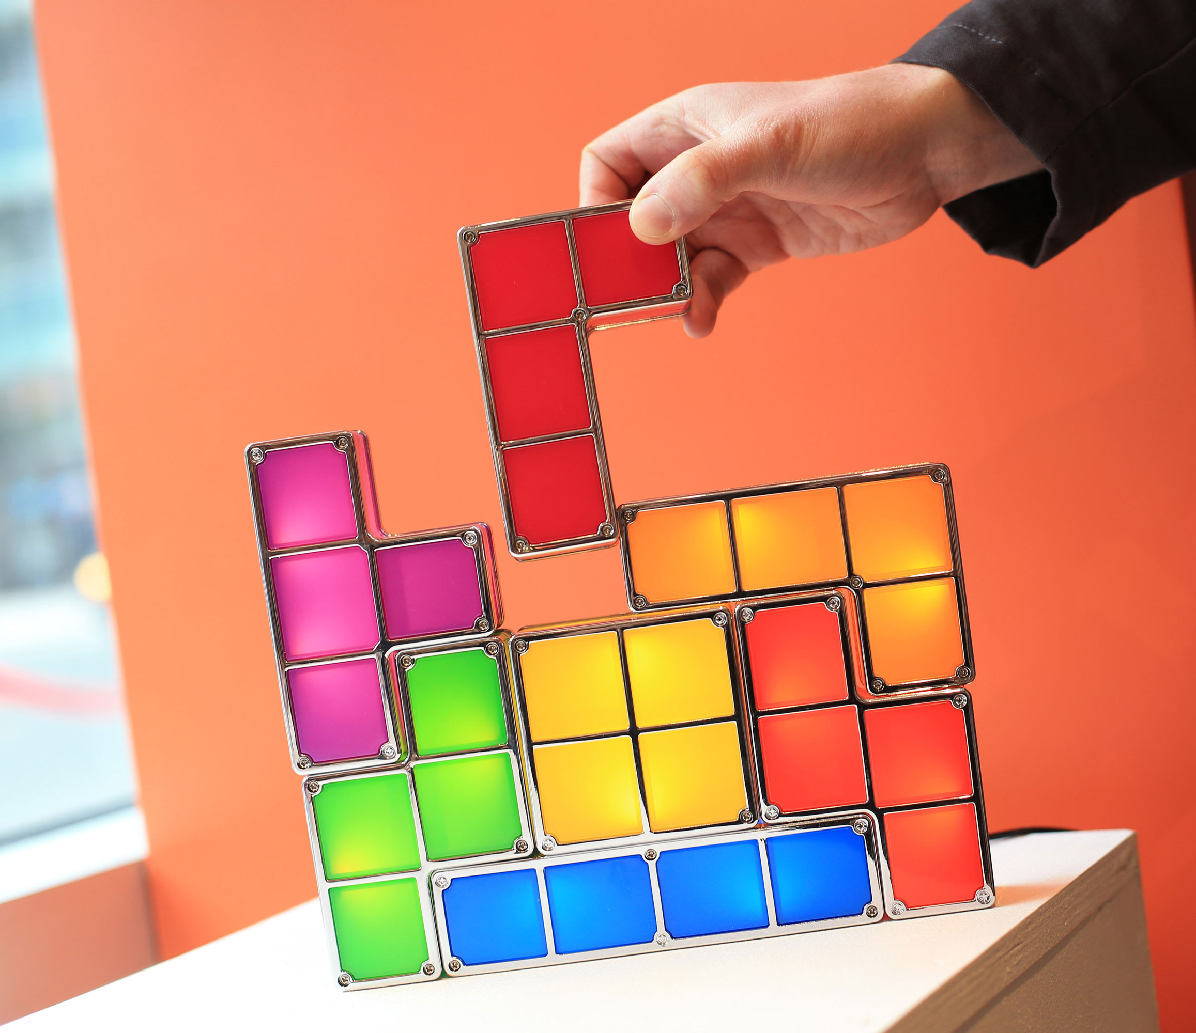
Why Tetris?
Tetris is a simple and fun game that has been familiar to everyone for years. We thought that turning the game into 3D, so that the game cubes are flying around the room in front of the player could be very interesting and fun!
We have participated in a Virtual Reality project, conducted by Mr. Yaron Honen and Mr. Boaz Sternfeld.
The project was fun and experiential, teaching and mostly satisfying.

Slide 4
Main Goal
Creating a new and adventured version for a game that we all love with 2 game modes:
Sitting
Walking

Slide 5
So…let’s play!

Slide 6
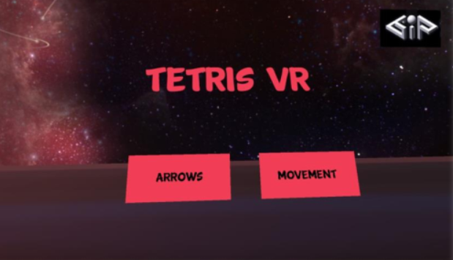
Menu
Movement: the Tetromino will move according to the controller position in the room.
Arrows: the Tetromino will move according to the touchpad clicking.

Slide 7
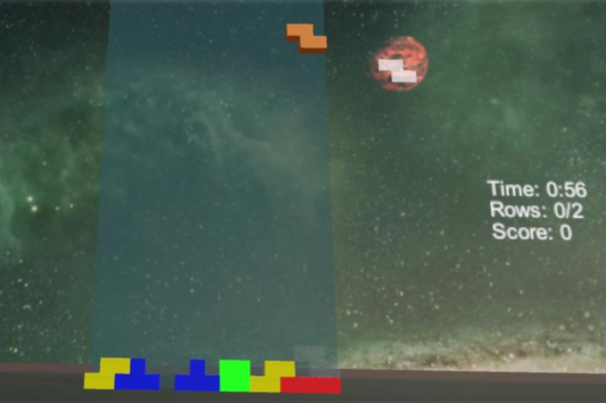
Movement Mode
In this mode the player is playing while standing.
The Tetromino will move according to the controller position.
Full line will disappear and provide points.
If the player will get 2 points he will win the game.
After 2 minutes the game is over.

Slide 8
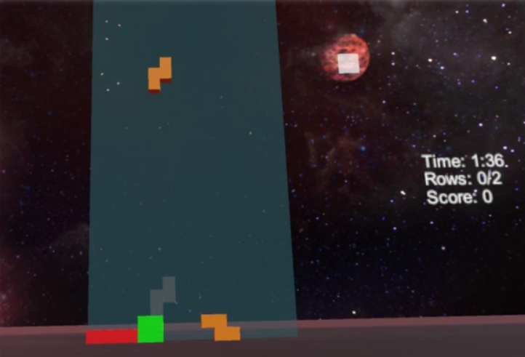
Arrows Mode
In this mode the player is playing while sitting.
The Tetromino will move according to the controller tuchpad.
Full line will disappear and provide points.
If the player will get 2 points he will win the game.
After 2 minutes the game is over.

Slide 9
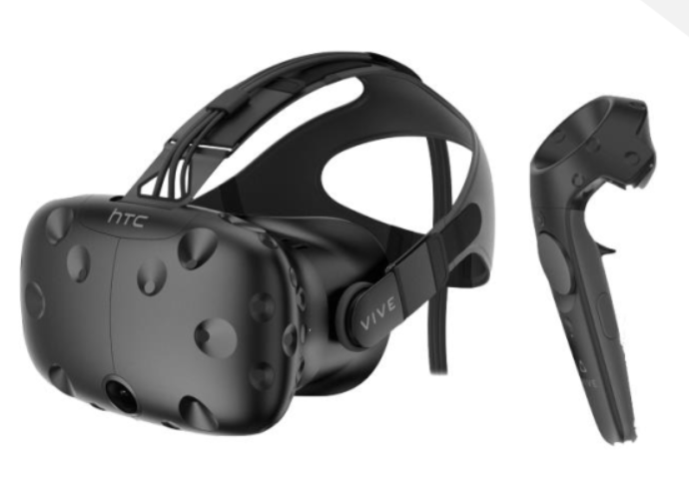
Technology
Headset HTC VIVE
Controllers HTC VIVE

Slide 10
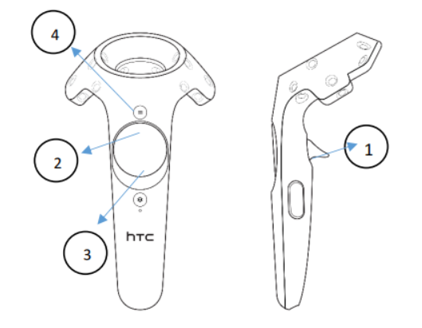
The Tetris Controller
Movement:
Let the tetromino fall down.
Flip the tetromino.
Move the tetromino down.
Go back to menu screen.

Slide 11
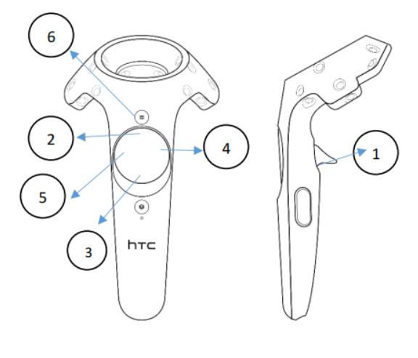
The Tetris Controller
Arrows:
Let the tetromino fall down.
Flip the tetromino.
Move the tetromino down.
Move the tetromino right.
Move the tetromino left.
Go back to menu screen.

Slide 12
Development environment
HTC VIVE
UNITY
Visual Studio

Slide 13
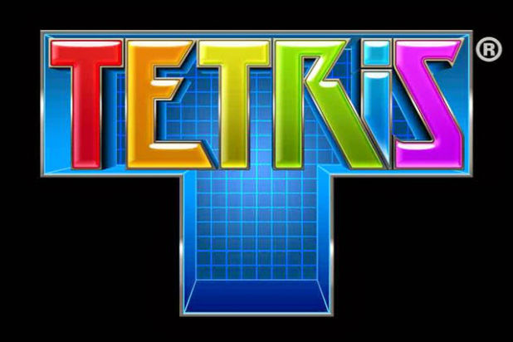
hank You!

