Slide 1
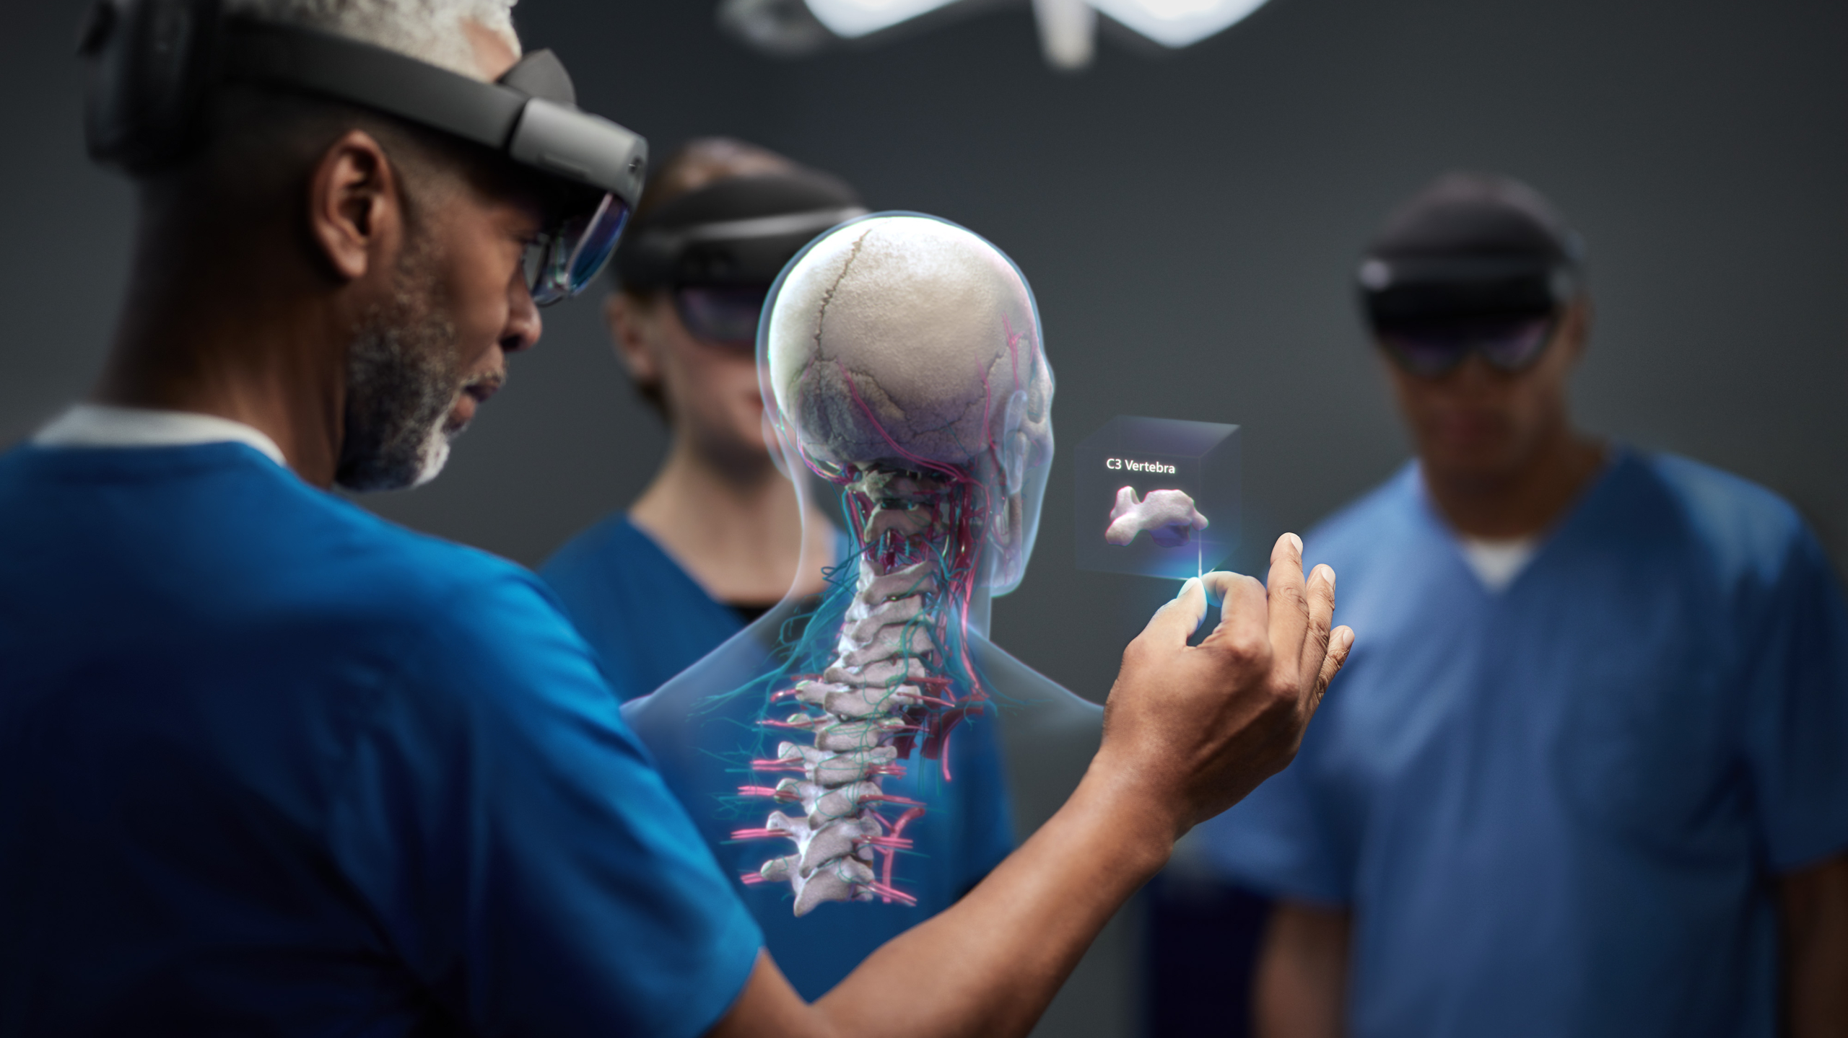
AR PROJECT SHEBA COLLABORATION Final Presentation
Students: Silvan Marti, Adriana Ester Dolgin, Zahi Cohen, Noy Gini
Supervisors: Amit Bracha, Ron Slossberg,
Yaron Honen
Semester: Spring, 2021

Slide 2
Project Goal
Using the HoloLens 2 AR abilities to improve the introduction of the needle to the patient’s low back.

Slide 3
Development tools
Visual Studio 2019 (16.8) – For running the HoloLens 2 SDK.
Windows 10 SDK – includes HoloLens 2 SDK
HoloLens 2 Emulator – For running applications on a HoloLens virtual machine image without a physical HoloLens.
Unity 2020 – real-time development platform
Mixed Reality Toolkit (MRTK) - development kit for mixed reality applications.

Slide 4
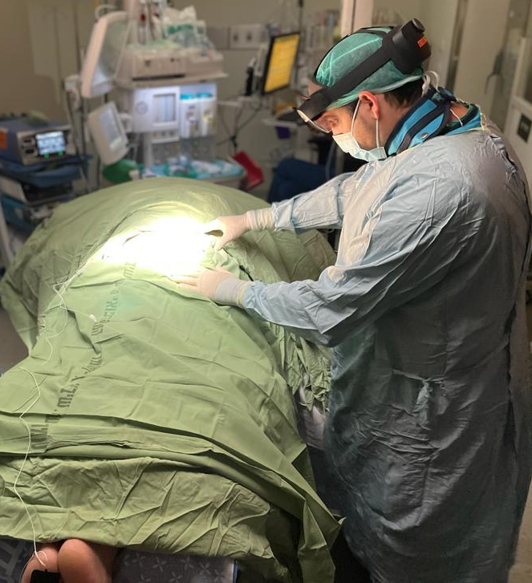
Procedure’s Main Stages
Preconfigure 3D model
Loading 3D premade model
Marking points on the model and the patient respectively
Model registration
Model fine tuning

Slide 5
Preconfigure 3D model
Split 3D model .stl file into multiple objects (skin, bones etc.) using for example blender
Export file as .fbx
Import into a unity project and create loadable asset bundle
Update model on predefined cloud location

Slide 6
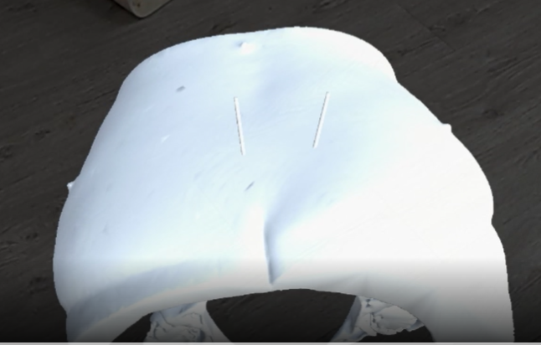
Loading 3D premade model
Loading the model during run time as a unity asset bundle using a voice command

Slide 7
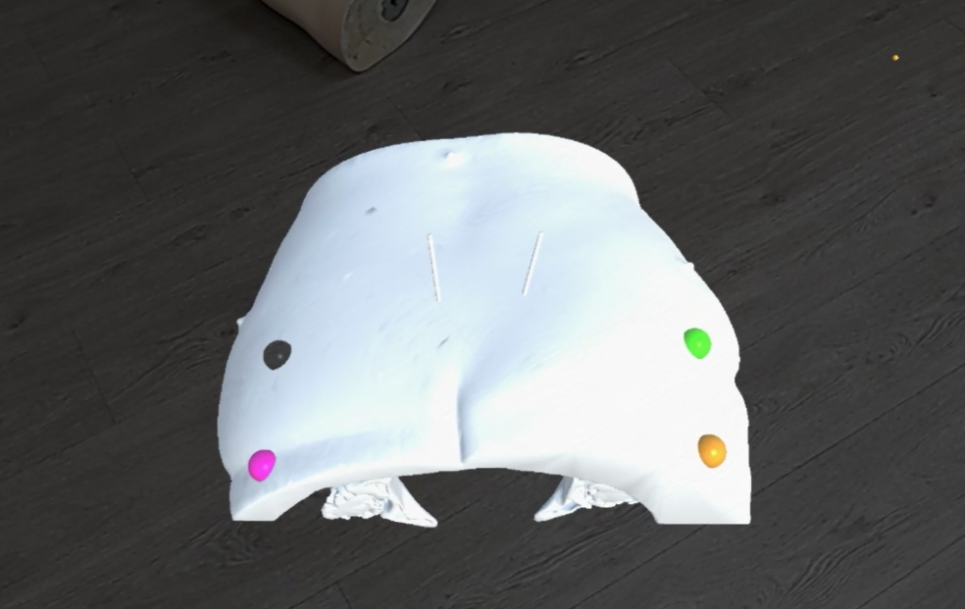
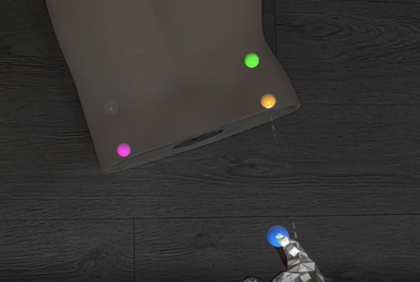
Choosing points
Using the ECG stickers’ location as the position of the points used for our algorithm
The stickers’ location will be obtained by pointing them in runtime – both on the model and the patient
The points position will be stored using voice command

Slide 8
The algorithm – introducing the problem
Given two corresponding point sets:
$$X=\left\{x_{1},…,x_{n}\right\}$$
$$P=\left\{p_{1},…,p_{n}\right\}$$
Wanted: Translation t and rotation R which minimizes the sum of the squared error:
$$E\left(R,t\right)=\frac{1}{n}\sum_{i=1}^{n}{{\left|\left|x_{i}−Rp_{i}−t\right|\right|}^{2}}$$
Where $x_{i}$ and $p_{i}$ are corresponding points.

Slide 9
The algorithm – the solution
Using SVD in order to find the desired R and t, then apply the registration according to them.

Slide 10
Improving the fit
Selecting vertices from the skin-model and the corresponding normal vectors.
Create rays (up and down) which are analyzed if they are intersecting with the spatial mesh generated by the HoloLens.
If they intersect keep the point pair, otherwise discard
Once again apply SVD-Algorithm to find t and R

Slide 11
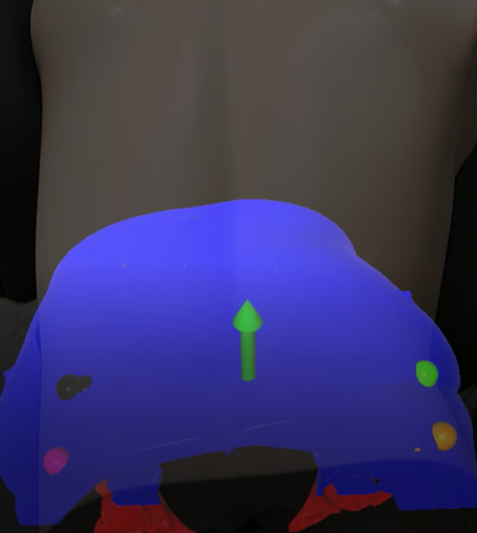
Model fine tuning
Fine tuning the model position and rotation with respect to every axis

Slide 12
Demonstration

Slide 13
Evaluation
The premade 3D model of the patient is fixed on the low back and in the right position for making the surgery.

Slide 14
Results
The HoloLens 2 sensor system was found suitable to our project needs
Recognizing the user’s finger location works properly in any light condition
The spatial mapping is done with sufficient resolution supplied by the HoloLens’s depth sensor, giving us good registration results

Slide 15
Conclusion
Low back area was found difficult for detection
Using limited manual user input proved to be an adequate approach
Help to detect ECG Stickers
Manually adjust if the automatic registration fails
Speeded up development to present a workable application, manual parts can still be improved and automated at a later stage

Slide 16
Recommendation
Using AI techniques for recognizing the stickers on the pre-made 3D model and on the patient’s low back for making the algorithm fully automatic.
Find better methods to determine the fit quality
Find a more elegant and robust way to load the 3D model

