Slide 1
Bike Fitting Using Image Processing
234329 - Project in Geometric Image Processing
Presenters: Rotem Elias & Emmanuel Ferdman

Slide 2
Agenda
Problem Description
Suggested Solution
Application Overview
Future Work
Conclusion
QA

Slide 3
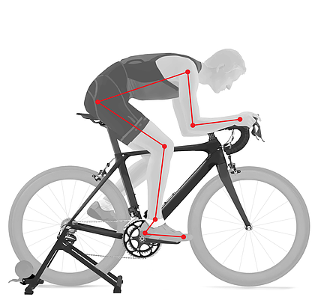
Problem Description
Every bike ridder should fit his bike to his measurements:
Improve performance.
Prevent long term injuries.
Optimize cycling experience by improving confidence and comfort.
Bike fitting is a complex task:
Professional bike fitting is very expensive and time consuming.
Self bike fitting could be inaccurate and lead to injuries.
Bike fitting occurs often because human’s body changes.

Slide 4
Suggested Solution
Use image processing to solve the task:
User will record a video of himself riding a bicycle and pass it to the software.
The software will find the coordinates and create a skeleton.
With the help of the coordinates, the software will calculate the angles.
The software will rank user’s bicycle configurations.
The software will notify the user with the results.
Record Video
Crate Skeleton
Calculate Angles
Rank Configurations
Notify User

Slide 5
Video Recording
Record Video
Crate Skeleton
Calculate Angles
Rank Configurations
Notify User
User will record a short video of himself riding a bicycle:
The length of the video should be around 5 seconds.
The type of the video should be AVI or MP4.
The shooting point of the video is from the right side.
The recommended height for shooting the video is about one meter from the floor.
Once uploaded, the software takes over and performs a full analysis of user’s position.
In addition to the video, the user will provide his height, height of the handlebar and the height of the chair.

Slide 6
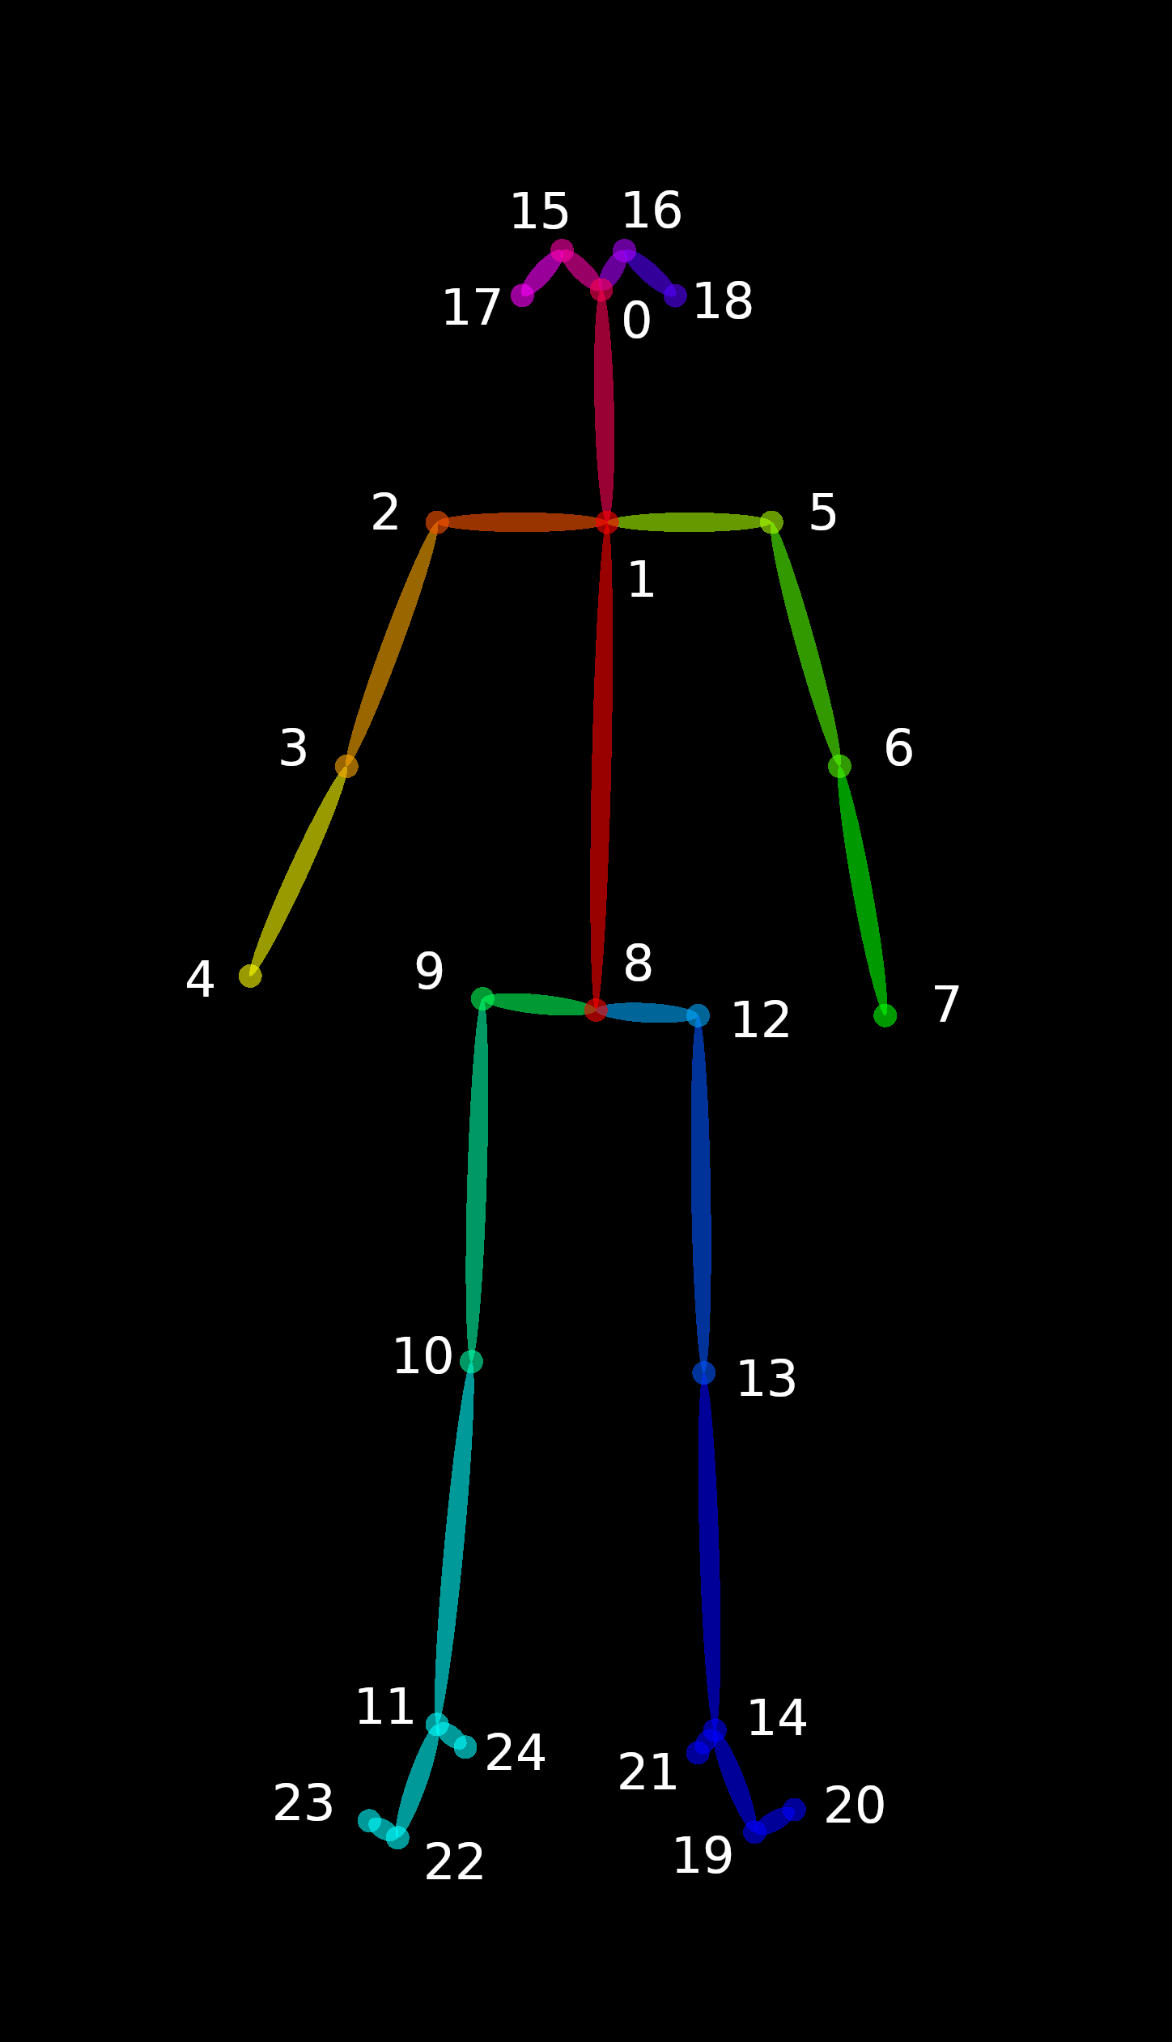
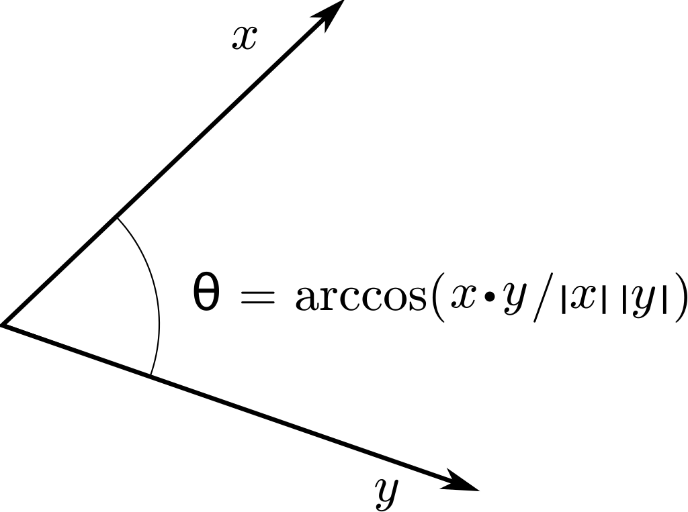
Skeleton Creation
Record Video
Crate Skeleton
Calculate Angles
Rank Configurations
Notify User
The software will find the coordinates and create a skeleton by parsing the video:
OpenPose was chosen to be used to parse each video.
The CLI allows to pass an MP4/AVI format video.
The CLI creates a directory of JSON files, one for each frame.
Each JSON file consist of a set of keypoints,
whose ordering is related with the UI output.
Once the software finishes creating the skeleton, it is now possible to parse the JSON files and calculate the angles.
Keypoints Illustration
Illustration of finding the angle
between vectors using the dot product

Slide 7
Ranking the Configurations – Collecting Data
Record Video
Crate Skeleton
Calculate Angles
Rank Configurations
Notify User
Shooting day at the Technion's gym:
We shot five participants (fitness trainer, two trainees and us).
Nine videos were shot for each participant.
Each time, the configurations of the handlebar and the chair were changed.
Each time, the participant rated the convenience of the configurations.
Additional ten videos of the fitness trainer were shot in order to be used as tests.
All of the videos were shot using Intel’s RealSense camera.

Slide 8
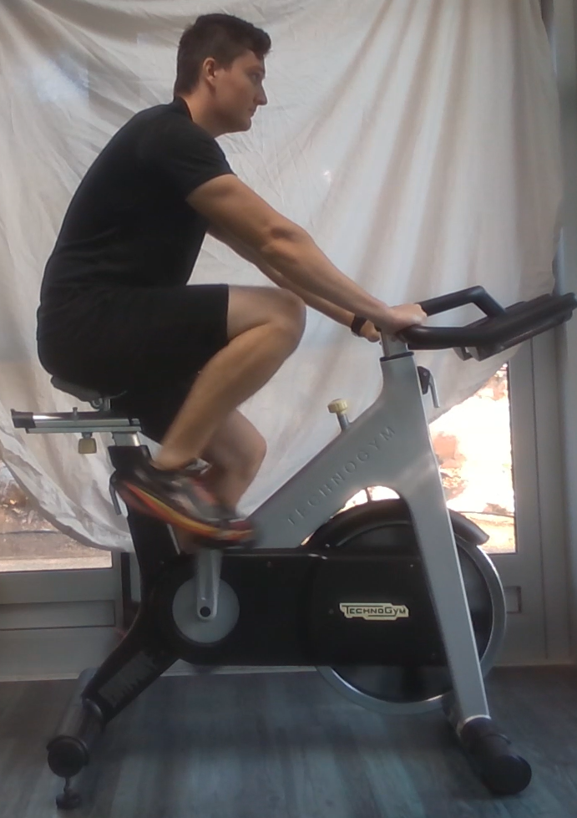
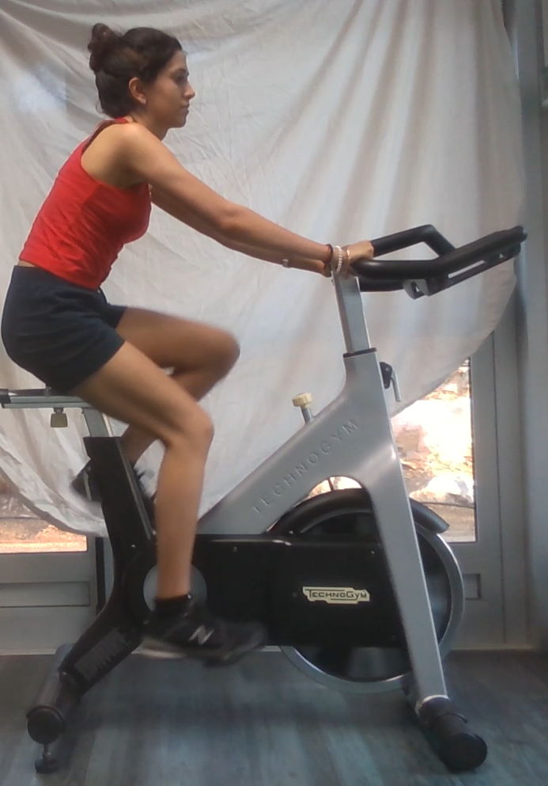
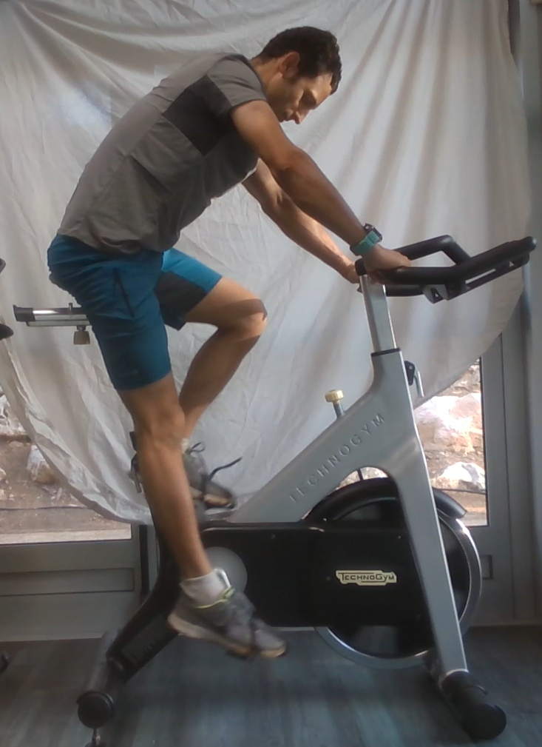
Ranking the Configurations – Collecting Data
Seat: 5, Handlebar: 12, Rank: 3
Seat: 2, Handlebar: 6, Rank: 1
Seat: 20, Handlebar: 12, Rank: 1

Slide 9
Ranking the Configurations – Using Prediction
Record Video
Crate Skeleton
Calculate Angles
Rank Configurations
Notify User
Using ML to rank the bike configurations:
Creating the table for the fit stage which consists of:
Features: participant's height, body coordinates and angles.
Labels: bike ranking.
The table was divided into train/test and passed to an ML algorithm.
Additional table was created for each test video:
The purpose of the video is to test the model.
The test is considered passed if the most common rank equals to the configured rank.
Score formula: $PredictionScore=\frac{\#passedTests}{\#tests}$
Various of ML algorithms were tested and for each one the score was calculated.
The K-Nearest Neighbors (KNN) algorithm was chosen.

Slide 10
User Notification
Record Video
Crate Skeleton
Calculate Angles
Rank Configurations
Notify User
The software will notify the user of the results.
The software consists of a frontend and backend:
The frontend is an Android application (Java + XML):
Users can create a new account and login into an existing one.
Users can upload a new video of themselves riding a bicycle.
Users can view the ranking of their bicycle configurations.
Dependencies: Firebase Authentication, DropBox Java SDK, Android Studio, Gradle.
The backend is a cron, written in Python:
Listens to changes in the drive and in case of new video, it will fetch it.
For every fetched video, it performs the analysis process, ranks the configurations and uploads the results back to the drive.
Dependencies: DropBox Python SDK, Sklearn, OpenPose.

Slide 11
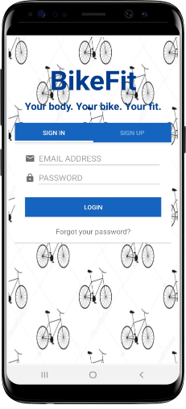
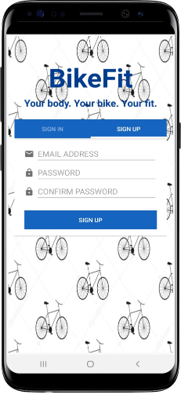
Application Overview
The opening layout of the application lets the user to create a new account by signing up or to enter into an already existing account by signing in.
Sign in into an already existing account
Create a new account using email and password

Slide 12
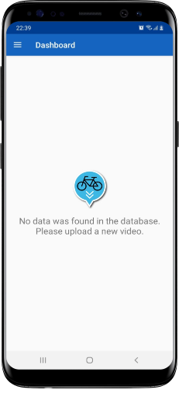
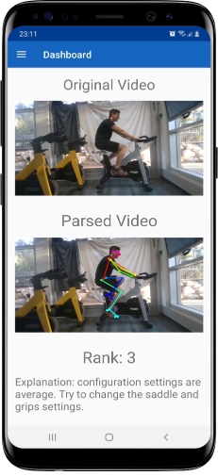
Application Overview
Once logged-in into the application, the user will be redirect to the dashboard, where he will see all his uploaded videos and their results.
Navigation menu
Layout without data
Layout with one uploaded video, showing the original video, the parsed video and the ranking results

Slide 13
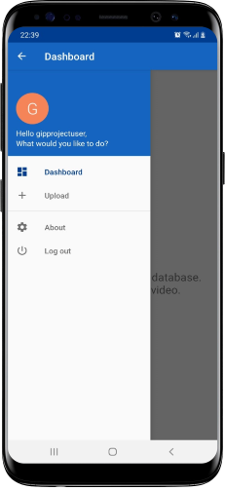
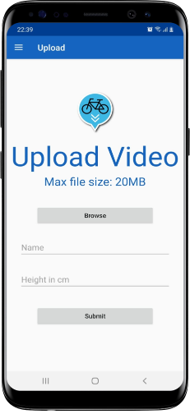
Application Overview
The user can use the navigation menu to move to the “Upload” layout, in order to upload a new video of himself riding a bicycle.
The navigation menu
The “upload” layout allows users to upload a new video

Slide 14
Future Work – Data Handling
Splitting the rank label:
Instead of using a single label in a dataset for a general rank, it is possible to set a label for each configuration.
For example, one label can be set for the configuration of the seat and another label for the configuration of the handlebar.
In this way, it is possible to explain more about what the user needs to do in order to improve his bicycle's configurations
Collecting more data:
Our training dataset consists of four different participants and the testing dataset consists of one participant.
Collecting more data will allow to train a better model and get better prediction results.
Use of actual bicycles and not spinning bicycles:
The data is consists of participates riding a spinning bicycle (from Technion's gym).
Since off-road bicycles are the most common, the dataset should be built upon it.
A dedicated component that holds the rider in place is needed for that.

Slide 15
Future Work – Application
Migrating from the drive to database:
We have used the DropBox drive as the storage for the videos and the user's information, such as his height.
Better user a dedicated database to keep the information and a cloud storage service (Amazon S3) for the videos.
Improving the UI:
Currently, the UI of the application is really basic and does not follow any predefined set of design principal.
An attempt should be made to make the application follow a set of design principal like of Google's Material Design.
Publishing the application:
Currently, the application is only available by direct download of the APK.
The application is not fully production-ready so it was not published to the Google Store.
In the future, it is possible to upload the application to the Google Store, once it's fully ready.

Slide 16
Conclusion
The project is a Proof of Concept (PoC):
The project demonstrates the bike fitting process on a simple spinning bicycle using Machine Learning algorithms.
The project is an initial infrastructure that can be expanded and used for follow-up projects.
The project granted us an opportunity to acquire new and different skills in the computer science:
Create an Android application and connect it to Firebase Authentication and external Storage Cloud.
Use different Image Processing utilities (such as OpenPose, MediaPipe, OpenCV).
Learn and use different Machine Learning algorithms.

Slide 17
QA

Slide 18
Backup

Slide 19
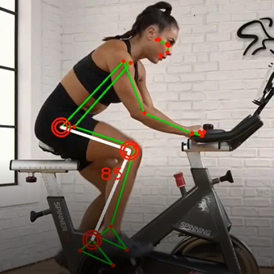
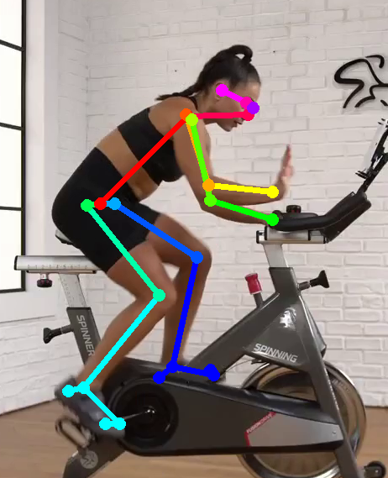
Comparison between tools
OpenCV + MediaPipe

Slide 21
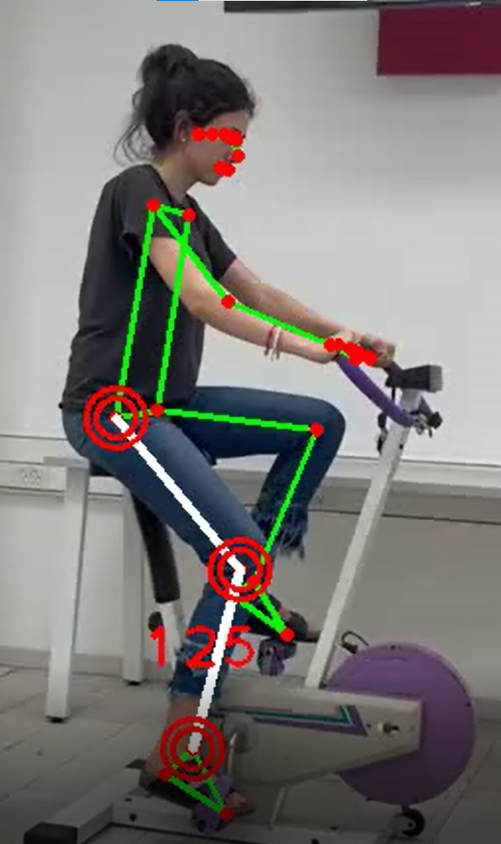
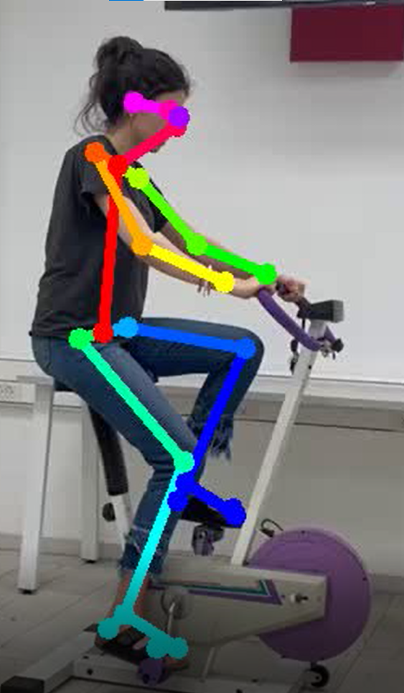
Comparison between tools – second test
OpenCV + MediaPipe
OpenPose

Slide 23
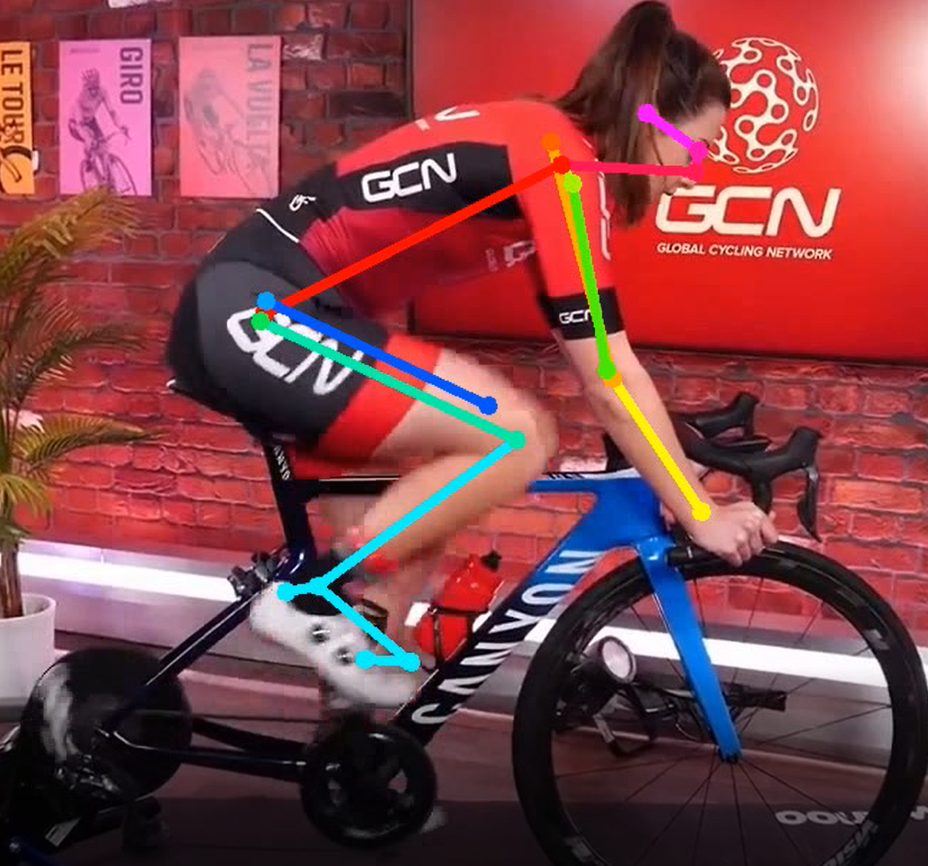
Comparison between tools – third test
OpenCV + MediaPipe
OpenPose

Slide 25
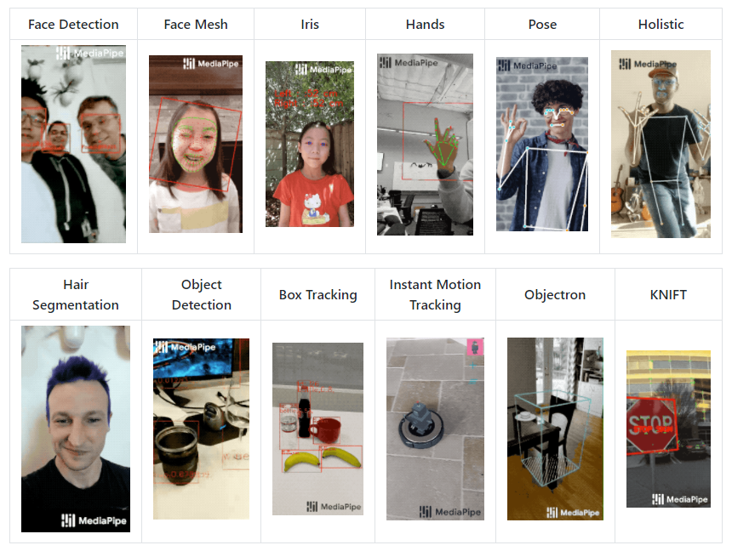
MediaPipe
MediaPipe offers cross-platform, customizable ML solutions for live and streaming media.
MediaPipe provides drivers in C++, Python, JS, etc.
Some of the MediaPipe’s features:
Pose detection.
Face detection.
Object detection.

