Slide 1
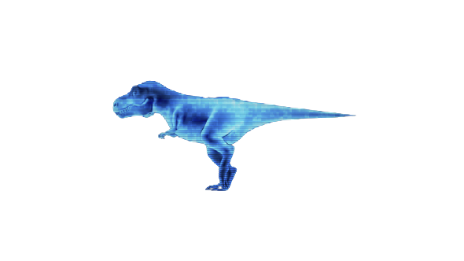
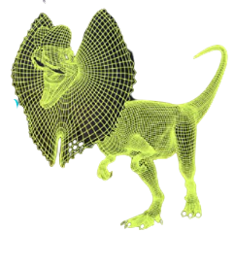
AR INTERACTIVE GAME
MOUSA ARRAF
PATRISIOUS HADDAD
&

Slide 2
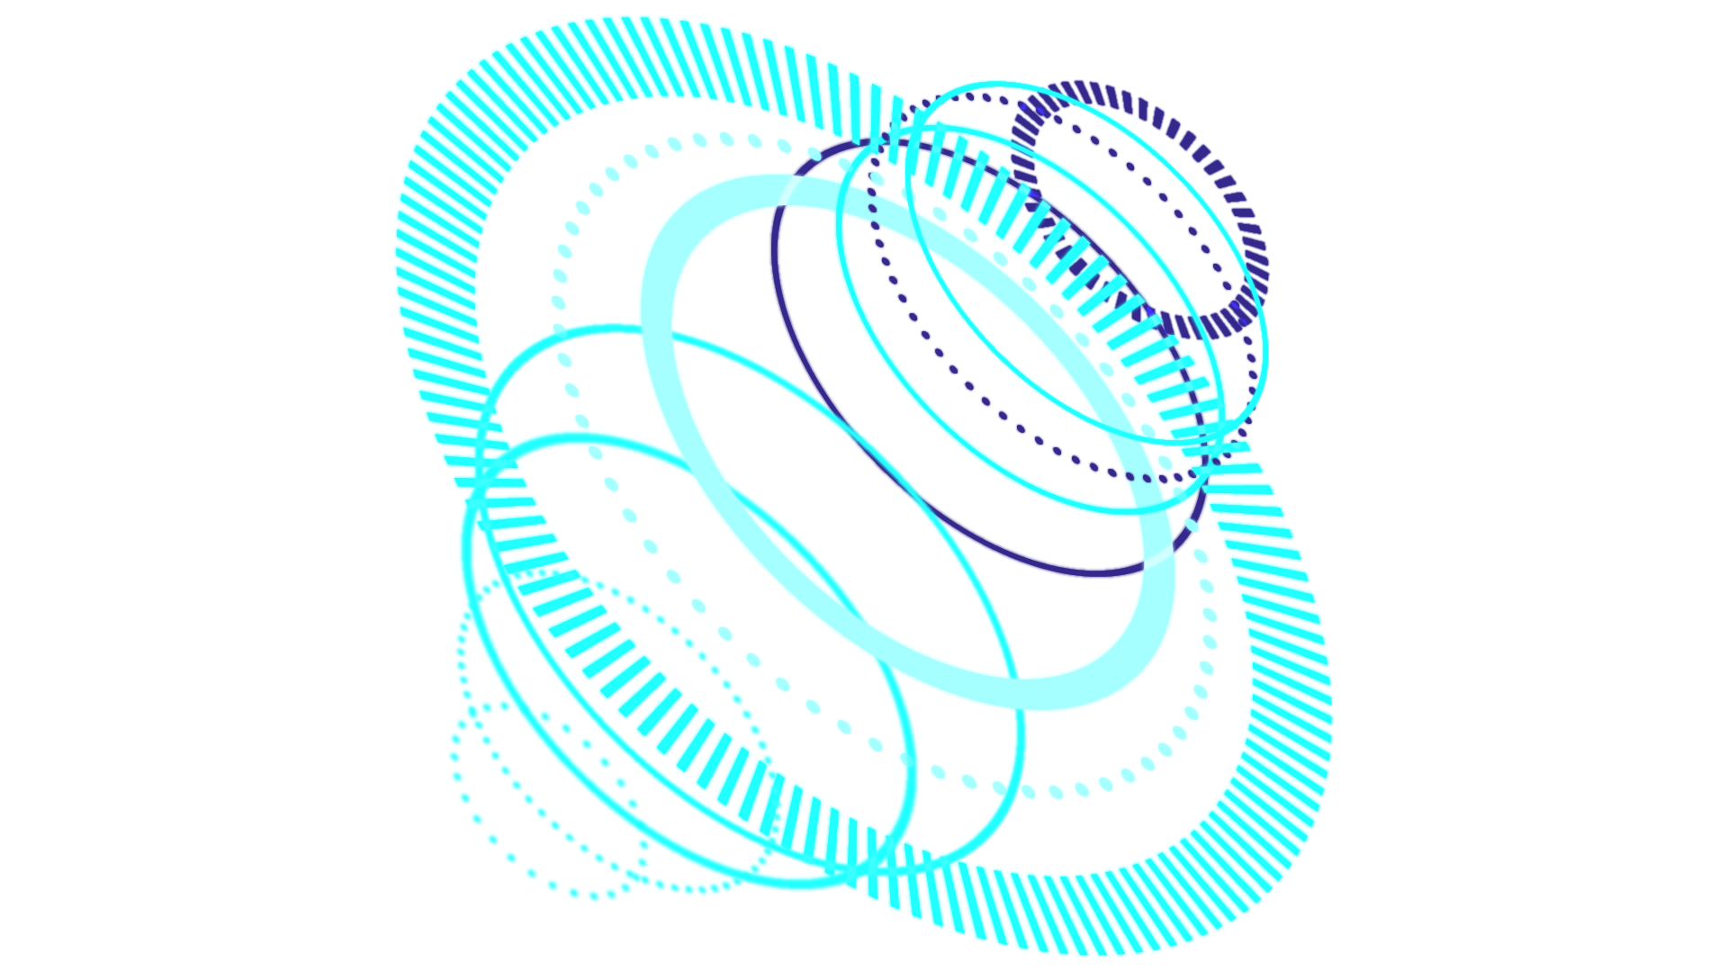
TABLE OF CONTENTS
SHORT DISCRIBTION OF MAIN IDEA
01
PROBLEMS & SOLUTIONS
02
FINAL OUTCOME
03
POINTS FOR FUTURE DEVELOPMENT
04
What do we wish to accomplish.
What and how we managed to overcome the different challenges we faced
A workign prototype of our initial expectation
How we can continue to further improve the game

Slide 3
INTRODUCTION
Using AR, we hoped to introduce a game which brings the game-field to your coffee-table. Because of the abundance of smart phones, today we are closer than ever to achieve said goal.

Slide 4
IDEA
A player can project the game-field onto a surface in front of them, so that their surroundings become part of the playing field. Through AR two player can connect over the network and project the same playing field, a playing field that they both can dynamically change by moving the objects physically in front of then and through AR the other player sees the change as well.

Slide 5
PROBLEM
So how do we recognize an object on the playing field ? And how do we place the arena smoothly ?

Slide 6
Wikitude SLAM
IMAGE TRACKER
SLAM uses physical-world feature points to map out the field and place AR objects on top of it, it also allows rotation of 360, something that can be perfect for showroom purposes, but in our case, we create a dynamically changing field which can conflict with the technology used in SLAM.
this method uses pre-defined targets and detects their existence, position, and orientation in the camera scene, we used a marker to set the location of the arena, the location of the arena is determined according to the middle-of-the-arena tracker, thus, by keeping the center of the arena marker in the frame, we will see the arena in the same place, hence achieving a smooth stable arena, that we can place on any surface we see suit.

Slide 7
PROBLEM
How do we keep the play-field synchronized ?

Slide 8
Our solution
Photon Unity Networking (PUN) is a unity multiplayer game package, it allows distant users to join each other in rooms where spawned objects can be synced over the network. By so, we synchronized the playing-fields, and every other in-game object.

Slide 9
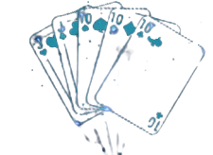
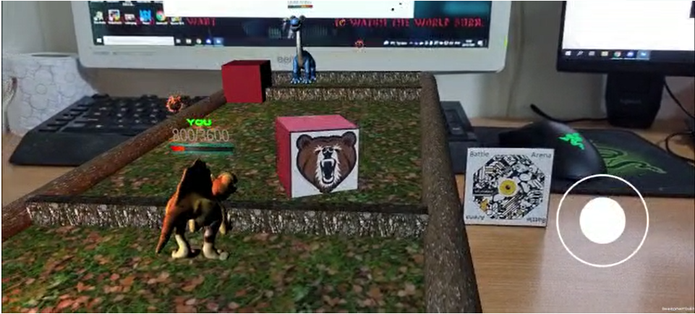
FINAL OUTCOME
CHAMPION
PLAYING CARD
The AR caharacter the player battles with
1. The arena-center card
2. The champions' card
3. The object’s card

Slide 10
POINTS FOR FUTURE DEVELOPMENT
sound effects for interactions
The game can benifit from sound effects and more lively animations
We could implement our own solution to solve the networking problem and not use a generic solution (PHOTON)
enhance server sync speed and accuracy
further enhances graphics and visual effects
To stay within the time-window, we used ready-made avatars and animations, we could create our own averts in the future.

Slide 11
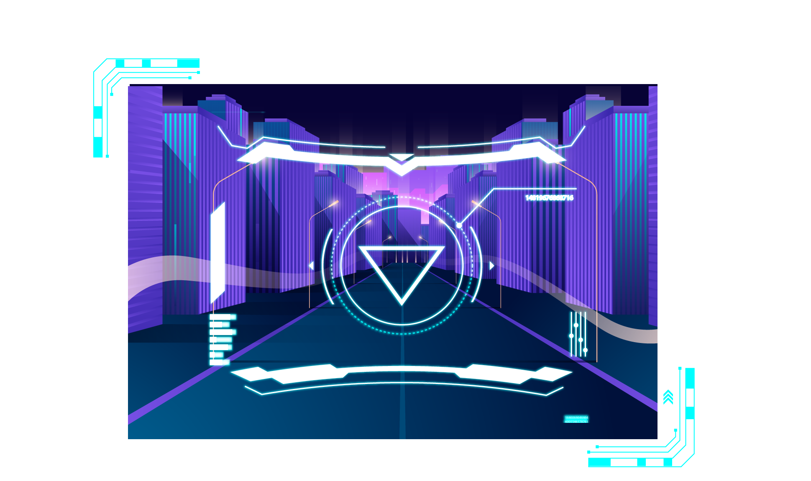
PRODUCT DEMO

Slide 12
THANKS
Does anyone have any questions?
PROJECT SITE
https://amosa22.wixsite.com/ar-project

