Slide 1
Cutout RL (reinforcement learning)
Presented by:
Yonatan Zarecki, Ziv Izhar

Slide 2
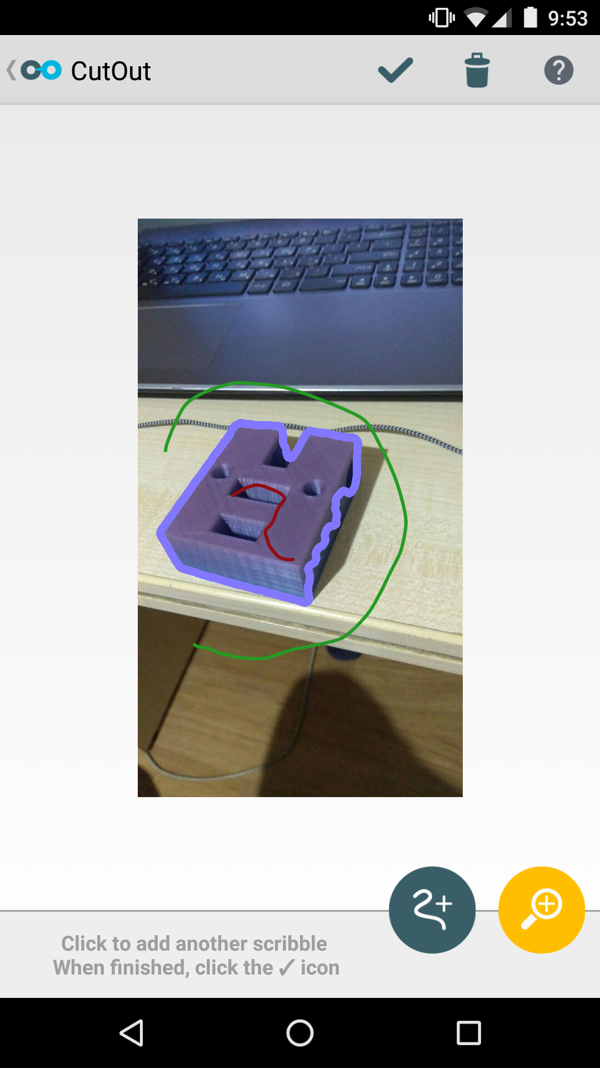
Project’s GOAL
We set out to build a new kind of task for neural network, the task of segmenting an image using CutOut.
Using reinforcement learning¹ algorithms we wanted to design a model that could use the CutOut algorithm to create lines that were interpretable to humans. Giving us some insight on how these networks operate.

Slide 3
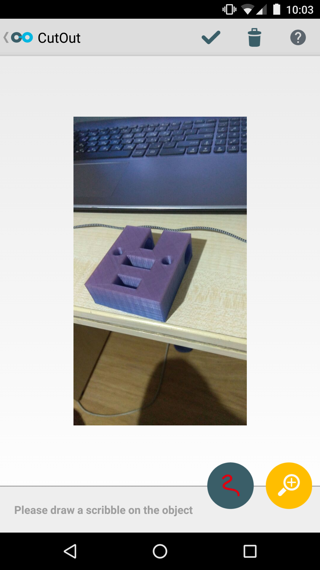
GAME DEFINITION
We start with 2 points.
A point on the object.
A point on the background.

Slide 4
GAME DEFINITION
The points can move in 16 directions.

Slide 5
GAME DEFINITION
The model chooses one step, and a point moves in the desired direction

Slide 6
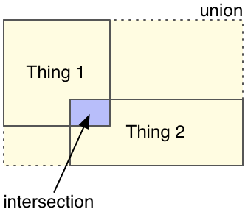
GAME DEFINITION
CutOut Segmentation
The reward at each step is the intersection-over-union of the resulting CutOut segmentation.
$$reward= \frac{area of intesection}{area of union}$$
Ground truth

Slide 7
GAME DEFINITION
And the game continues ..
Until we run out of steps

Slide 8
GAME DEFINITION - overview
The game start with 2 points, on the object and in the background.
At every step we choose from 16 directions to move out current points to.
We keep making steps in the image until we run out of steps. Then the game is finished.

Slide 9
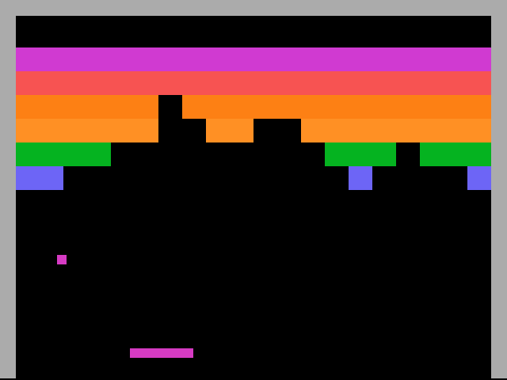
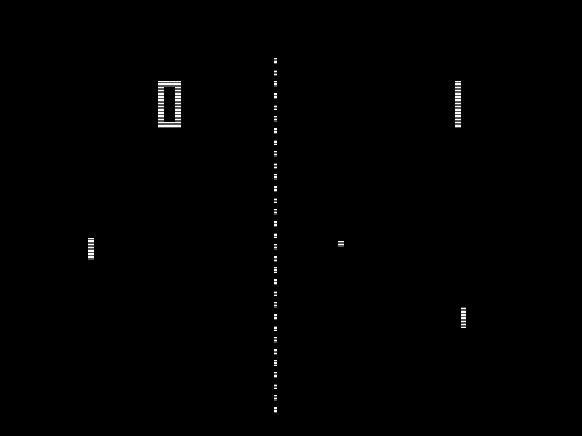
Proposed pipeline
We opted to use a reinforcement learning based model for our problem as it is very similar to games like PONG and Breakout.
RL models worked very well on these games while working on only the pixel data.
BREAKOUT
PONG

Slide 10
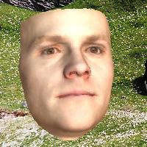
Proposed pipeline
Dir 1
Convolutional Neural Network
Dir 16
CNN
Notes:
First we enter the image to the CNN, and then from it’s features we decide the wanted direction, sounds simple right ?

Slide 11
Work throughout the Project

Slide 12
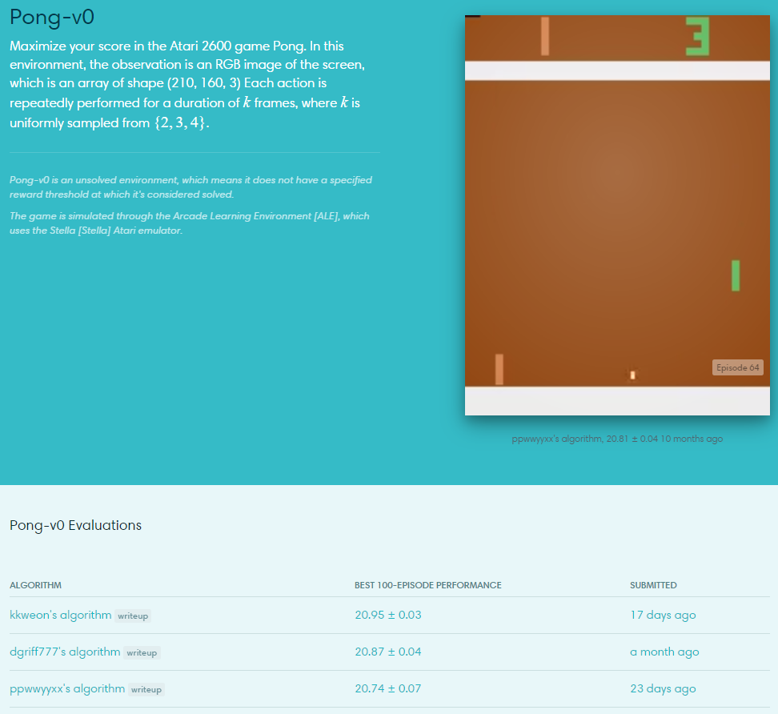
Looking for a baseline
First we went and looked for working implementation of RL algorithms for games similar to our which rely on CNNs and get their information from pixels.
We started from the PONG game, famously solved by NN-based RL models.
There is a list of implementation with the highest scores on OpenAI’s gym website.
However, none of them actually worked !
They top model won 33% of the time after 2 days of training.

Slide 13
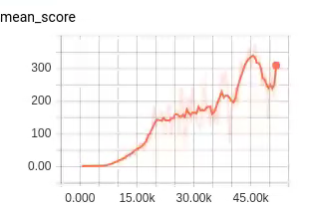
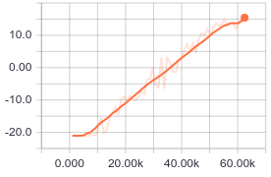
Looking for a baseline (2)
We continued searching for a working model to start with, and switched to looking for Breakout models.
At the end the last implementation¹ we tried from the top 10 in the gym’s website was the first one to actually work !
This implementation also worked on PONG which was promising, So we set out to understand the code and use it for our problem !
BREAKOUT Mean Score
BREAKOUT
Win-rate graph on PONG

Slide 14
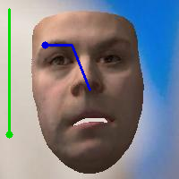
Implementing our Problem
We’ve started implementing our problem environment, using Elad CutOut algorithm in C++ we could:
Segment images based on lines
Feed the network with an updated version of the image with the new lines over it
We implemented a function for calculating the IoU
We started each “game” with a point on the object in (50, 50) and outside the object in (0, 0)

Slide 15
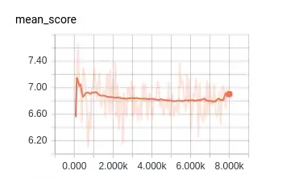
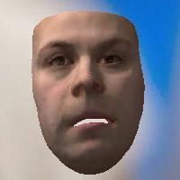
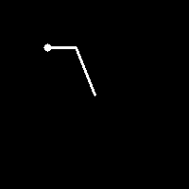
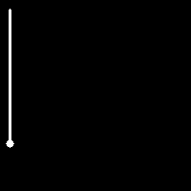
Training the model
After fixing some small errors, we started training.
We trained the model overnight and saw no progress ☹ (also after more hours of training we didn’t any progression)
After thinking over the results, we decided to try a different input to the network.
Instead of using only the image with scribbles we opted to use 3 layers, the original image, object line and background line.

Slide 16
Training the model - Step count
After visualizing the model’s work on several images we saw the amount of steps we used for the model (16 steps with length of 8 pixels) was insufficient for the model to create a meaningful scribble.
We’ve experimented with 16, 40, 60 and 100 steps and only 60,100 seemed sufficient.
After training with a larger step count we can see some small progress, but still not by a very significant amount.

Slide 17
Training the model - Reward at end
Seeing the model takes a very long time to train, but makes a relatively small amount of epochs in the process. We’ve measured the amounts of time spent in each part of the system and got some interesting results.
Most of the time is spent calculating the reward function, which involves calling CutOut at every step.
This resulted in in a very high CPU utilization (100% on all cores) and very low GPU utilization (2-3% at most).

Slide 18
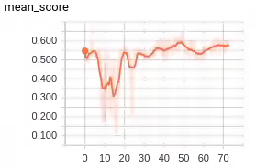
Training the model - Reward at end (2)
In order to increase the GPU utilization and make the model make more updates.
We decided to try a reward-at-end approach, where the reward is 0 at all steps until the very end where we run CutOut, similarly to games like chess. (We’ve also made the epochs much larger)
We also switched the graph to show only the end results IoU instead of the sum over all the steps.
The results were disappointing even tho the model made much more epochs and GPU utilization was high, the overall IoU reward was lower than before, and very low in general.
IoU
Hours
Reward-at-end
Notes:
We think this is before the model get less information this way

Slide 19
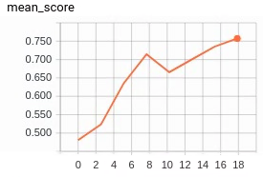
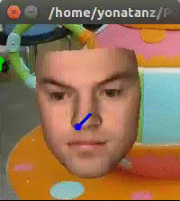
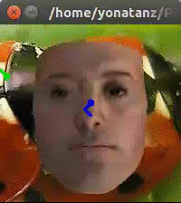
Training the model - Changing the learning rate
As it is commonly known, the learning-rate is one of the most important hyper-parameters for any NN model. So we decided it would be important to play with it a bit.
We thought maybe a larger LR would help the model converge faster (as it starts from completely random weights).
The IoU was much better than before, however the qualitative results not as much.
IoU
Hours
Larger LR

Slide 20
Training the model - Changing the learning rate (2)

Slide 21
Training the model – Enlarging the epoch size
We thought maybe the epoch size was too small, resulting in steps in the wrong direction.
In order to estimate the gradient better, we enlarged the epoch size by the multiple of 4, 8, 16 and run the training procedure.
In this case, the model ran so slowly it didn’t make many epochs at all, so we halted the experiments mid-way without seeing any significant improvements.

Slide 22
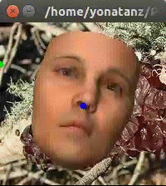
Training the model – Enlarge the step length
Echoing the problems state beforehand, CutOut takes most of our runtime. In another effort to reduce the time it takes to run, we wanted to keep the game short by enlarging the step length and reducing the number of steps.
This ideas has indeed shorten our runtimes without any loss in overall score.
Small step length
Large step length

Slide 23
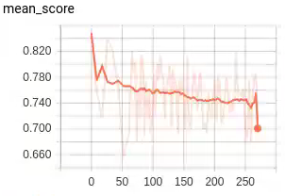
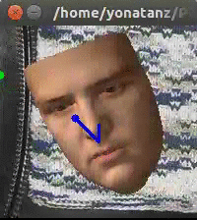
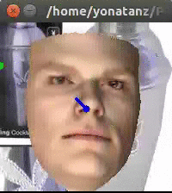
Training the model – Enlarge the step length (2)
But even running the model for an entire week didn’t seem to show an increase in performance over the established 0.8 score.
Qualitative results even show that some games are stuck in a loop.
IoU
Hours
Larger step length

Slide 24
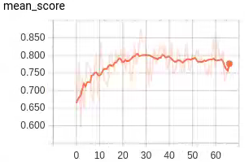
Training the model – ENLARGING THE INPUT IMAGE
The image’s size was reduced to 128x128, we decided to try and enlarge it to 256x256.
This has also didn’t change results significantly.
IoU
Hours
Larger input image

Slide 25
Training the model
Notes:
At this stage we stopped experimenting new ideas

Slide 26
Future goals
Taking over the world !
We talked bout this with Elad, and decided to end the project here ☹
We need to:
Write a final report going through all the experiments we’ve tried.
Submit the code to GIP, it may be useful for future teams working on reinforcement learning tasks (as a basic model to start with).

