Slide 1
ExpressionMime
Dor Granat, Ran yeheskel
ADvisor: matan sela

Slide 2
Pose Estimation
What we were trying to do was create an application which shows that
face pose estimation is a possible task to do in real-time,
together with facial expression estimation.

Slide 3
Pose Estimation
To demonstrate this possibility – we made an application that captures video
and, in real-time, estimates the poses of all faces in the frame and renders a
3D modeled face on top of them, such that its pose is aligned with the
original face’s pose.

Slide 4
Video Demonstration

Slide 5
How is it done?
Detection of all faces in the frame
For each face, we find facial landmark points in our video frame with a pre-trained learning model
We find the same landmark points in the 3D model
Using iterative optimization techniques, we find approximate rotation and translation matrices for the model
Then, projection of the model to the camera plane is done for each of the faces in the frame
Using Z-Buffering, each face is rendered according to its texture.

Slide 6
Expression Estimation
Another one of our goals was estimating the expressions of the faces and
mutate the 3D model so that it will render the same expression.
This task proved to be more difficult, as every face is actually a combination
of changes that need to be made. And finding the right weights – that will
create the correct mutation is hard.

Slide 7
Still, what can we do?
Because finding the correct weights vector is hard, we can stick to just one face at a time.
There are 84 different expressions we can make, by mutating the 3D model and rendering the new expression.

Slide 8
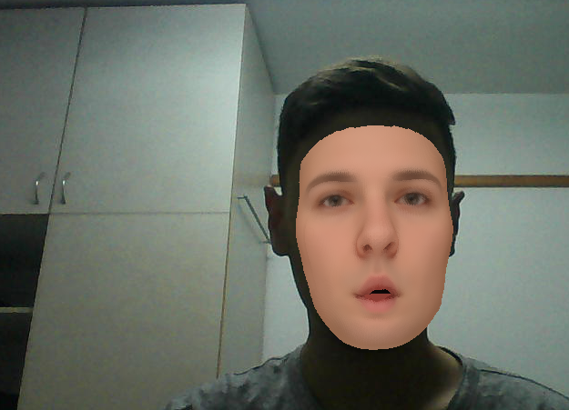
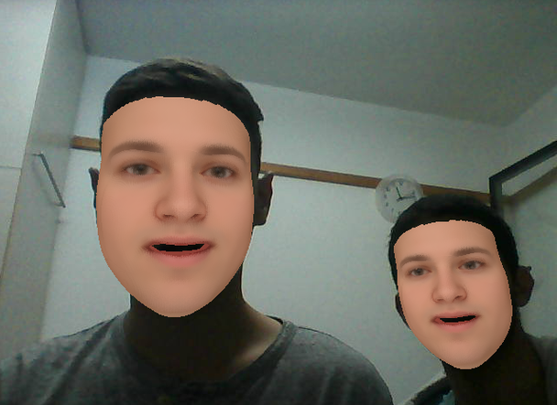
Photo Examples

Slide 9
Conclusions
The theoretical solutions for face detection and pose estimation hold up in real life with high quality practical solutions that have very good real-time performances.
It seems that expression estimation is also within reach of a practical real-time solution, but it requires a much more subtle treatment with very high level of theoretical understanding.

Slide 10
Questions?

