Slide 1
HoloLens Face Emotion Detection
By: Ilya Smirnov, Dani Ansheles, Denis Turov
Supervisor: Yaron Honen and Boaz Sternfeld

Slide 2
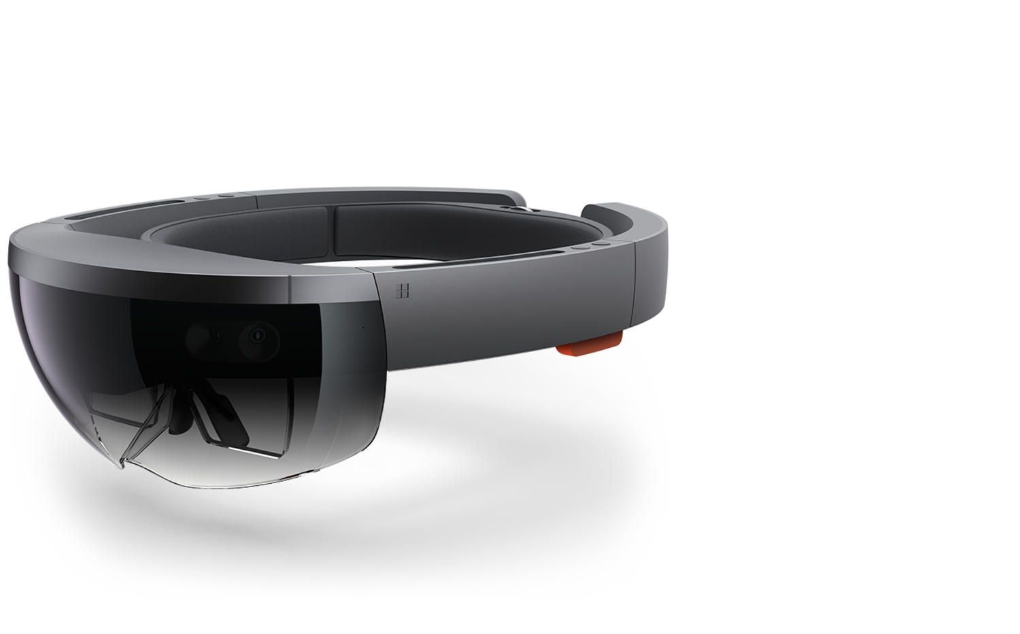
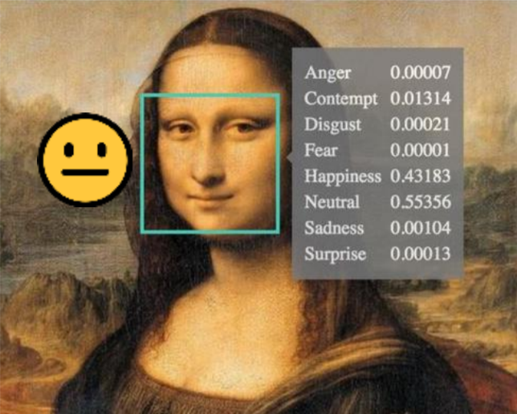
Project Description
The project will represent face emotion detection algorithm, that runs on Microsoft HoloLens device.
The purpose of the project is providing to User real-time detected emotion as attached smiley near visible faces
The project could be used to help people, with inability to identify and describe emotions by themselves (Alexithymia). As a result, people suffering from this disorder will be able to understand other people emotions by attached smiley.

Slide 3
Technologies and Services
HoloLens Windows Holographic
Unity 2017, C# scripts
Visual Studio 2017
OpenCV 2.2.8 for Unity
Azure Emotion Recognition Service

Slide 4
Goals and Objectives
Real-Time video stream processing
Azure Web API synchronization
Establish the emotion near real multiply faces
Diagnostic mode for future development
Voice commands for debug/release modes
Additional parts of the face as eyes, nose, mouth detection
Providing informative debug data

Slide 5
Main Flow Diagram

Slide 6
Azure json Response
"[{\"faceRectangle\":
{\"top\":257,\"left\":261,\"width\":154,\"height\":154},
\"faceAttributes\":
{\"emotion\":
{\"anger\":0.0,
\"contempt\":0.0,
\"disgust\":0.0,
\"fear\":0.0,
\"happiness\":0.0,
\"neutral\":0.889,
\"sadness\":0.0,
\"surprise\":0.111}}}]"

Slide 7
Encountered Problems
Different unstable libraries for FaceTracking and OpenCV migration
OpenCV for Unity
Azure Web API
Web API changes - Update usage according to new API description
API Usage once per 3 seconds
Design according to User Friendly usage
Voice commands

Slide 8
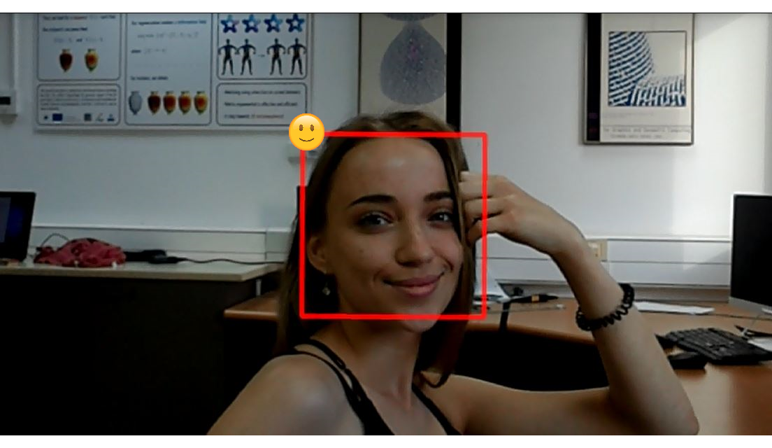
Results
Single Normal Mode

Slide 9
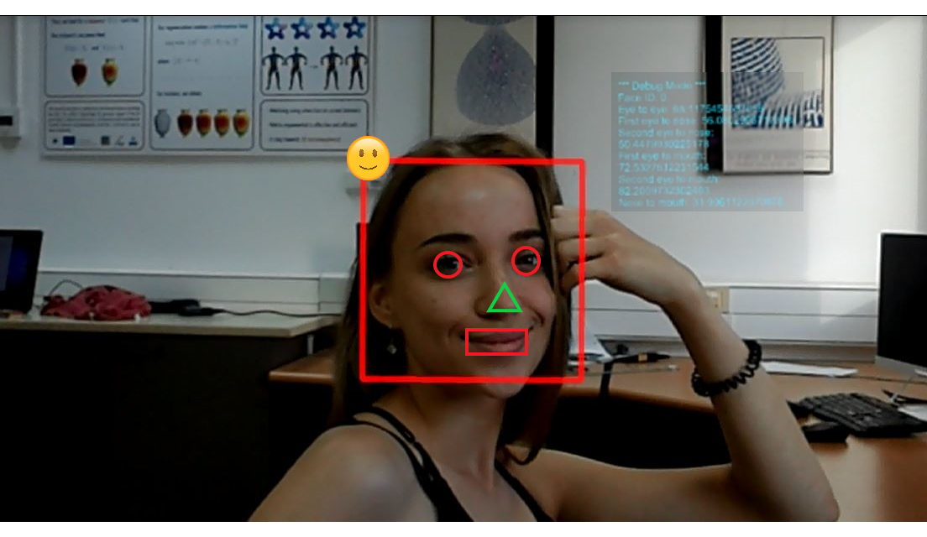
Results
Single Debug Mode

Slide 10
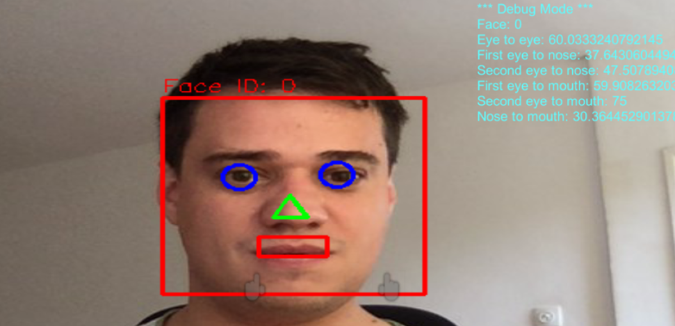
Results
Single Debug Mode from Unity

Slide 11
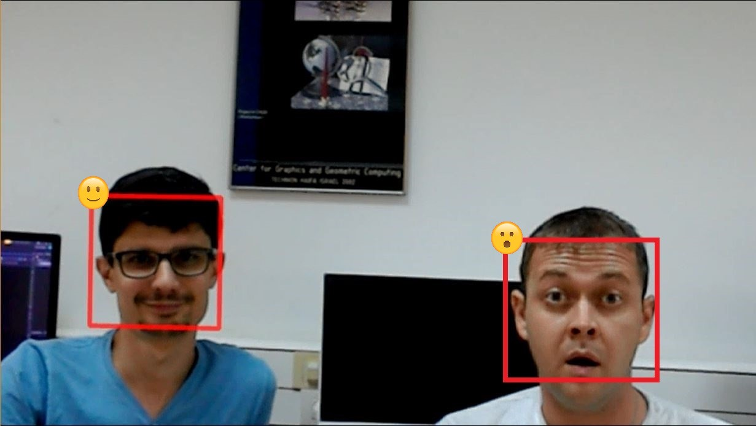
Results
Multiply Mode

Slide 12
Links
Project Web Site
Project Video

