Slide 1
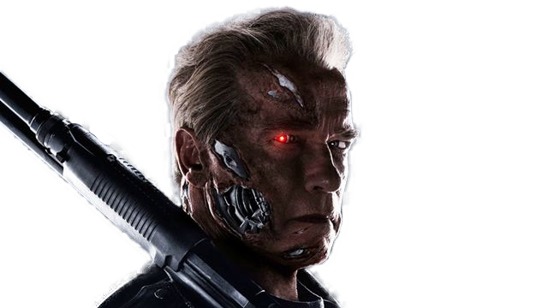
TermiNet: Learning a First Person Shooter Game Agent Using Deep Learning
Course 234329 – Spring 2016
Student: Itai Caspi
Supervisor: Aaron Wetzler

Slide 2
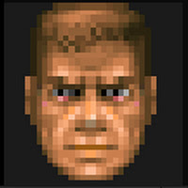
Overview
Project Description
Learning a First Person Shooter Game Agent Using Deep Reinforcement Learning on Raw Pixels
Goals
Design and implement a first person shooter game agent
Use an external image of the game as input
Use recent advancements in deep reinforcement learning
Frameworks
Unreal Engine 4 game engine with Torch (UETorch) Integration
Shooter game demo for UE4
Keras with ViZDoom

Slide 3
Overview
The project had two phases -
Learning a FPS player as a multi-agent entity
First implemented on UETorch
Later implemented on ViZDoom
Learning a FPS player as a skills learning problem
Implemented on ViZDoom only
GitHub repository - https://github.com/itaicaspi/keras-dqn-doom

Slide 4
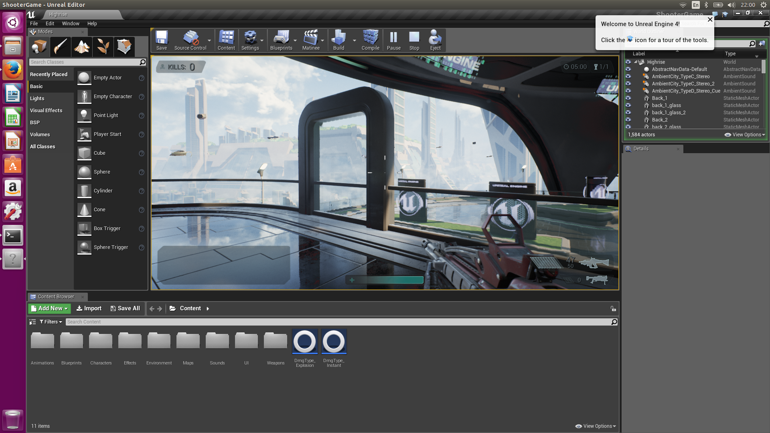

Slide 5
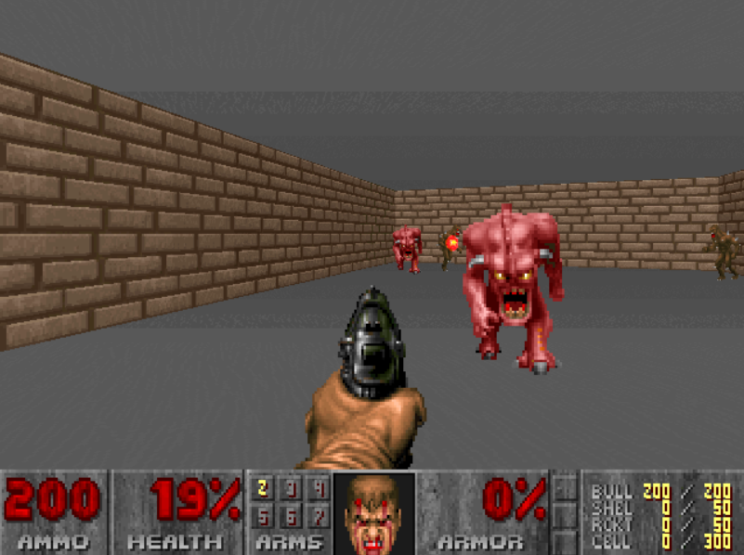

Slide 6
YouTube Video

Slide 7
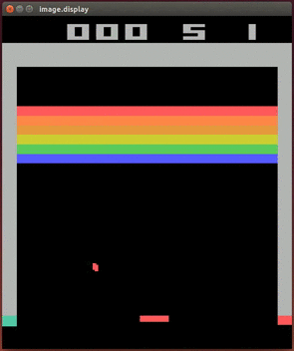
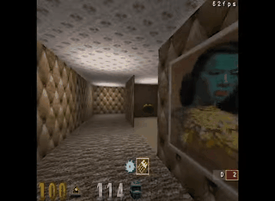
Previous Work
Playing Atari with Deep Reinforcement Learning
Asynchronous Methods for Deep Reinforcement Learning
Notes:
What’s different?
World is not very dynamic
Only simple 4 controls
World is very consistent

Slide 8
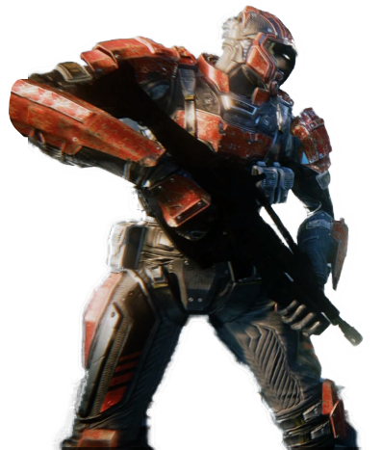
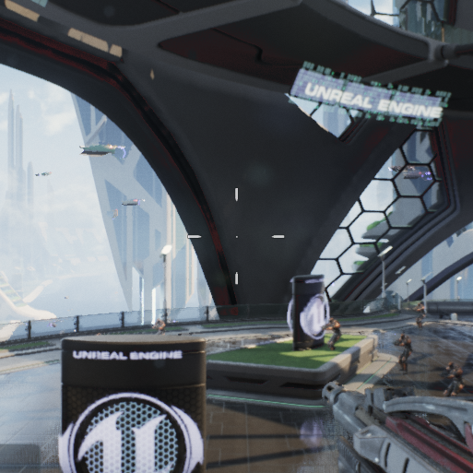
Background
Reinforcement Learning
State
Reward
Agent
Environment
Action

Slide 9
Background
MVP – Markov Decision Process
$$<𝒮,𝒜,𝒫,ℛ,γ>$$
$𝒮$ – a finite set of Markov states
$𝒜$ – a finite set of actions
$𝒫$ – a state transition probability matrix
$ℛ$ - a reward function
$γ$ – a discount factor $∈\left(0,1\right)$
Discounted Return - $G_{t}=R_{t+1}+γR_{t+2}+…=\sum_{k=0}^{∞}{γ^{k}R_{t+k+1}}$
$$a_{0}$$
$$R=1$$
$$1$$
$$S_{0}$$
$$S_{1}$$
$$R=0$$
$$0.7$$
$$R=1$$
$$R=1$$
$$a_{1}$$
$$a_{3}$$
$$0.3$$
$$a_{2}$$
$$0.8$$
$$1$$
$$S_{2}$$
$$0.2$$
$$a_{4}$$
$$R=−1$$
$$1$$
$$S_{3}$$
Notes:
Green = states
Orange = actions
R = rewards
Blue text = transition probability

Slide 10
Multi-agent System Architecture
Mouse Up
Mouse Down
Mouse Left
Mouse Right
Gaze Guiding
Robot Detection
Up
Down
Left
Right
Jump
Screen Image
Movement Control
Score Parsing
Gun Shooting
Shoot
Reload
Input - State
Feature & Reward
Extraction
Agents
Output - Actions

Slide 11
Feature & Reward Extraction
Mouse Up
Mouse Down
Mouse Left
Mouse Right
Gaze Guiding
Robot Detection
Up
Down
Left
Right
Jump
Screen Image
Movement Control
Score Parsing
Gun Shooting
Shoot
Reload
Input - State
Feature & Reward
Extraction
Agents
Output - Actions

Slide 12
Numerical Reward Parsing
Implemented a Google architecture for Street View house number parsing (https://arxiv.org/pdf/1312.6082.pdf)
Classifies up to 5 digits per number
4096
3072
Sequence Length
1st Digit Classification
48
64
128
160
192
192
192
192
2nd Digit Classification
3rd Digit Classification
Input Image
1x54x54
4th Digit Classification
5th Digit Classification
$$H$$
Feature Vector

Slide 13
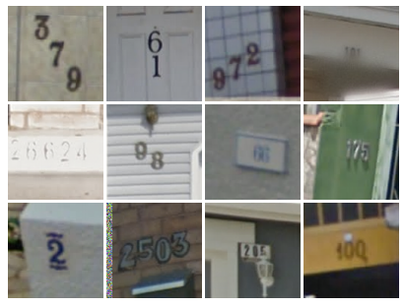
Numerical Reward Parsing
Trained on SVHN dataset
Over 600,000 training images after preprocessing
Achieved 95.4 % accuracy on test set (~50,000 SVHN images)
SVHN
Scores
Ammo
Notes:
Score and ammo patches are cropped to get only the number

Slide 14
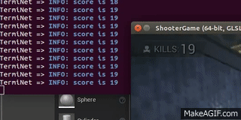
Numerical Reward Parsing - Demo
YouTube Video

Slide 15
Robot Detection
Used transfer learning with GoogLeNet v2 pretrained network as a base to fine tune for robots

Slide 16
Robot Detection
Take only 10 first layers of GoogLeNet with fixed weights
Add a fully convolutional trainable head that classifies the image into 2 classes – robot or background
Use dropout to reduce overfitting

Slide 17
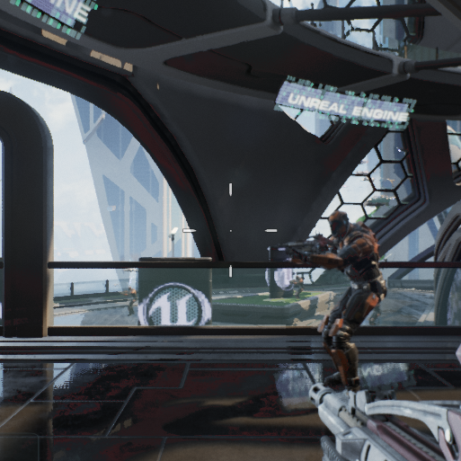
Robot Detection
Train with 3x128x128 images – 100 robot and 100 background images
Run with an image with size $≥$ 128x128 to get a heat map
Very efficient - 0.12 sec per 512x512 image
Input Image
Heat map
Size = 3x512x512
Black = robot
White = background
Notes:
Heat map size is 13x13 and is rescaled for visualization

Slide 18
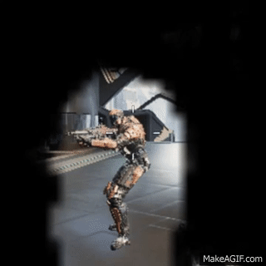
Robot Detection - Demo
YouTube Video

Slide 19
Agents
Mouse Up
Mouse Down
Mouse Left
Mouse Right
Gaze Guiding
Robot Detection
Up
Down
Left
Right
Jump
Screen Image
Movement Control
Score Parsing
Gun Shooting
Shoot
Reload
Input - State
Feature & Reward
Extraction
Agents
Output - Actions

Slide 20
Agents Training Process
Train Gaze Guiding
Control Gaze
Control Gaze
Train Gun Firing
Control Gun
Train Movement Control

Slide 21
Reinforcement Learning
Policy
A distribution over actions given states
$$π\left(a | s\right)=ℙ\left[A_{t}=a | S_{t}=s\right] A_{t}\sim π\left(∙ | S_{t}\right)$$
State-Value Function
The expected return for following policy $π$ from state $s$
$$v_{π}\left(s\right)=𝔼_{π}[G_{t}|S_{t}=s]$$
Action-Value function
The expected return for selecting action $a$ in state $s$ and following policy $π$
$$q_{π}\left(s,a\right)=𝔼_{π}\left[G_{t} | S_{t}=s, A_{t}=a\right]$$

Slide 22
Reinforcement Learning
Bellman Equation
$$q_{π}\left(s,a\right)=𝔼_{π}\left[G_{t} | S_{t}=s, A_{t}=a\right]=𝔼_{π}\left[R_{t+1}+γR_{t+2}+… | S_{t}=s, A_{t}=a\right]=𝔼_{π}\left[R_{t+1}+γq_{π}(S_{t+1},A_{t+1}) | S_{t}=s, A_{t}=a\right]$$
Q-Learning Control Algorithm (SARSAMAX)
Off-Policy Learning – learn from observing other agents
Select action using behavior policy - $A_{t}\sim μ(.|S_{t})$ ($ε$-greedy)
Consider alternative action $A_{t}^{′}\sim π\left(. | S_{t}\right)$ (greedy)
$$Q\left(S_{t},A_{t}\right)←Q\left(S_{t},A_{t}\right)+α\left(\underset{from μ}{\underbrace{R_{t+1}}}+\underset{from π}{\underbrace{γ\max_{a^{′}}{Q\left(S_{t+1},a^{′}\right)}}}−Q\left(S_{t},A_{t}\right)\right)$$
$$S,A$$
$$R$$
$$S′$$
$$A′$$
MSE loss derivative
Notes:
R(t+1) is the reward we actually got when we followed mu
Q(S(t+1),a’) is the value of the next state if we followed A’
Initialize Q(s,a) for each s and a
Repeat for each episode:
Initialize S
Repeat for each step in episode:
Choose A from S using policy derived from Q (epsilon greedy)
Take action A, observe R, S’
update Q(S,A)
S<-S’
Until S is terminal

Slide 23
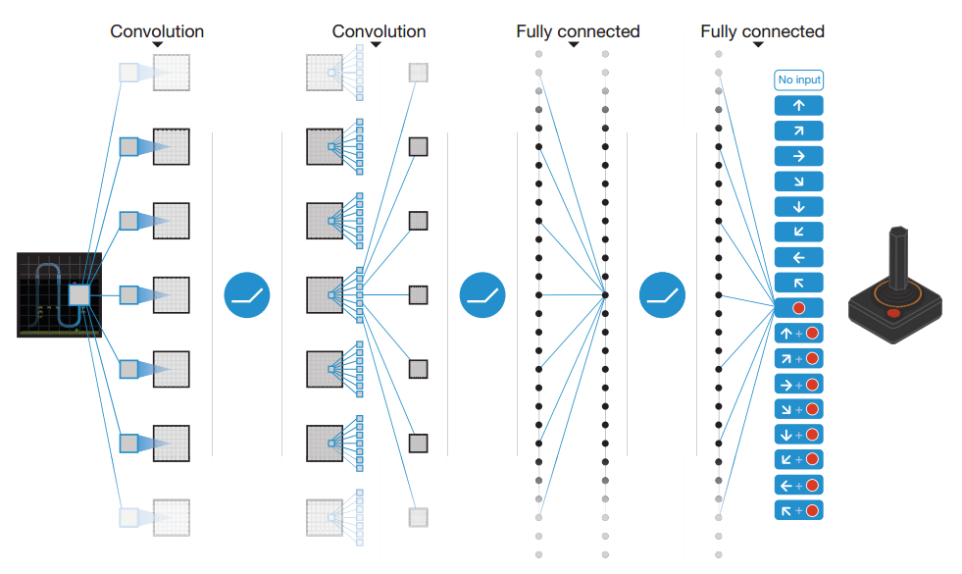
DQN – Deep Q-Network
Uses a CNN network to estimate $Q(s,a)$
Uses experience replay $𝒟$ –
Store transitions $\left(s_{t},a_{t},r_{t+1},s_{t+1}\right)$ in $𝒟$
Sample random mini-batches for training
Reduces variance in the SGD updates
Input - stack of pixels from last N frames
Output - $Q(s,a)$ for each possible action
Used by Google DeepMind to play Atari 2600 games

Slide 24
Gaze Guiding
Use DQN learning to guide the players view
Data -
Input – stack of 13x13 robot heat maps from last 4 frames
Output – $Q(s,a)$ over 5 mouse controls – Up, Down, Left, Right, None
Reward – a positive robot classification of a small patch from the screen center
Game rules –
Player is static
Robots are moving but can’t shoot
Game has infinite time
Player is respawned in different locations

Slide 25
Gun Firing
Use DQN to control the gun
Data –
Input – patch from screen center and the current ammo parsed using the score parsing network
Output – $Q(s,a)$ over 3 controls – Shoot, Reload & None
Reward - number of kills - ammo lost
Game rules - shooting range
Player is static
Robots are moving but can’t shoot
The trained gaze guiding network is working in parallel to aim the gun

Slide 26
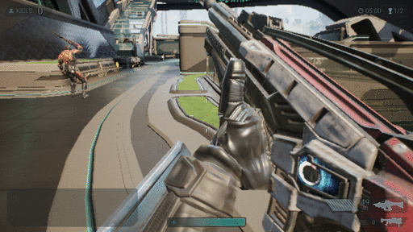
Gun Firing

Slide 27
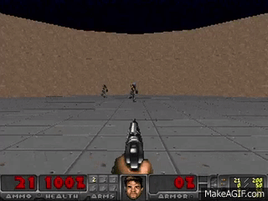
Gun Firing

Slide 28
Movement Control
Use DQN for controlling the player movement
Data -
Input – Entire screen image
Output – $Q(s,a)$ over 6 controls – Up, Down, Left, Right, Jump, None
Reward – number of kills + ammo gain – time passed ( + health change)
Game rules –
Player is dynamic
Robots are static / moving
Trained gaze guiding and gun control are working in parallel

Slide 29
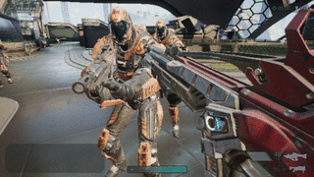
Movement Control

Slide 30
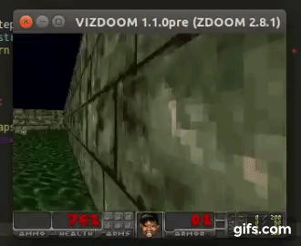
Movement Control

Slide 31
Improvements Over Standard DQN
DDQN (https://arxiv.org/pdf/1509.06461v3.pdf) –
Standard DQN regularly overestimates the Q values
DDQN reduces overestimation and therefore achieves better, and more stable results
Done by simply decomposing the action selection and action value estimation to two separate operations
$$y_{t}=r_{t+1}+γQ\left(s_{t+1},argmax_{a}Q\left(s_{t+1},a;θ_{t}\right);θ_{t}^{−}\right)$$

Slide 32
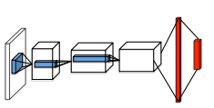
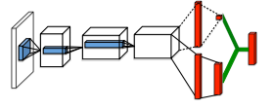
Improvements Over Standard DQN
Dueling Network (https://arxiv.org/pdf/1511.06581.pdf) –
Better estimation of action values can be done by decomposing the Q action value function into – state value estimation and action advantage estimation
$$Q\left(s_{t},a_{t}\right)=V\left(s_{t}\right)+A\left(s_{t},a_{t}\right)$$
The neural network head is separated into two heads – one estimates $V$ and the other estimates $A$

Slide 33
Improvements Over Standard DQN
Prioritized Experience Replay (https://arxiv.org/pdf/1511.05952.pdf)-
A simple technique for prioritizing the transitions sampled from the experience replay mechanism for training
The algorithm selects transitions with high expected learning progress more frequently
The value of a transition is determined by its TD error
$$TD error=R_{t+1}+γ\max_{a^{′}}{Q\left(S_{t+1},a^{′}\right)}−Q\left(S_{t},A_{t}\right)$$

Slide 34
Playing by Learning Skills
Motivation -
Instead of defining the sub-agents manually, we let the agent learn them by itself
The agent should learn to decompose the game into –
Shooting
Looking for enemies
Navigating the maze

Slide 35
Learning Skills by Modelling Action Sequences
Instead of predicting the next action from each state, predict the next several actions
Implicitly requires the agent to learn action sequences structure
Models the process as a Semi-Markov Decision Process where transitions are grouped to form skills
Experience Replay stores full episodes instead of single transitions, allowing training using n-step Q updates for faster convergence

Slide 36
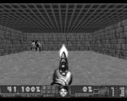
Playing by Learning Skills
$$a_{t}$$
$$a_{t+1}$$
$$a_{t+2}$$
$$Q(s_{t},a_{t})$$
LSTM
$$s_{t}$$
Action embedding
Convolutional neural network encoding
LSTM cells
Dueling network Q value estimation
start token

Slide 37
Conclusions
Unreal Engine is a very memory and compute demanding framework and therefore is very hard for agent training
ViZDoom with Keras allowed very fast progress and experimentation
The multi-agent entities approach has good potential and was also recently implemented on ViZDoom with promising results –
https://arxiv.org/pdf/1609.05521v1.pdf
Action sequence predicition did not turn out to be better than single-agent standard DQN

Slide 38
Future Work
Skill learning is an open problem which gets a lot of focus recently
Recent advancements in sequence learning should allow better results on skill learning using techniques such as:
Dilated convolutions –
https://deepmind.com/blog/wavenet-generative-model-raw-audio/
HM-RNN’s –
https://arxiv.org/pdf/1609.01704.pdf
Multi-agent entities should be tested on more environments such as SNES (https://openreview.net/pdf?id=HysBZSqlx)

Slide 39
Bibliography
Vizdoom: A doom-based AI research platform for visual reinforcement learning (http://arxiv.org/abs/1605.02097)
Hierarchical deep reinforcement learning: Integrating temporal abstraction and intrinsic motivation (http://arxiv.org/abs/1604.06057)
Deep successor reinforcement learning (http://arxiv.org/abs/1606.02396)
Playing FPS games with deep reinforcement learning (http://arxiv.org/abs/1609.05521)
Learning physical intuition of block towers by example(http://arxiv.org/abs/1603.01312)
Automatic discovery of subgoals in reinforcement learning using diverse density
Playing atari with deep reinforcement learning (http://arxiv.org/abs/1312.5602)

Slide 40
Bibliography
Asynchronous methods for deep reinforcement learning (http://arxiv.org/abs/1602.01783)
Between mdps and semi-mdps: A framework for temporal abstraction in reinforcement learning
A deep hierarchical approach to lifelong learning in minecraft (http://arxiv.org/abs/1604.07255)
Deep reinforcement learning with double q-learning (http://arxiv.org/abs/1509.06461)
Strategic attentive writer for learning macro-actions (http://arxiv.org/abs/1606.04695)
Show and tell: A neural image caption generator (http://arxiv.org/abs/1411.4555)
Dueling network architectures for deep reinforcement learning (http://jmlr.org/proceedings/papers/v48/wangf16.html)

Slide 41
Thank You

Slide 42
Backup

Slide 43
Required HW
Minimum system requirements:
Ubuntu 15.04
GPU with CUDA & DirectX 11 support
Quad-Core Intel or AMD processor
At least 8 GB RAM
External camera & stereo microphone
Servos for keyboard and mouse control - Optional

Slide 44
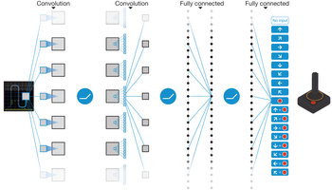
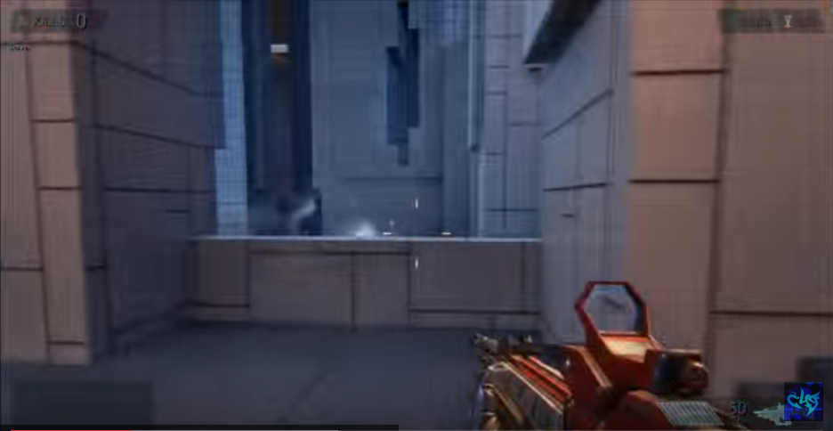
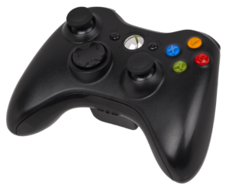
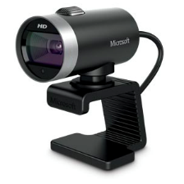
Basic Design
Movement Control
Score Parsing
Gun Control
Robot Parsing
Gaze Guiding

Slide 45
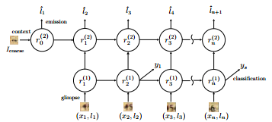
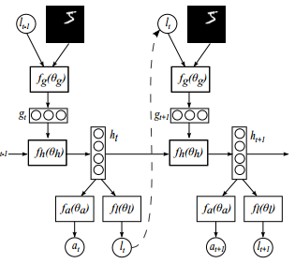
Basic Design
Score Parsing
Asynchronous Deep Reinforcement Learning
Attention Model

Slide 46
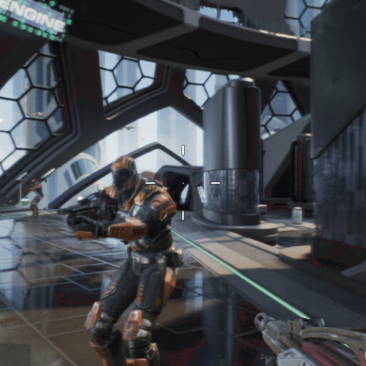
Robot Detection
Train with 3x256x256 images – 100 robot and 100 background images
Run with an any image with size $≥$ 256x256 to get a heat map
Very efficient - 0.12 sec per 512x512 image
Input Image
Heat map
Size = 3x512x512
Black = robot
White = background

Slide 47
Project Schedule
משימה | תאור | שבוע
1 | הרמת סביבת עבודה ולמידת האלגוריתמים והמחקר שבוצע עד כה | 3
2 | תכנון ומימוש מבנה רשת לזיהוי טקסט עבור חילוץ ה-rewards | 4
3 | תכנון ומימוש מבנה רשת שמשתמשת במודל Attention למיקוד הפוקוס של רשת ה-Deep Reinforcement Learning | 5
4 | תכנון ומימוש מבנה רשת ה-Deep Reinforcement Learning | 6-7
5 | אימון וניסויים בסביבת סימולציה (קלט מתוך צילומי מסך) | 8-9
6 | מעבר לעבודה עם מצלמה חיצונית (אולי גם שליטה חיצונית במקשים?) | 10
7 | הוספת שיפורים אפשריים שיתגלו מתוך תוצאות הניסויים (הוספת שמע?) | 11-12
8 | כתיבת מאמר / מצגת ושיפורים אחרונים | 13-14
Mid project goal (week 8): Working environment and model, ready for training and testing

Slide 49
System Architecture
Mouse Up
Mouse Down
Mouse Left
Mouse Right
Gaze Guiding
Robot Detection
Up
Down
Left
Right
Jump
Screen Image
Movement Control
Player Agent
Score Parsing
Gun Shooting
Shoot
Reload
Input - State
Feature & Reward
Extraction
Agents
Output - Actions

